Slide 1
Applications of Congruence Transformations in tessellations with Technology-Enhanced RESOURCEs
Ana Donevska-Todorova
Humboldt-Universität zu Berlin

Slide 2
Overview
Relevance of the theme and aim of the study
Theoretical background and research stand
Research questions and research method
Design of a micro-world in a DGS for applications of congruence mappings in tessellations
Results and discussion
Conclusions and suggestions for further research

Slide 3
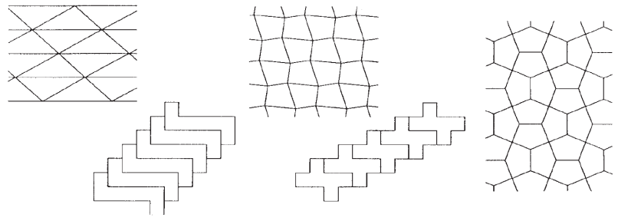
1. Relevance of the Theme in Mathematics Education
Preschool:
  laying and puzzle games without a particular attention to learning of congruence mappings; absence of a precise mathematical language and terminology
Elementary school:
  mathematical patterning refers to chances and challenges of interdisciplinary and creative teaching and learning approaches in mathematics and arts in elementary schools (e.g., Hartfeldt & Henning, 2002).
Secondary school:
  Understanding and applying theorems for congruence of geometric figures, theorems for the sum of inner angles of polygons (referring Curricula)

Slide 4
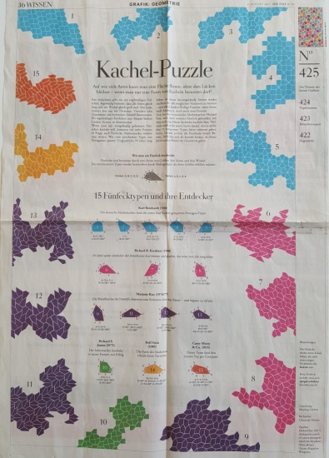
2. Theoretical background
Mathematical content
A tessellation of a plane - covering the plane without gaps and overlaps, is possible with any types of triangles and quadrilaterals.
  This includes the regular 3- and 4-sided polygons.
A tessellation of a plane is also possible with regular hexagons, but not with regular pentagons.
  There exist special pentagons, which are an exception (Figure)
  Tessellation by regular n-gons, for n>6 is not possible.

Slide 5
2. Theoretical background and research stand
    Previous Research
      The 17th ICMI Study, Mathematical Education and Technology-Rethinking the Terrain:
        design of teaching and learning technology-based environments, curricula evolution and current research trends in developing theories.
    Future perspectives
      “There is a wide technological space that is nearly terra incognita.” (Artigue, 2010, p. 469)
        “From microworlds and open software to tutorials and on-line resources” (Artigue, 2010, p. 468)
        “ The role of emerging technologies, e.g. tablets, smartphones, virtual learning environments, augmented reality environments and haptic technologies ” (ICME-13, TSG 43 Call)
    Current Research State
      Cognitive and epistemological perspectives of technological utilization in mathematics education remain insufficiently discussed (ICME-13, TSG 43 Call).
        This study investigates the mathematical cognition in terms of kinds of mathematical thinking which characterize Geometry

Slide 6
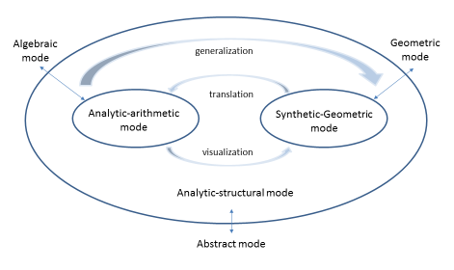
2. Theoretical background and research stand
Three modes of thinking and description of mathematical concepts in Linear algebra (Sierpinska, 2010; Hillel, 2010)
A nested model for connecting the modes in Geometry (Donevska-Todorova, 2018, p. 270; Donevska-Todorova & Turgut, 2017)
Konyalioglu et al., 2011, p. 4042
Donevska-Todorova, 2018, p. 270

Slide 7
2. Theoretical background and research stand
Recursive Exploration Space (Hegedus, Dalton & Moreno-Armella, 2007)
  connections between the geometric and the algebraic modes by the dragging or the zoom tools
Action-reaction loops by dragging modalities (Arzarello et al. 2002)
  As the frequency of these action-reaction loops is increasing, the time-intervals between the loops are decreasing.
”The cognitive distance between the students and the problem diminishes” (Hegedus, Dalton & Moreno-Armella, 2007, p. 1422).
RES has continuous dynamic (as much as it is allowed by the software), in comparison to static inert, static kinesthetic/aesthetic or static computational features (Moreno-Armella, Hegedus & Kaput, 2008).
The RES is more than an infrastructure for embodied actions, more than a technical mediator. It is rather a collaborator in co-actions which allow self-control of the user.
Frozen/ fluid medium (Donevska-Todorova, 2018)

Slide 8
3. Research questions and research method
How could a DGS-based teaching environment facilitate the learning of applications of congruence mappings in tessellations with quadrilaterals and triangles by pre-service elementary school teachers?
Participants interact with the micro-environment containing a DGS file involving also paper-pencil activities.

Slide 9
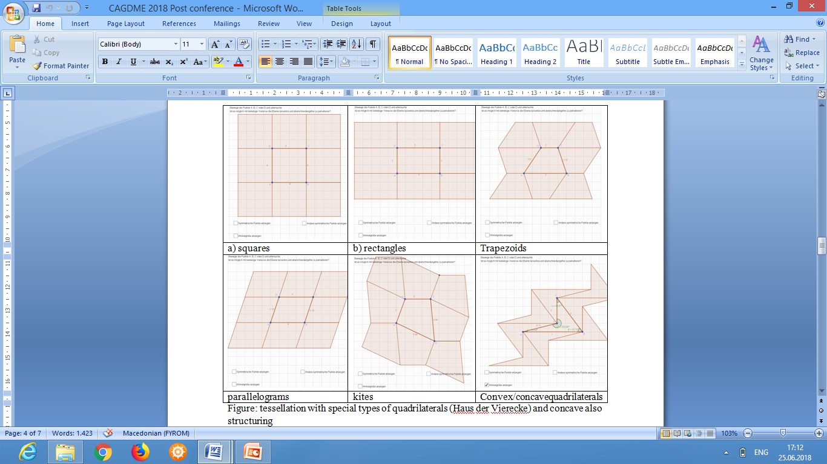
4. Design of a micro-world in a DGS for applications of congruence mappings in tessellations
Figure 1. Tessellations with special types of quadrilaterals

Slide 10
4. Design of a micro-world in a DGS for applications of congruence mappings in tessellations
Figure 2. Tessellations with special types of quadrilaterals

Slide 11
4. Design of a micro-world in a DGS for applications of congruence mappings in tessellations
Are tessellations with concave quadrilaterals possible?
Figure 3. Tessellations with concave quadrilaterals

Slide 12
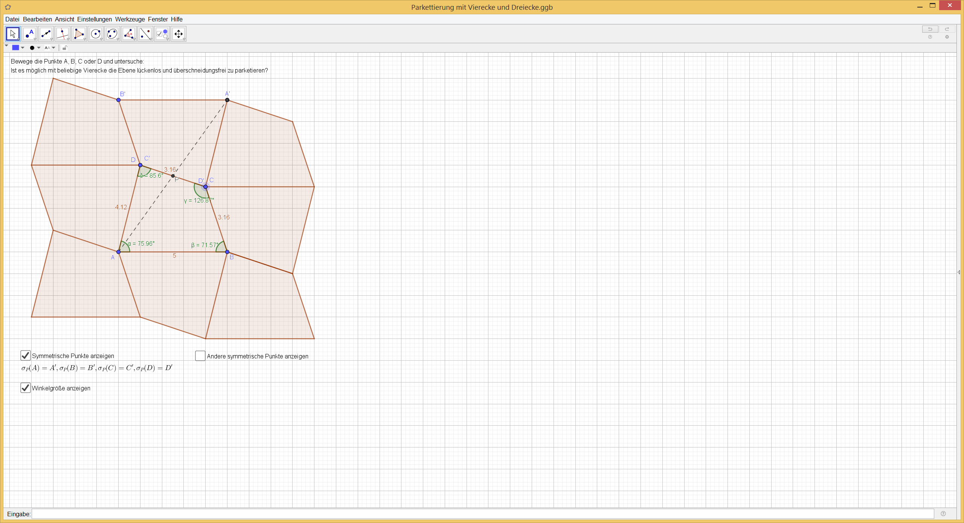
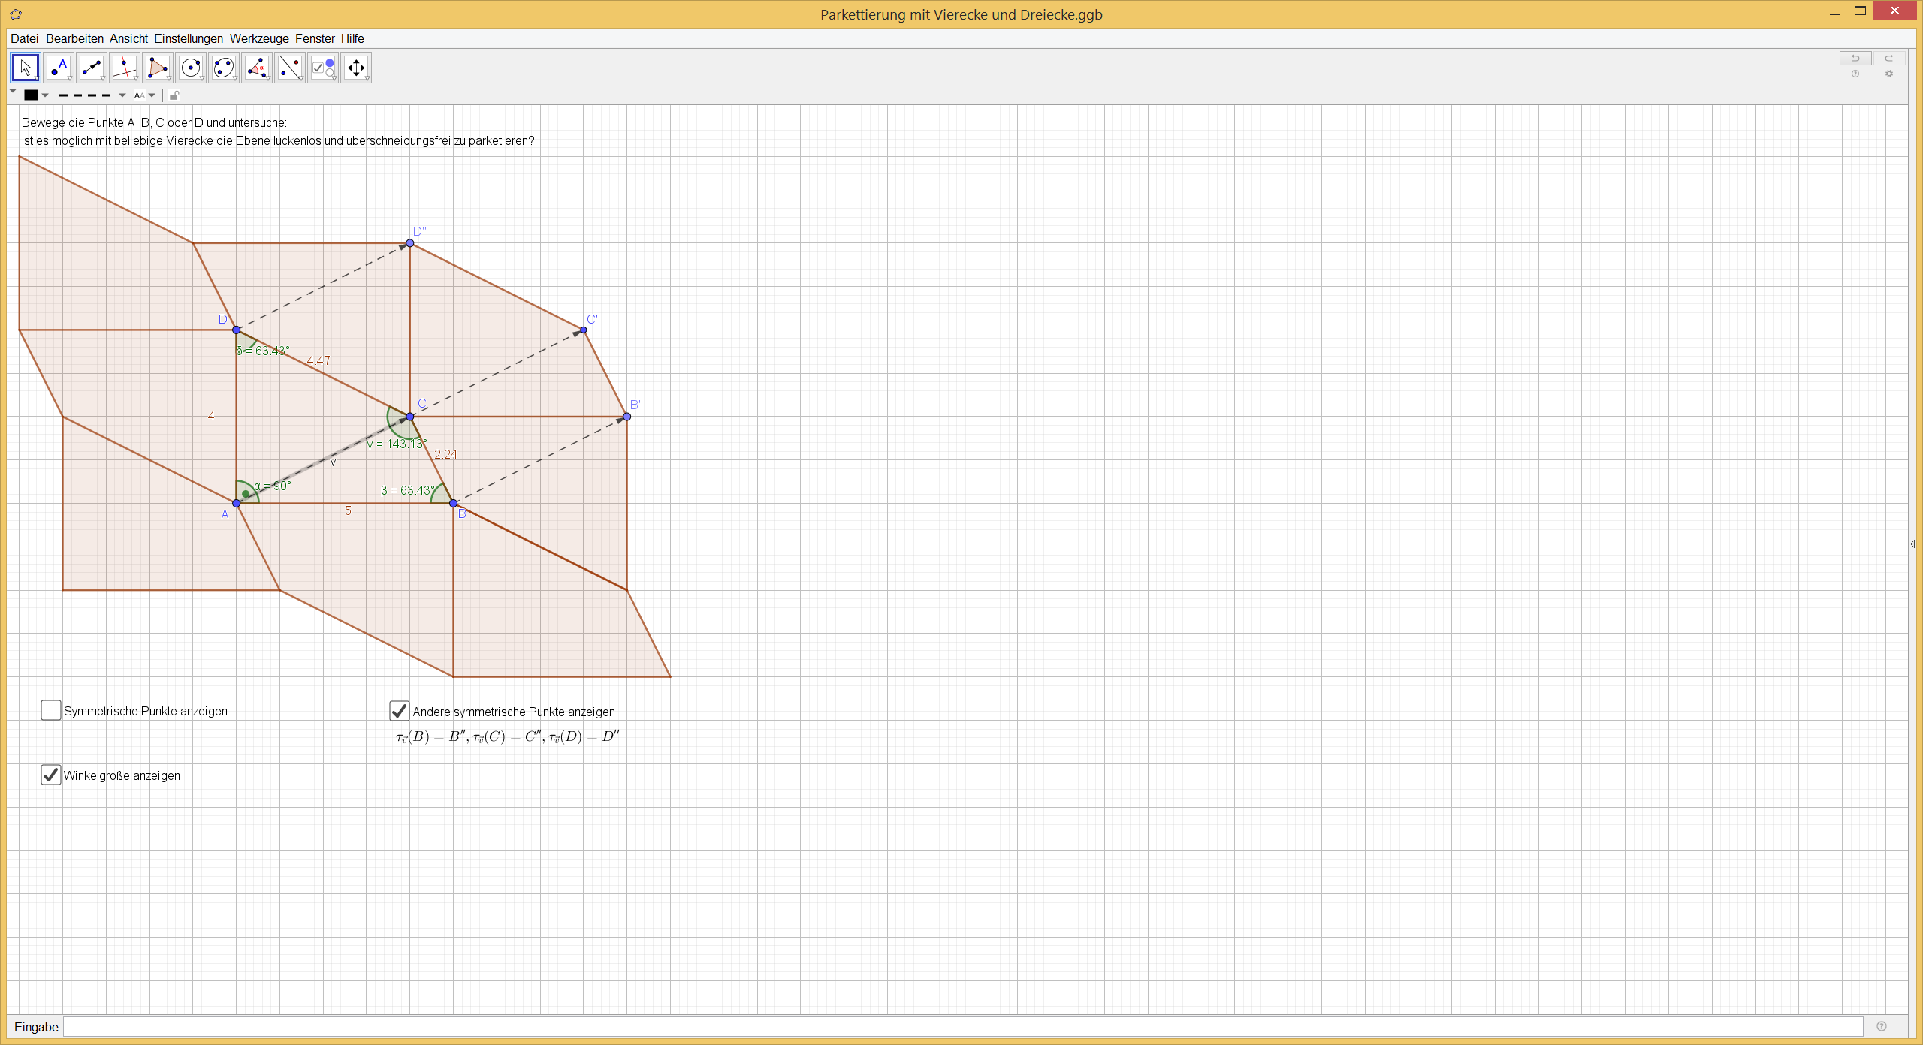
4. Design of a micro-world in a DGS for applications of congruence mappings in tessellations
Figure 4. Tessellations with arbitrary quadrilaterals

Slide 13
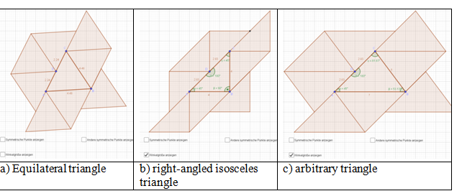
4. Design of a micro-world in a DGS for applications of congruence mappings in tessellations
Figure 5. Tessellations with triangles

Slide 14
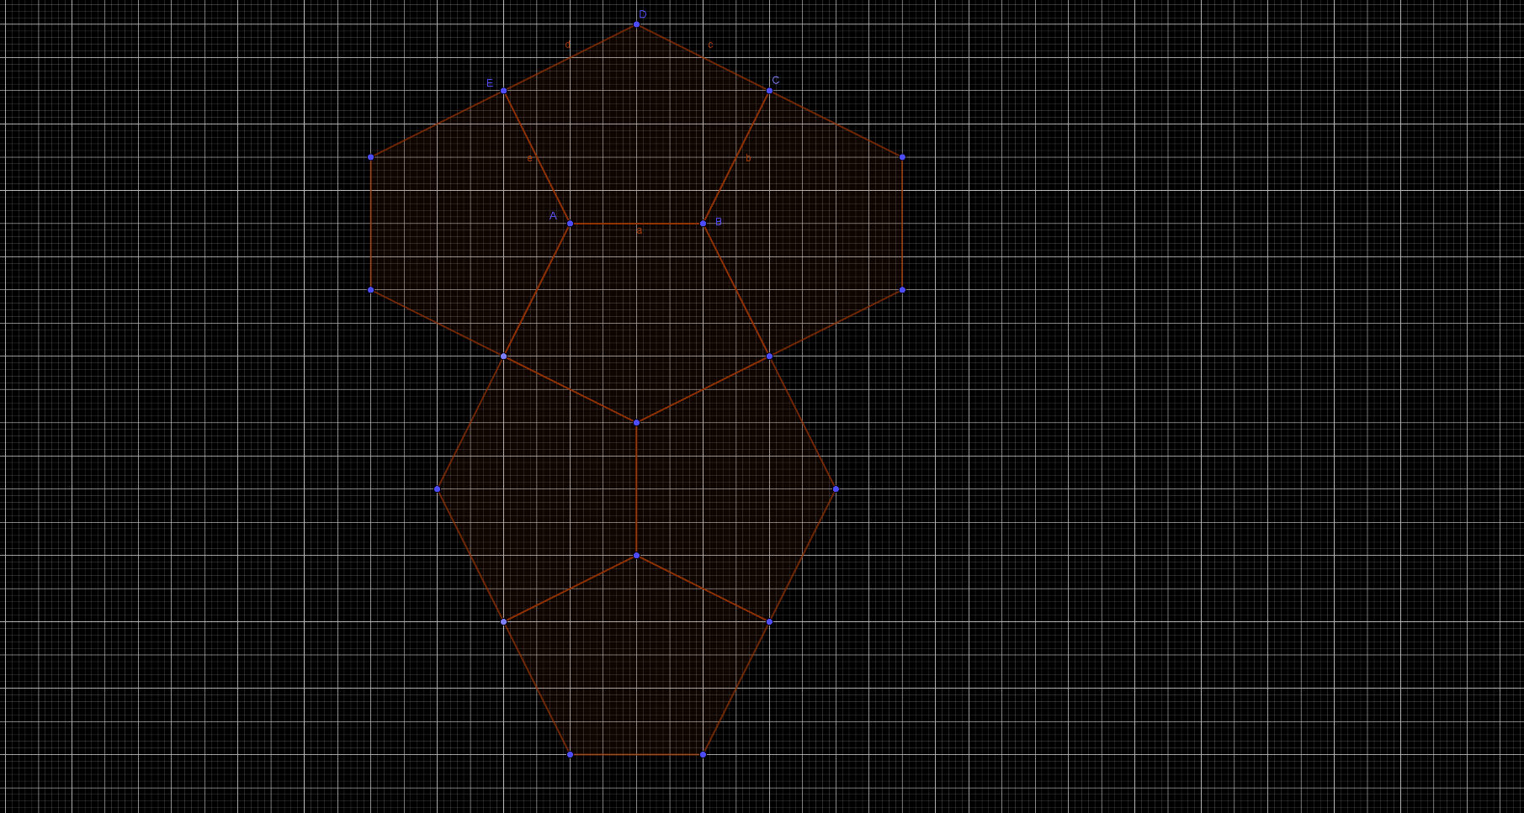
4. Design of a micro-world in a DGS for applications of congruence mappings in tessellations
Figure 6. An example of a tessellations with a particular pentagon

Slide 15
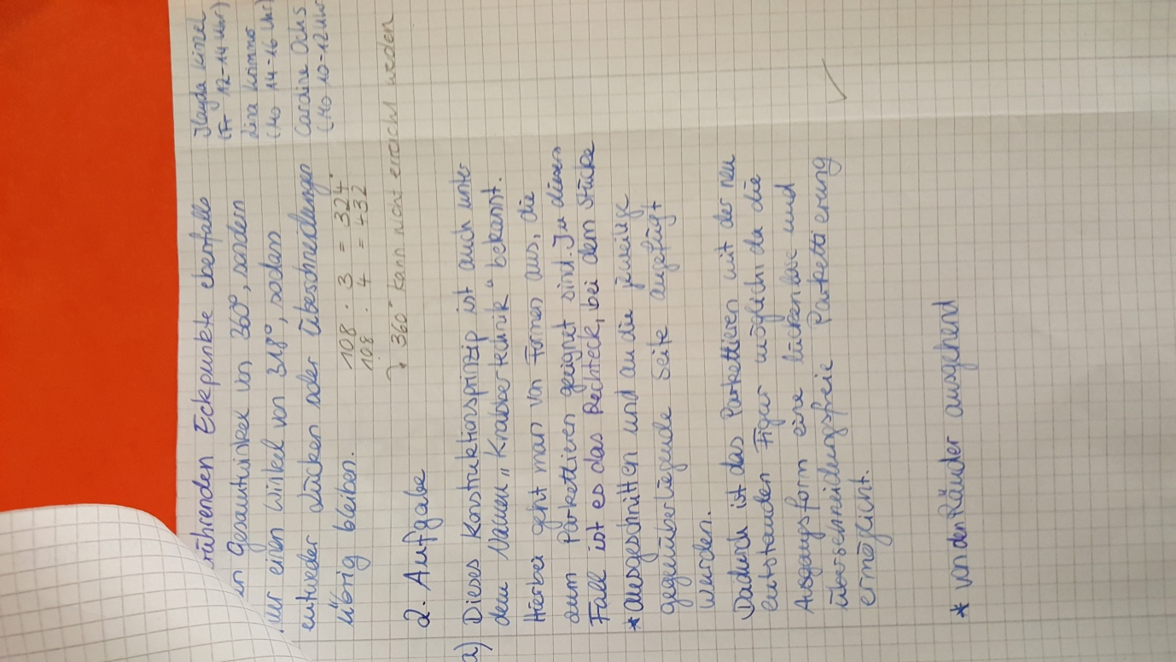
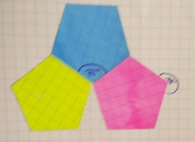
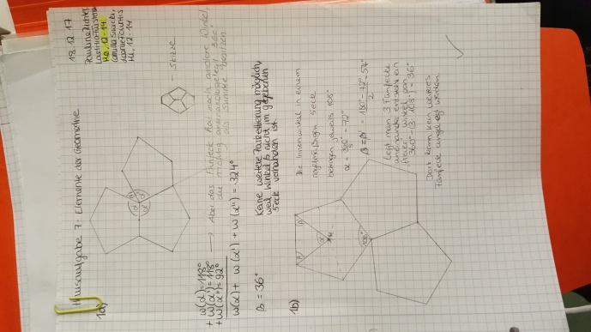
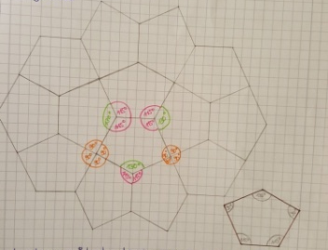
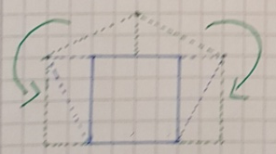
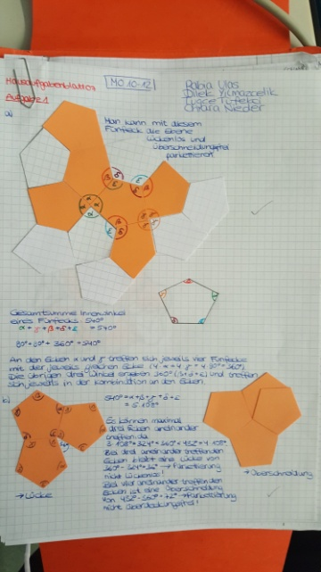
5. Results and discussion

Slide 16
5. Results and discussion
Related to the research question:
Synchronized changes between different modes of description and thinking, both geometric and algebraic (of point reflections and translations) in a single window available through a check box
Systemized explorations of all types of triangles and quadrilaterals using the drag mode of points
Possibility for individualization of the learning processes through tasks with different levels of difficulty

Slide 17
Thank you very much for your attention!
Contact
  Ana Donevska-Todorova
  Humboldt-Universität zu Berlin
  todorova@math.hu-berlin.de

