Slide 1


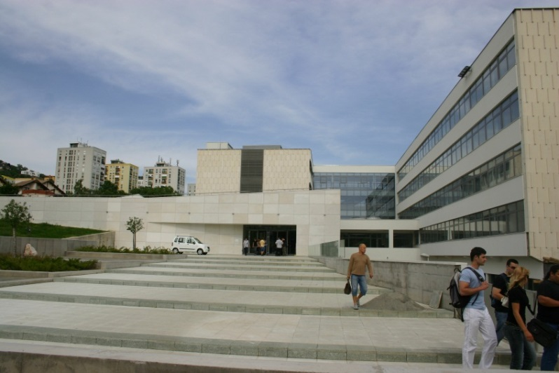
Computer algebra systems (CAS) as a bridge between Mathematics and Engineering
Ildikó Perjési-Hámori
Department of Mathematics
Faculty of Engineering and Information Technology
University of Pécs, Hungary
Notes:
j

Slide 2
Outline
Course of Mathematics in engineering education
CAS in the courses of Math – examples
International students at the University Pécs Faculty of Engineering and Information Technology
Students’ project works at the end of the 3. semester
Didactical questions

Slide 3
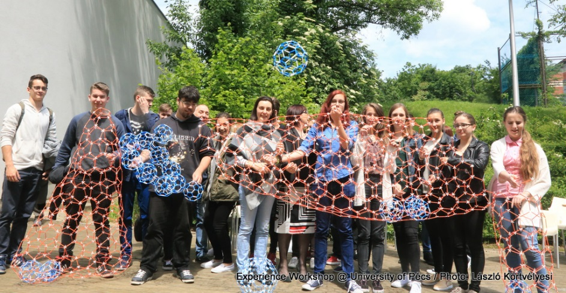
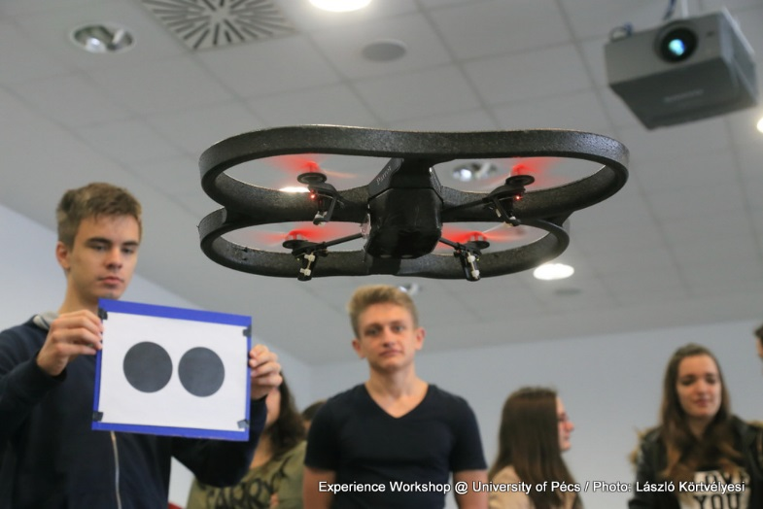
Role of math
Elementary education - game, counting, steps of problem solving, Geogebra, elementary programing, creativity (STEAM), makes our life orderly,
High school:
for everybody: everyday math (banking, financial knowledge), reasoning, creativity, abstract or spatial thinking, critical thinking, problem-solving ability ,
for the future engineering and science students: math as a language of the nature motivation: STEAM to have fun (Experience Workshop International Math-Art Movement Kristóf Fenyvesi)
Workshop, University of Pécs, 24/05/2018

Slide 4
Role of math in engineering
University level, engineering education
American Heritage Dictionary (2009), engineering is "the application of scientific and mathematical principles to practical ends such as the design, manufacture, and operation of efficient and economical structures, machines, processes, and systems."
An engineer must be able to use mathematical and scientific understanding to analyze a problem, describe it, talk about it, and successfully find and execute a solution. Pamela Truesdell Engineering Essentials for STEM Instruction
In briefly: engineering is an application of math and science.
Needs: clear and concise problem formulation, critical thinking skills
Questions: how – engineers, why – mathematicians (both?) controversary (?)

Slide 5
Role of math in engineering
Specialities for engineering mathematics :
Pure math, but with simple engineering problem at starting point (short CAS presentation)
Theoretical explanation (definitions, theorems with or without proof) (more and more important) black box white box
Simple example and application using paper and pencil only
Complicated problem solving: engineering problem – translation into math – translation into CAS - discussion – feedback in practice

Slide 6
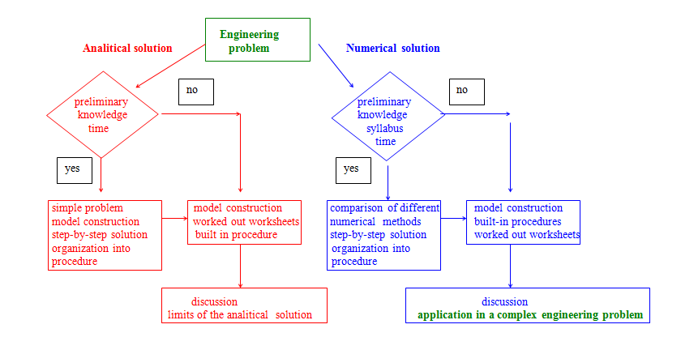
Flow chart of math in engineering

Slide 7
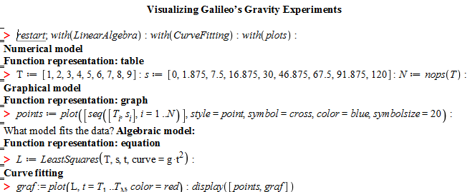
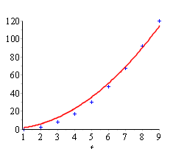
Courses using CAS in BSc level
Engineering mathematics (in English and in Hungarian) (electrical-, civil-, computer science engineering)
Math1: sets of numbers, vectors and operations with vectors, functions, sequences, limit and continuity, differential calculus of functions in one variable
CAS: only on lectures, visualization

Slide 8
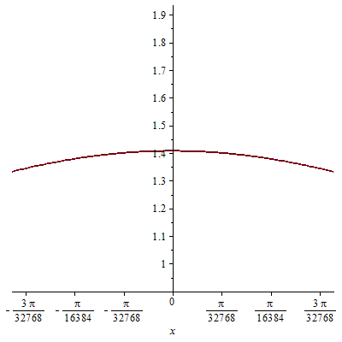
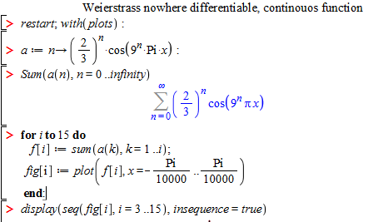
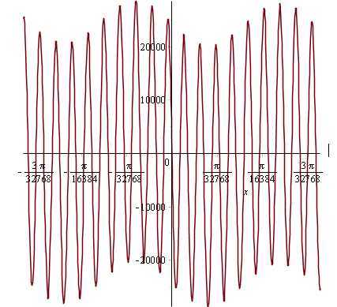
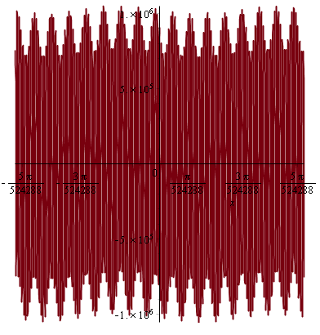


Courses using CAS in BSc level

Slide 9
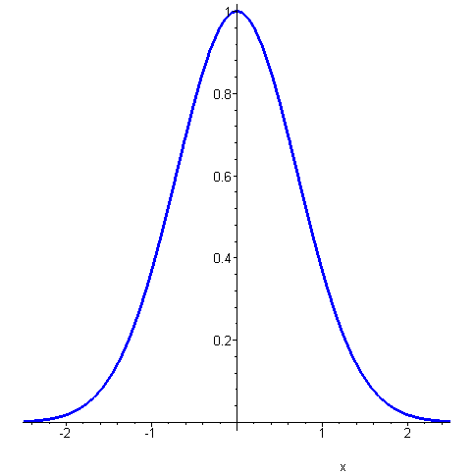
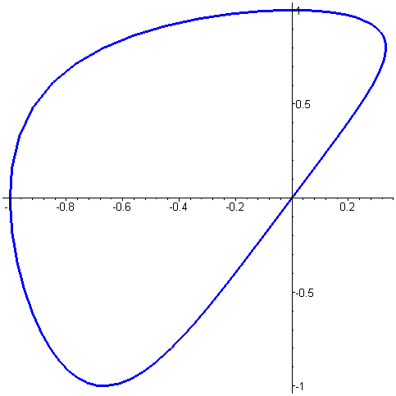
Grouping of functions
1. Real functions with one variable
Example:
or
When function f(x)=x³ is considered, sometimes its domain is not specified.
Than D_{f} is the largest set of the real numbers for which the expression is defined correctly.
Definition: The set of all points (x;f(x)) on the plane is called the graph of the function.
Methods for representing functions:
a.) With a formula
b.) With instructions
c.) With a table
d.) Graphically
e.) Parametrically
x | 1 | 2 | 3 | 4 | 5
f(x) | 1 | 3 | 4 | 6 | 7

Slide 10
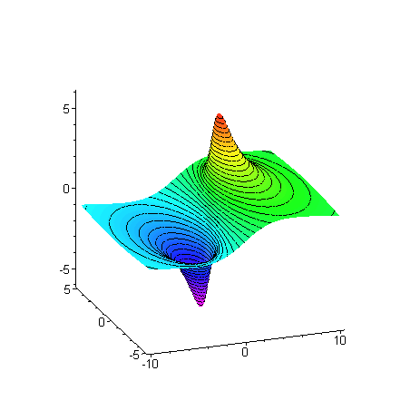
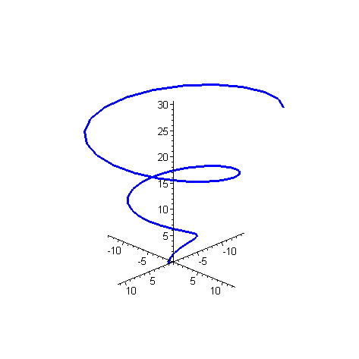
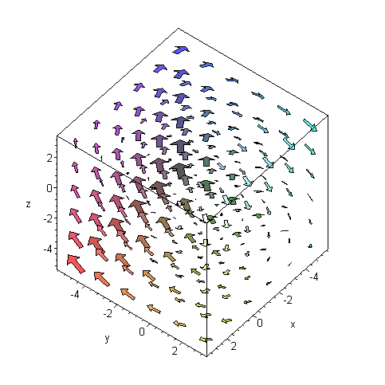
Grouping of functions
2) Real functions with two variables:
Mapping ordered pairs to real numbers.
Notation:
or
Domain of function: a subset of the xy- plane. Visualization: in the three-dimensional, right-handed Cartesian coordinate system (point wise)
3) Real functions with several variables
Mapping ordered n-tuples → real number
5) Vector – vector functions
,
3 dimensional vectors → 3 dimensional vector
4) Vector – scalar functions
Real number → 3 dimensional vector
Real pair → 3 dimensional vector

Slide 11
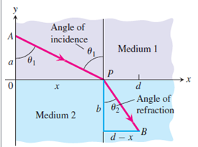
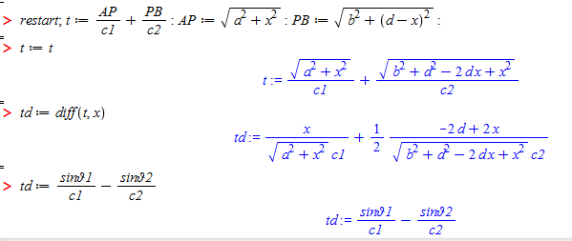
Courses using CAS in BSc level
Math2: application of derivation, integral calculus, applications of integral, functions of two variables
CAS: on few practice classes, visualization, numerical and symbolical calculation
Example from physics – application of derivatives

Slide 12
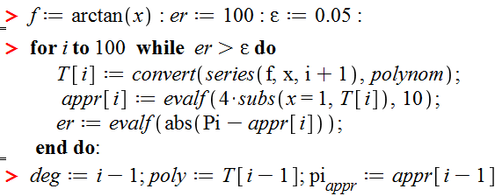
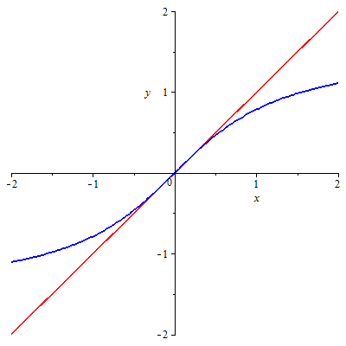
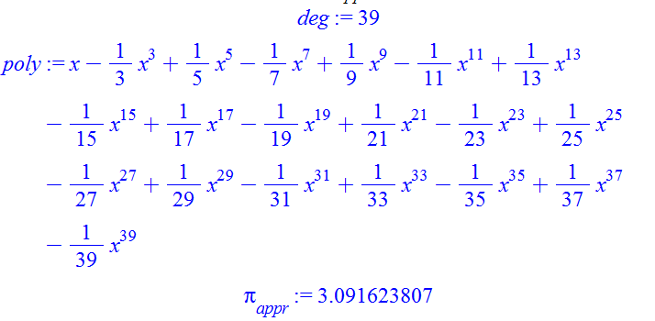
Courses using CAS in BSc level
Approximation– application of derivatives

Slide 13
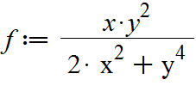
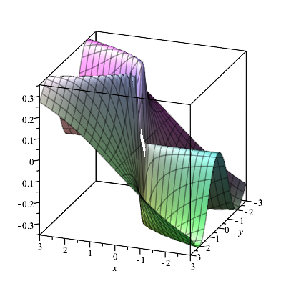
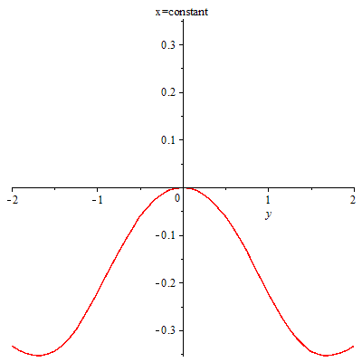
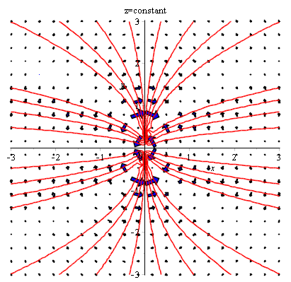
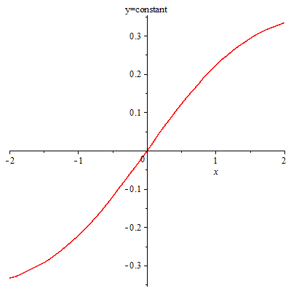

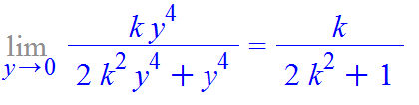
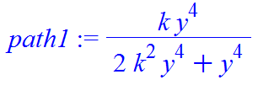
Courses using CAS in BSc level
Function of two variables:
Contours, gradient and level curves:
Limit

Slide 14
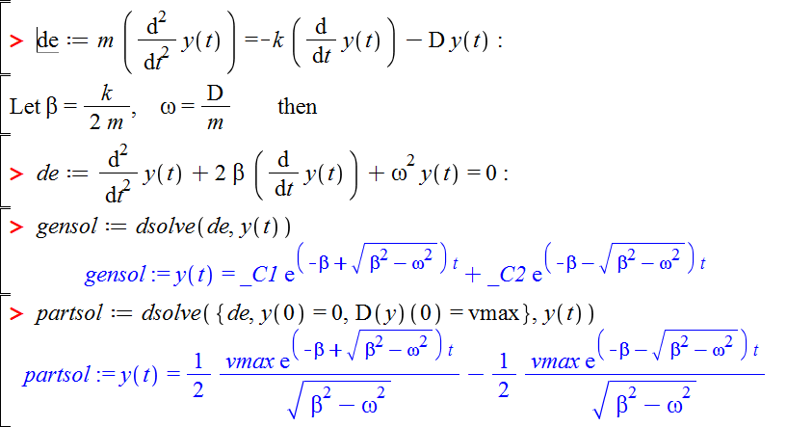
Courses using CAS in BSc level
Math3: differential equations, elements of linear algebra
CAS: practice classes in computer lab, visualization, numerical and symbolical calculations

Slide 15
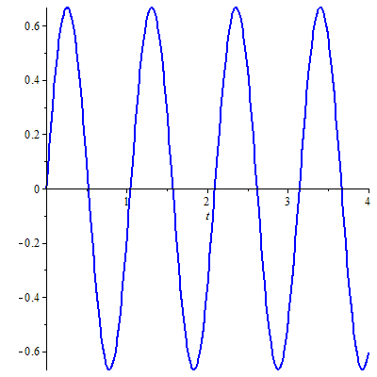
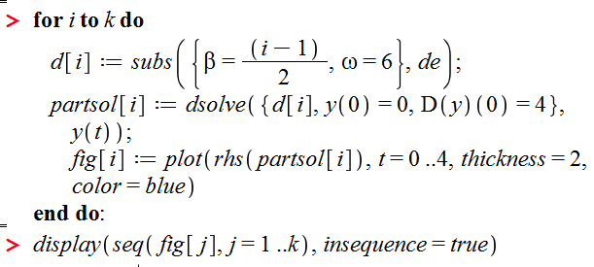

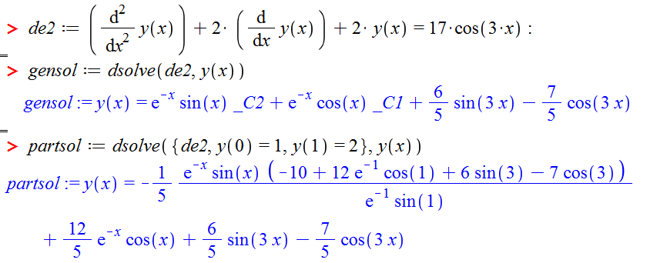
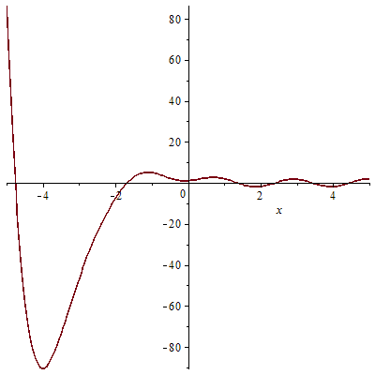
Courses using CAS in BSc level

Slide 16
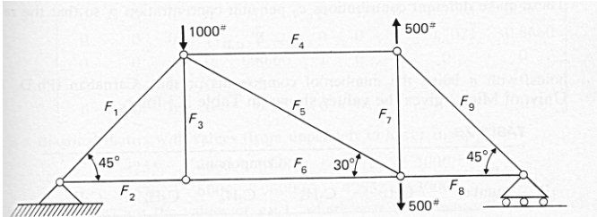
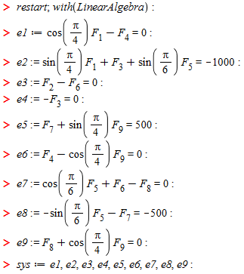

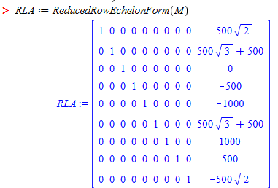
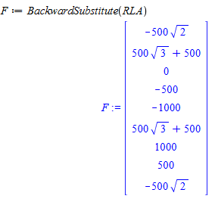
Courses using CAS in BSc level
Solution of linear equation system

Slide 17
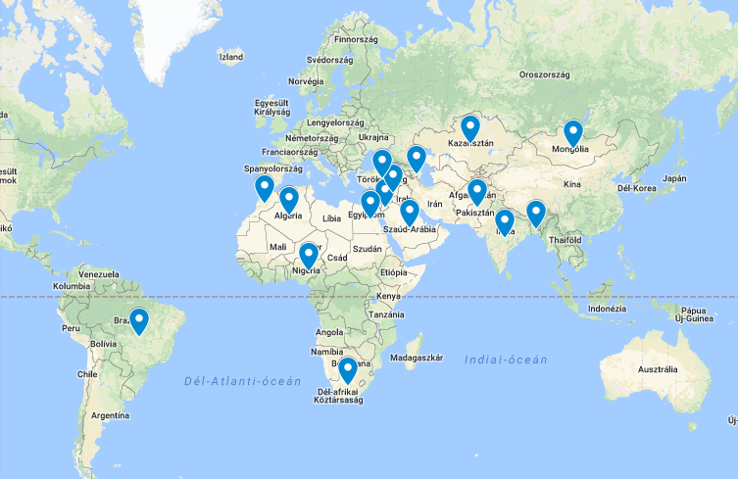
The beginnings
Stipendium Hungaricum Scholarship Programme: bilateral agreement between Hungary and 60 sending countries

Slide 18
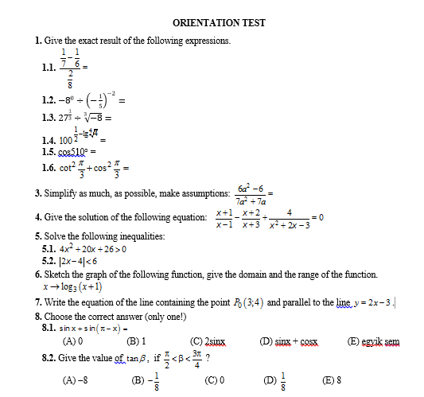
The beginnings

Slide 19
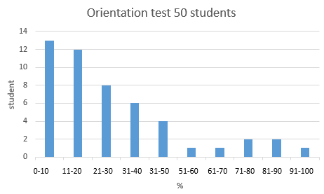
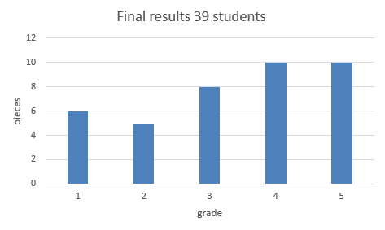
End results after 3 semester

Slide 20
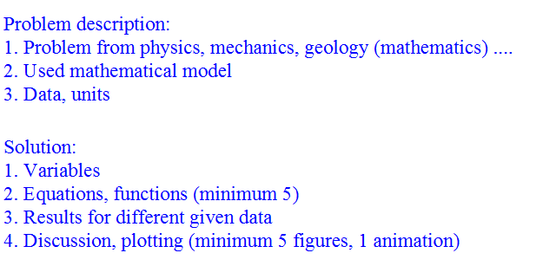
Presentation requirement for Mathematics A3 students

Slide 21
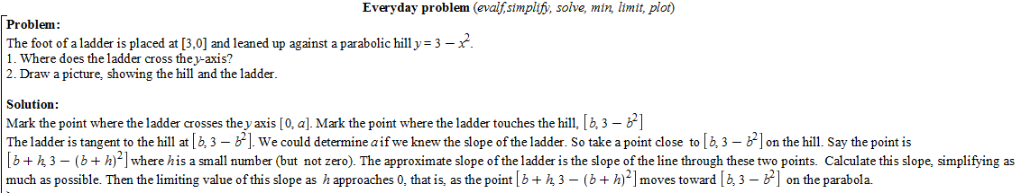
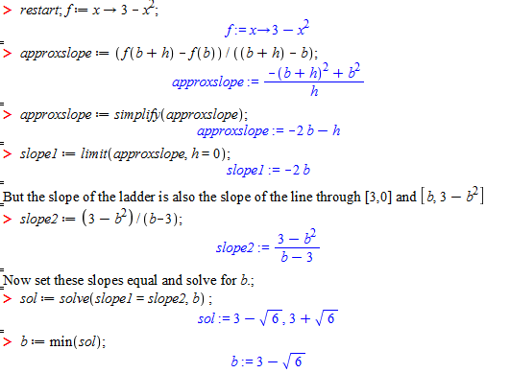
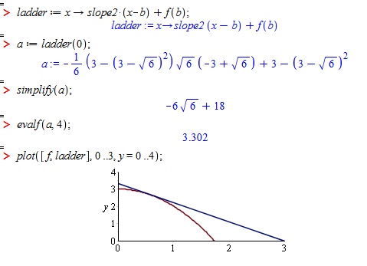
Problem 1
He does not use higher math, but he thinks.

Slide 22
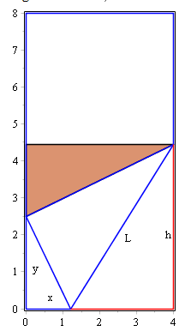
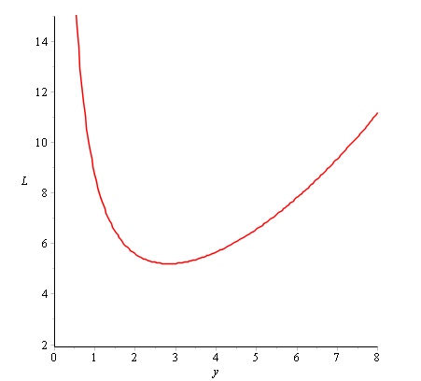
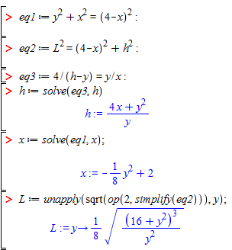



Problem 2
Elementary geometry, minimum of function

Slide 23

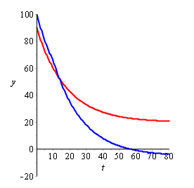
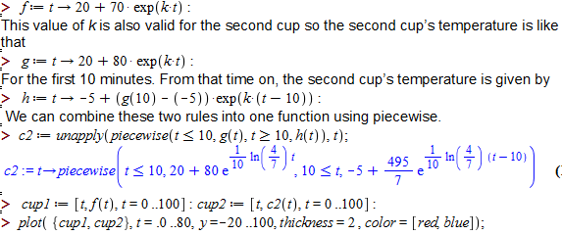

Problem 3
Simple physics problem, step-by-step problem solving

Slide 24
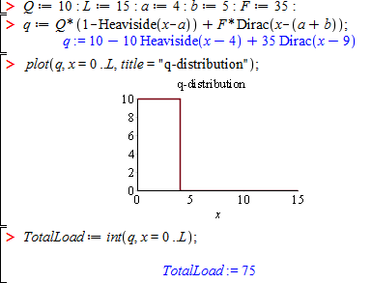






Problem 4
Typical civil-engineering problem, not-mentioned commands

Slide 25






Problem 5
Maple application center, reorganizing ☺

Slide 26
Didactical questions:
If there is no way to „Learn-by-doing” but „Learn-by-programing math” using CAS brings closer math to the real life.
Lecture: complicated problem solving, prepared worksheet (upload to net)
Practice: well-prepared (not solved!) worksheets
Self-made problem solving:
Simple problem from literature
Hard to connect engineering problem to math
The oral presentation is useful – own solution or not
The greatest success is that the students have become open to processing unusual issues
Next step: integration some engineering course (e.g. mechanics) and math course.

Slide 27

Thank you for your attention
Mathematics,
Information and communication technologies,
Engineering and engineering trades

