Slide 1

Methodological coaching of teachers in order to prevent eArly school leaving
EFOP-3.1.2-16-2016-00001

Slide 2

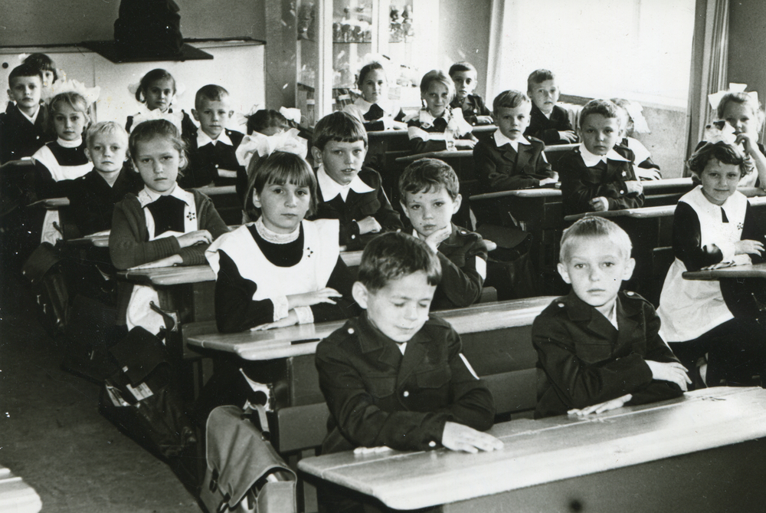
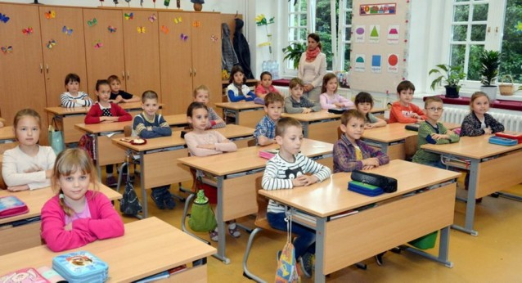
School in the past…
…and present

Slide 3
About the Project
EFOP 3.1.2-16-2016-00001 – Methodological coaching of teachers in order to prevent early school leaving – Introducing a Complex Basic Program to Hungarian primary schools
Term: 2017.01.01-2021.09.30
Members: EKE, ELTE, SZTE, PTE, NYE, DE, ME, OH

Slide 4
Aims of the complex Basic PROGRAM
Establishing preventive strategies against early school leaving without qualification;
Working out a system of learning supportive pedagogical methods appropriate to prevent early drop out for primary schools in Hungary;
Renewing the content of in- and pre-service teacher trainings to enhance the changing of their pedagogical aspect;
Spreading the new strategies among Hungarian primary schools (1500 country-wide).

Slide 5
The complex Basic program
  Alloy the differentiated generative methods into a homogenious system;
  Apply the methods of the CIP to handle and change the status of the pupils in school situations and therefore raise the learning motivation;
  Place special emphasis on developing basic skills and abilities;
  Supported by sub-programs to achieve a complex personality development.

Slide 6
The building of complex Basic PROGRAM
Complex Basic Program
(CBP)
Aims, principals, values
Exercise-based Sub-program (PES)
Life-practice based Sub-program (LPS)
Art-based Sub-program (AS)
Learning-teaching strategy
Digital based Sub-program (DS)
Logic-based Sub-program (LS)

Slide 7

Principals of the CBP
Adaptivity
Complexity
Building community
Learning supportivity
Equity

Slide 8

The learning-teaching strategy
DDHG

Slide 9
The aims of DDHG
Development of pupils, heterogenious in knowledge and socialization, in collaborative groups.
Reach a pozitive influence on pupils’ behaviour.
Modify low learning motivation.
To realize development of cognitive, affective and social skills together.
Promotion of pupils’ collaboration.

Slide 10
Functioning of „Experience School”
The subjects are the same as in NCC.
Using the differentiated methods pliantly, in minimum 20% of the yearly school hours of each subjects.
Developing experiences pervade the whole school day.
All the sub-programs appear in the school – giving opportunity for all kids to join the activities.
The rates of the Complex activities can be different according to the main profil of the school.

Slide 11
Learning supportive methods
Compulsory lessons and voluntary activities
DDHG

Slide 12

learning supportive methods
Mathematics
Physics
Hungarian language
History

Slide 13

LeArning supportive sub-pograms
Notes:
Az alprogramokról van külön prezentáció

Slide 14
To help implementation in schools we’ve
developed the conception of the CBP, HDDG, 5 sub-programs;
developed 7 accredited teacher-training courses for in-service teachers;
worked out 5 teacher handbooks for the sub-programs;
worked out teacher handbooks for every subject and classes to help implementation of the differentiated teaching strategies;
built a webpage, where all important information is available about the program;
worked out a Professional Supporting System (contact and online) to help teachers in implementing the program.

Slide 15
Teacher training courses
30-hours blended courses for inservice teachers
Conception of the Complex Basic Program
DDHG strategy
Digital-based sub-program
Logic-based sub-program
Exersice-based sub-program
Art-based sub-program
Life-practice based sub-program

Slide 16
Changes in maths teaching
Cc. 30% of the content is tought with the help of the sub-programs.
Differentiated group work appears on every 5th lesson (pliantly).
Approaches of the 5 sub-program appears, where it fits to the maths content.
Emphasis on development of mathematical competences.
Multidisciplinary and cross-curricular approaches appear regularly.
Mathematics „come to live”.

Slide 17
The main points of the innovation
Combining good practices and methods to help fighting against ESL;
Making schools receptive, safe and acceptable;
Make learning important and useful;
Giving opportunity for creativity (both teachers and pupils);
Giving a chance for complex personality development;
Giving a chance for equity.

Slide 18


Thank you for your attention! teglasi.ilona@uni-eszterhazy.hu

