Slide 1



The Changing Usage of Teaching Tools in Hungary
29 of June, 2018,
CADGME, Coimbra
Gergely Wintsche, György Emese
ELTE, Faculty of Science,
Mathematics Teaching and
Education Centre
Notes:
In spite of many previous lecturer I will not talk about digital teaching tools or better to say that I will only touch of them.

Slide 2
Content
History
Questionnaire
Data
Conclusion
Notes:
Before I talk anythig I must say some words about the history as I promised.

Slide 3
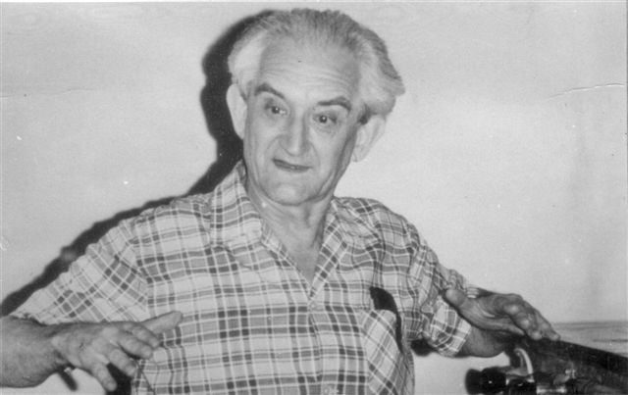
The dream of Tamas Varga
The reform introduced by Tamás Varga during the 1960s and ‘70s, named
“complex mathematics education”
is often recognized in Hungary and in an international level as focusing particularly on problem solving and on heuristic methods and using proper tools.
Notes:
Let us go back upproximately 50 years. A famous hungarian guy Tamas Varga create a „new” teaching system the so called complex mathematics education. He focused on problem solving and a very emhesized use of teaching tools. It was introduced in Hungary, and it was a success and a fail together, because the children enjoyed it in general sense but the teachers not.

Slide 4
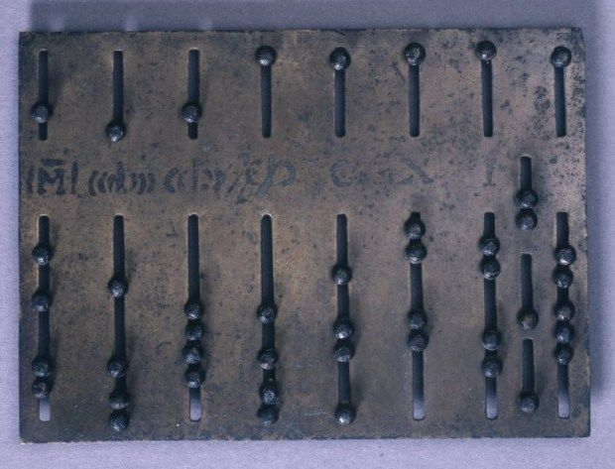
The part of the dream
Mathematics education in early childhood can not be separated from manipulation with objects. Even the ancient Chinese, Sumerian, Egyptian, or Greek cultural memorials prove that the abstract imagination of numbers are closely connected to manipulation with pebbles and sticks. It is quite natural that for every era and age there were objects to use in mathematics teaching started from the color pebbles collected on the riverside through the slate, to the wooden sticks and to the plastic elements.

Slide 5
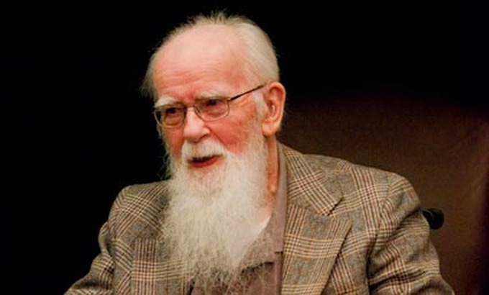
The part of the dream
In the second half of the 20th century, Tamás Varga created and designed a method, including teaching tools and materials for supporting and teaching mathematics education. These were, on the one hand, textbooks and booklets of books, which we are not discussing here and now, but the other hand there were objects planned by himself or Zoltán Dienes or any other colleagues.

Slide 6
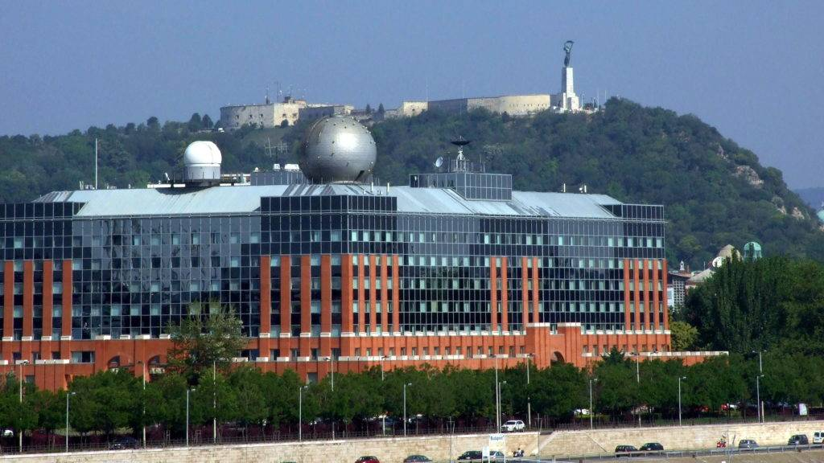






MTA-ELTE Complex Mathematics Education Research Group
Hungarian
Academy
of Science
Eötvös Loránd University
University of Nyíregyháza
University of Debrecen
University of Szeged
University of Kaposvár
Notes:
The Hungarian Academy of Science support groups novadays, who deal with methdology. One of theese groups is the complex mathematics education research group and thanks god some colleagues from the group are here, namely Eleonora Stettner,, Eszter Kónya and Zoltan Kovacs.

Slide 7

Goals
Finding the signs and marks of the influence of Tamas Varga’s method in the nowadays teaching practice.
Reloading and reorganising the 50-year-old conception along the new technology and the new theory of cognitions.
…
Notes:
So revitalize and reorganize something if worth it

Slide 8
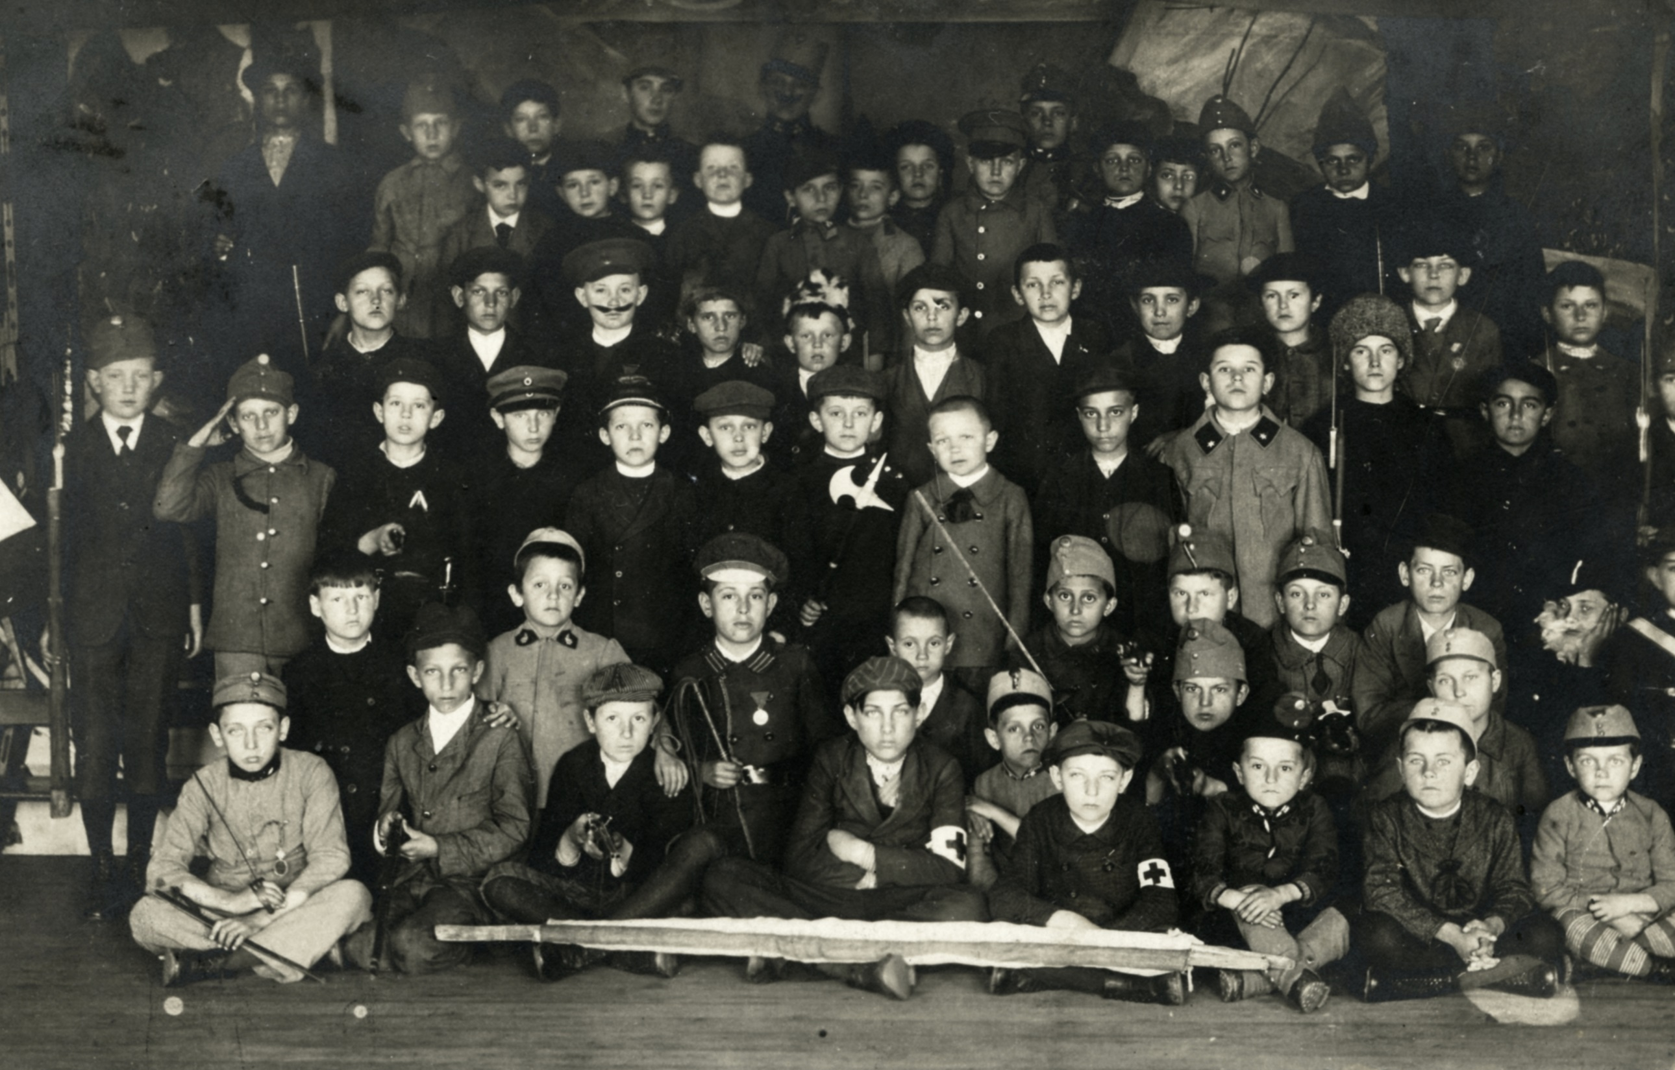



Historical background
In the socialist era, before 1989, production and distribution of teaching tools were centralized. There was only one big company that supplied state schools with teaching tools, TANÉRT.
Almost all Hungarian schools were
state schools, there were only very
few church and private schools.

Slide 9
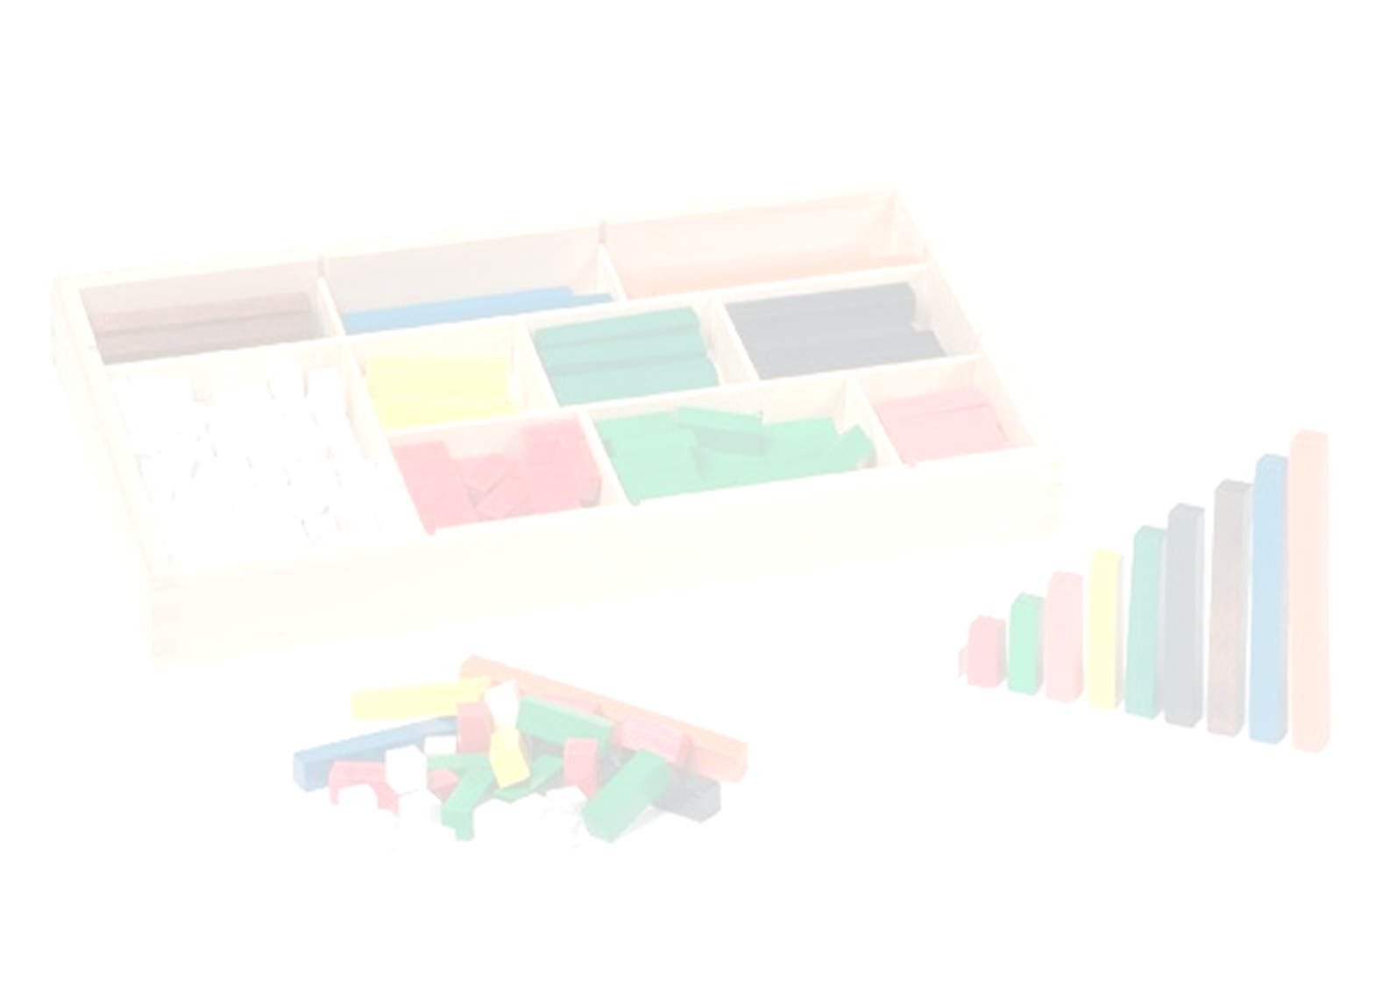
Historical background
TANÉRT sold a centrally chosen selection of teaching tools for each subjects. Manuals and didactical materials were developed for these tools in a more or less scientific way. These tools were really cheap and in that centralized system it was more or less expected that schools buy these tools and teachers use them. When state inspectors evaluated a teacher it was one of the criteria how many teaching tools are used and how.
Notes:
But theese years had gone a lot of changes swept away.

Slide 10
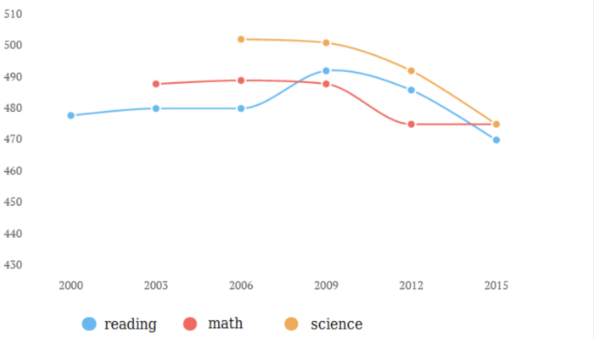
PISA results in Hungary
Notes:
There is a slightly decreasing sign of the PISA results.
In spite of this the TIMMS, where Hungary is in the upper third.

Slide 11
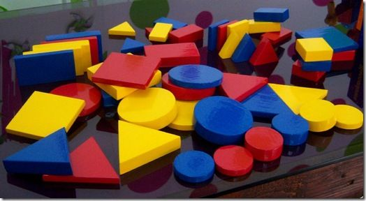
Our Basic Question
Are there any changes in the practice of the teachers using traditional and other teaching tools?
Is it measurable?
We created a questionnaire.

Slide 12

The questionaire
1. Which grade do you teach?
(You can mark more options.)
2. Age
3. Gender
4. How many years do you teach maths?

Slide 13
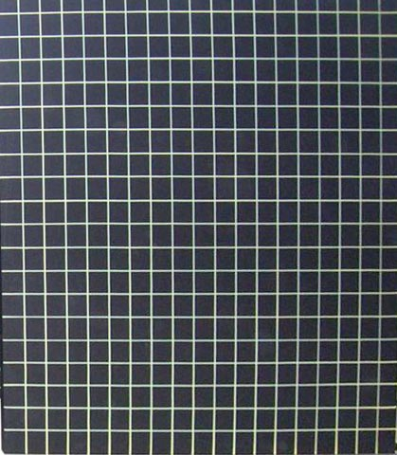
5-14. Using of tools
Lined blackboard
Tiled blackboard
Magnetic board
Printed tables and drawings on the wall
Possible answers
Not in school, and I did not use it
We have in school, but I did not use it
Not in school, but I used it
We have in school and I used it
The kids used it

Slide 14
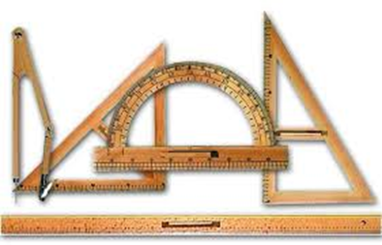
6. Devices, tablebars, table rulers
Measuring rods, metering devices
Weights, weighing instruments
Measuring pots, volume measuring devices
Clock, timing devices
Notes:
You can met with rulers in a previois lecture too. But nobody wants to punish with a meter rod.

Slide 15
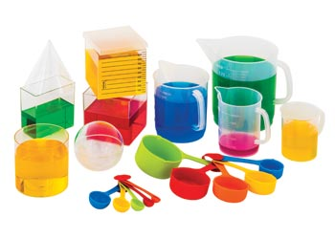
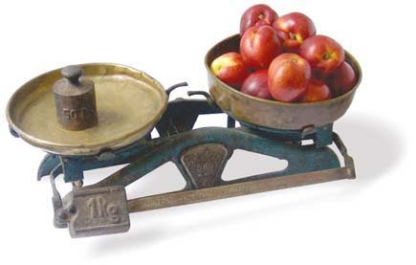
7. Dice, Dominoes
Geometric illustrative bodies (eg. cubes, bricks, cones, ..)
Scales for teaching equations

Slide 16
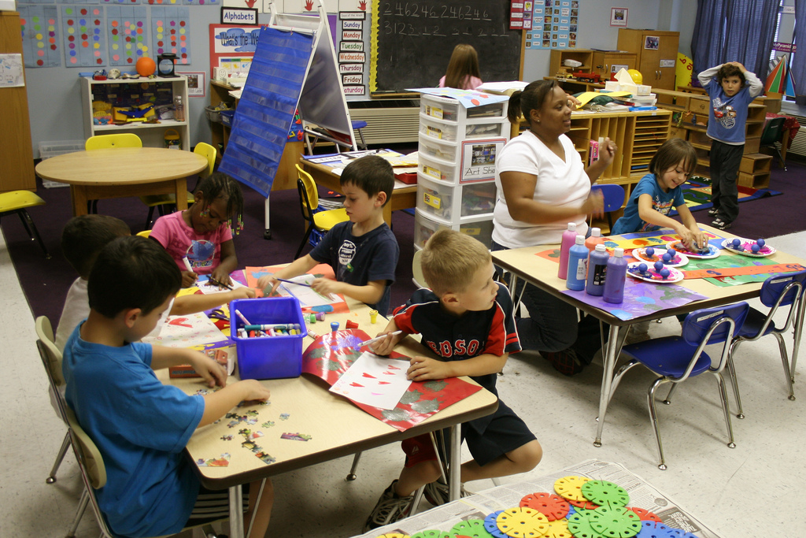
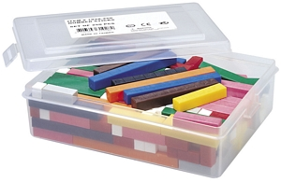
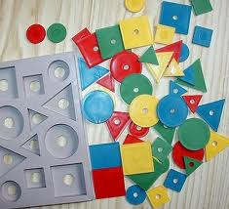
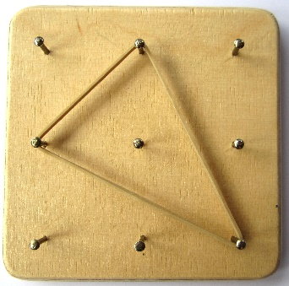
8. Cuisenaire Rods (Color rods)
9. Logical Kit
10. Geoboard

Slide 17
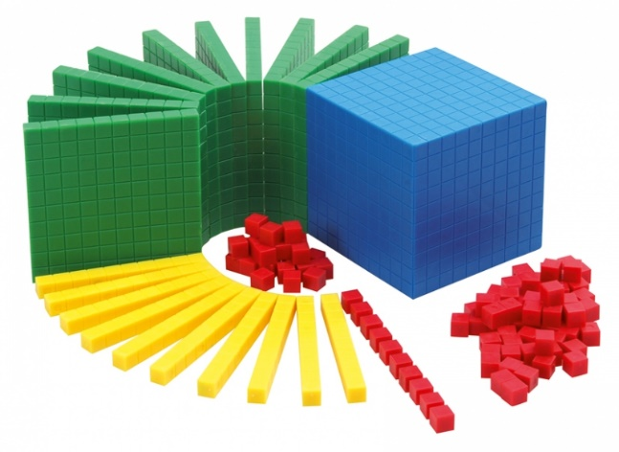
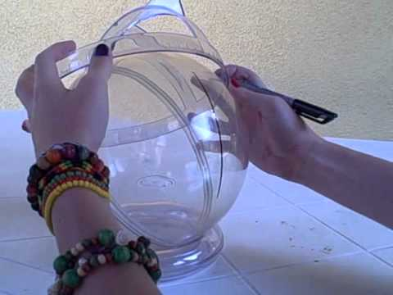
11. Numerical System Illustrative Devices
12. Building and modeling sets for solids (or similar)
13. Lenart spheres
14. Lego bricks

Slide 18

The last four questions were not mandatory, but we had been happy with the answers.
15. Please list any material (non-electronic) tools that you did not find in this listing, but you as a teacher use your lessons for demonstration purposes (for example, Zometool, Polyuniverse, Jomili cubes, 4Dframe, ...). Where did you get to know the device?

Slide 19
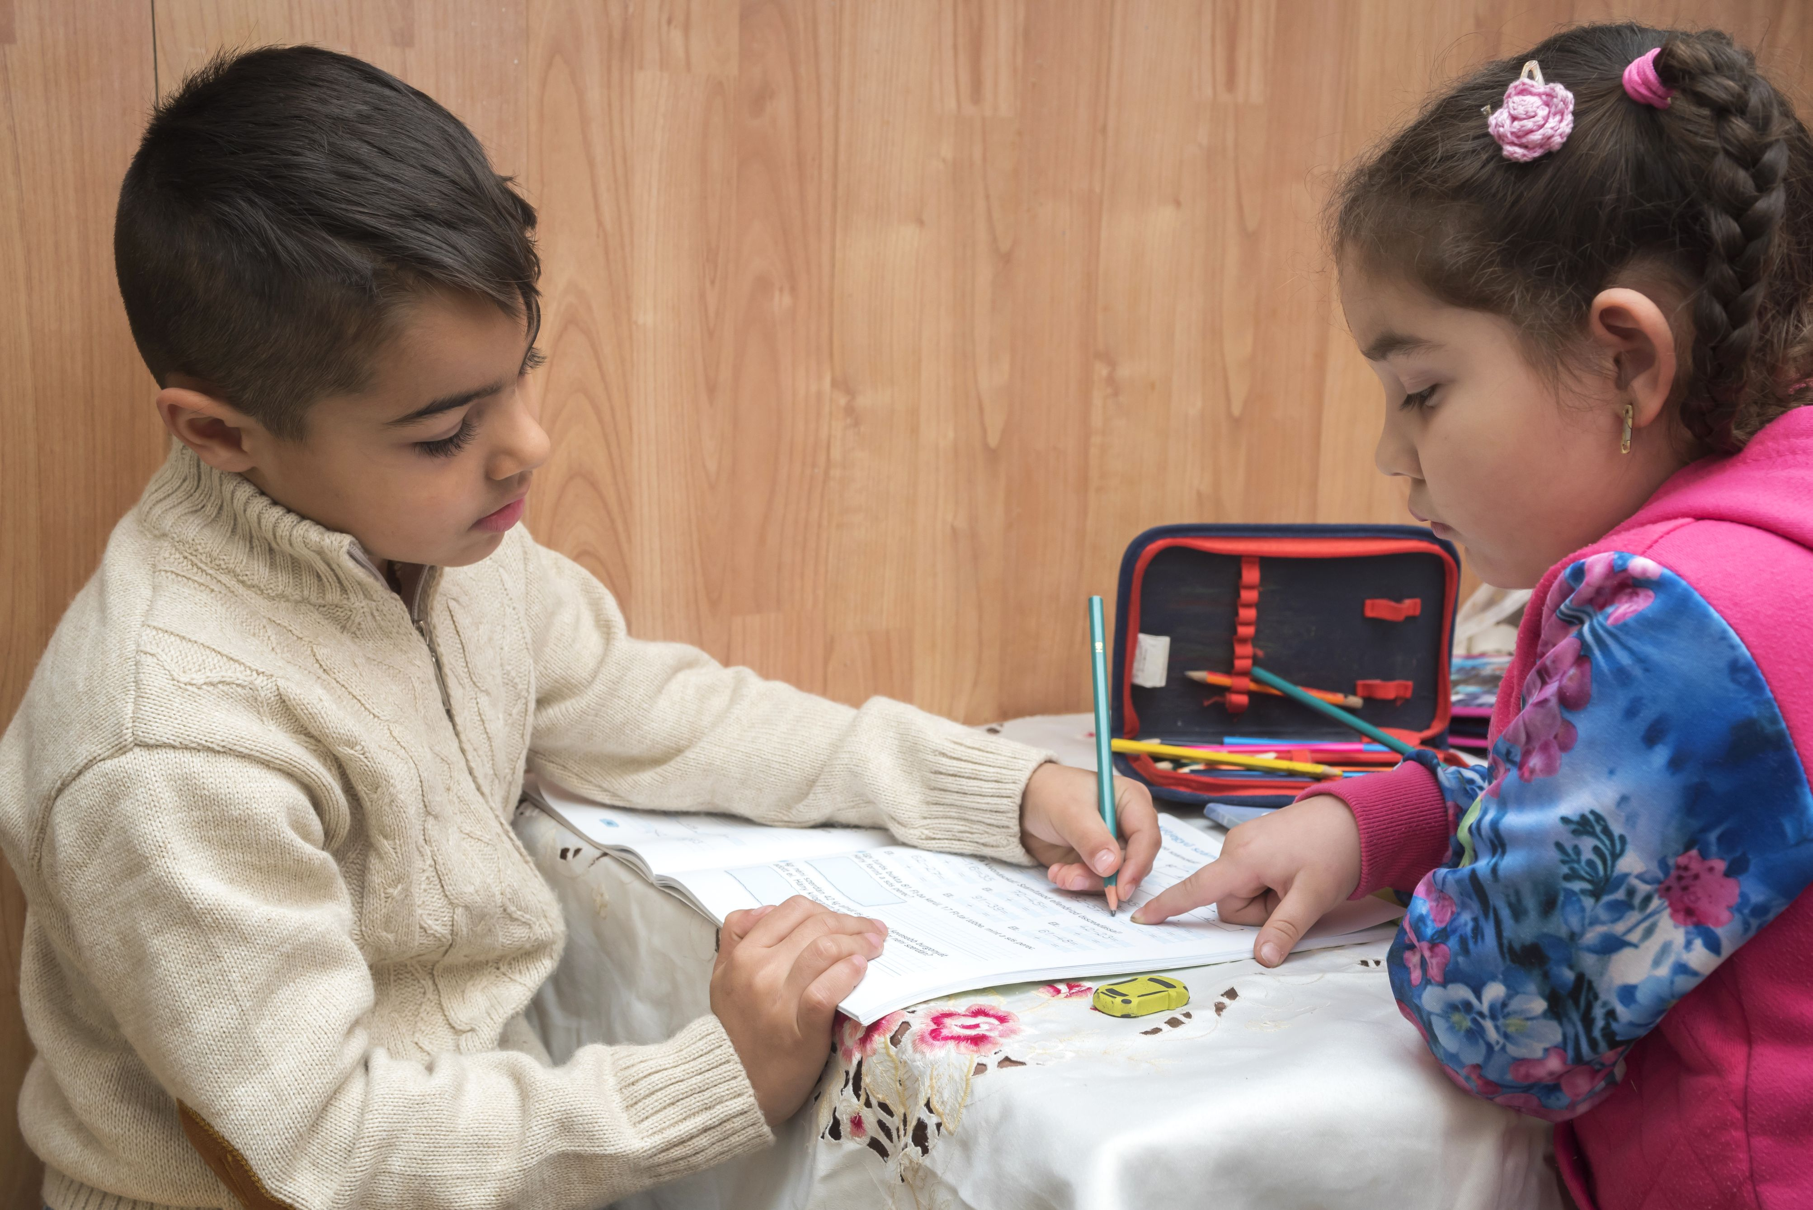
16. Please list any non-electronic tools you did not find in this questionnaire, but the kids used them.
17. Please list electronic devices (not software) that you or your students used in their lessons.
18. By entering your email address, you agree that we contact you and talk to you and your students about the use of the teaching tools.
Notes:
This was the questionnaire in a nutshell an we waited the answers but

Slide 20
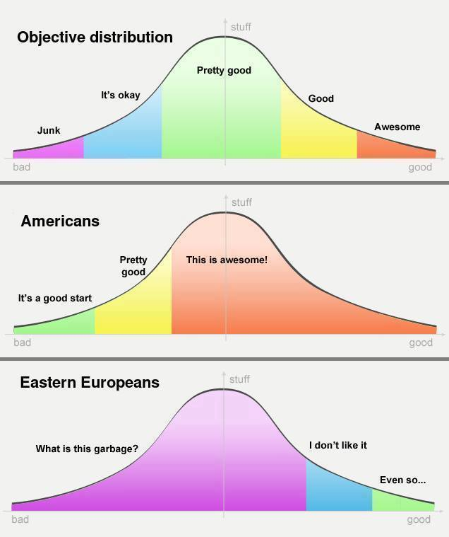
Theoretical background
Notes:
We are over the two third of my talk so it is time for a refreshment. Before our statistical results here it is a theoretical background. I must remind you that we are from Hungary, part of mid or eastern europe.

Slide 21

Answers
Avoiding the effect of active teachers we circulate the questionnaire only for 43 teachers who were supposed not to teach in a highly ranked schools.
In the second round we shared the link of the questionnaire in the list of the Bolyai Society (http://www.bolyai.hu/index_en.htm) on the facebook and the link was shareable. As a result we got 213 more answers but they were mainly teachers who are member of the Hungarian math teacher society. (43 + 213 = 256 = 2⁸)
Notes:
Our fear was justified But every number shold has even chance.

Slide 22
Answers
The basic tools are available in the schools.
For example in the elementary schools.
Color rods | Frequency | Percent
Not in school, and I did not use it | 10 | 14,3
Not in school, but I used it | 1 | 1,4
The kids used it | 51 | 72,9
We have in school and I used it | 6 | 8,6
We have in school, but I did not use it | 2 | 2,9
Total | 70 | 100
Notes:
Only two tools remained untouched in the last 50 years. Naturally two simple tools.

Slide 23
Color rods

Slide 24
Answers
The basic tools are available in the schools.
For example in the elementary schools.
Logic_set | Frequency | Percent
Not in school, and I did not use it | 3 | 4,3
Not in school, but I used it | 4 | 5,7
The kids used it | 56 | 80,0
We have in school and I used it | 5 | 7,1
We have in school, but I did not use it | 2 | 2,9
Total | 70 | 100

Slide 25
Logic set
Notes:
These tools remained in the practice, but the others are less available.

Slide 26
Answers
Teachers use tools, but they are highly renewed or partly transmitted the tools to the digital space preferred by students.
They listed a lot of different tools what we never mentioned.
The teachers could choose from a much wider selection than we could imagine it.
Notes:
I will not detail avery cohors and every tools, just I give a short summary. Thanks to the teachers creativity they used a lot of different tools.

Slide 27


Slide 28
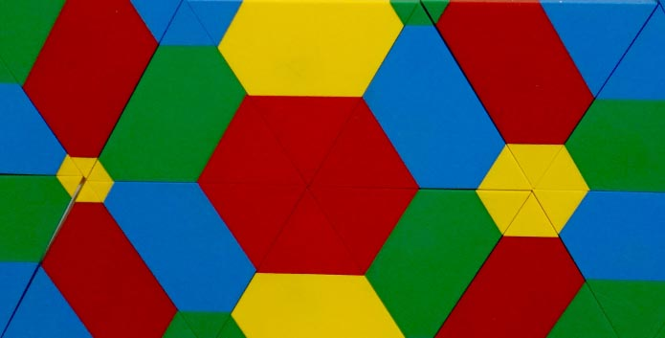
Results
If a tool is available in the school than the teachers will use it.
(75%-95%).
Teachers over 50 use more tools than the youngsters. (We have to strengthen the using of tools in the teacher training.)

Slide 29
Results
Teachers do not use less teaching tools than 40 years ago, but their use of devices are less directed and cover much wider spectrum.
The changes in device usage or teaching tools alone can not cause the decreasing in PISA results.
Notes:
What could be the reason? I have no answer.

Slide 30
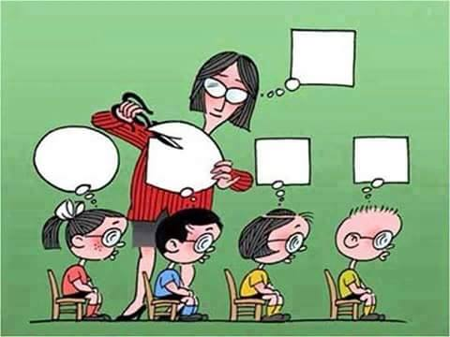
Obrigado
Thank you

