Slide 1
Didactic consideration regarding applets for mathematics teaching
Michal Frankel
Anatoli Kouropatov
Regina Ovodenko
CADGME 2018
Coimbra

Slide 2
What do we know from research?
Digital technology opens new ways of discovering mathematics and allows for various teaching and learning opportunities.
At the same time, didactical questions can arise:
What is the tool’s didactical purpose?
What is the tool’s educational potential?
How should we design classroom or homework activities using the tool?
How and why does the tool work?
Are there any theoretical foundations to aid the decision making process?
(Artigue, 2007; Drijevers et al., 2016; Gryzun, 2016; Kieran & Drijevers, 2016; Lagrange et al., 2003; Naftaliev & Yerushalmi, 2011; Yerushalmi, 2005).
CADGME 2018
Coimbra

Slide 3
The Center for Educational Technology (CET) amassed
wide experience in digital technology development and implementation for the teaching and learning of mathematics (such as digital math textbooks, e-books, and databases) that integrate the use of applets.
CADGME 2018
Coimbra

Slide 4
Questions:
How should we choose a digital tool for a specific didactical purpose?
What are the benefits of digital tools for students?
What are the benefits of digital tools for teachers?
When should we use a digital tool, and when should we avoid it?
CADGME 2018
Coimbra

Slide 5
Digital tools planned and constructed by students for their own investigations
Digital tools constructed by a teacher or a developer for students' use (applet)
Objectives:
To demonstrate mathematical situations, stages of solutions or proofs, etc.
To support limited investigations aimed at dealing with a specific task or exploring a specific generalization.
CADGME 2018
Coimbra

Slide 6
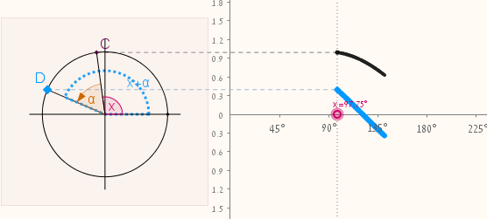
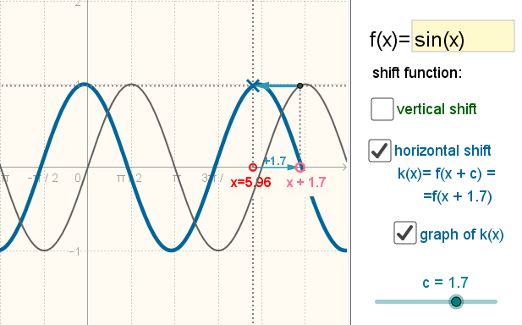
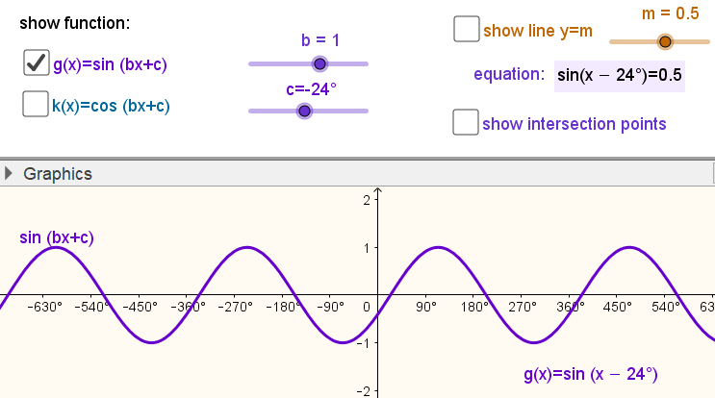
Horizontal and vertical graph transformations
Applet 1:
Applet 2:
Applet 3:
CADGME 2018
Coimbra

Slide 7
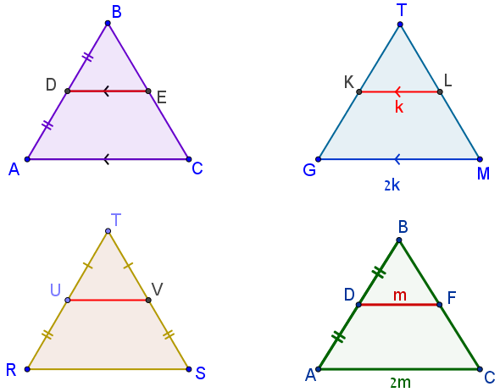
According to the given information, is the red segment necessarily a midsegment? Justify your answers.
Applet 4:
CADGME 2018
Coimbra

Slide 8
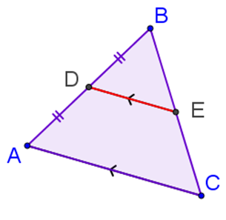
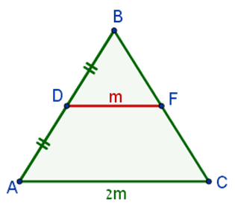
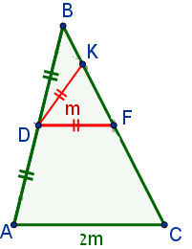
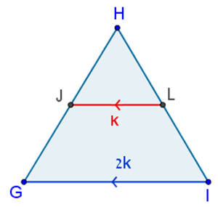
INVERSE ARGUMENT 3
If a segment joins the midpoint of one side of a triangle with a point on another side and is equal to half the length of the third side, this segment is a midsegment.
INVERSE ARGUMENT 2
If a segment joins the midpoint of one side of a triangle with a point on another side and is parallel to the third side, this segment is a midsegment.
THEOREM
The midsegment between two sides of a triangle has two properties:
It is parallel to the third side;
It equals half the length of the third side.
INVERSE ARGUMENT 1
If a segment joining points on two sides of a triangle is parallel to the third side and equal to half its length, this segment is a midsegment.
Not True!
Applet 5:
INVERSE ARGUMENTS:
CADGME 2018
Coimbra

Slide 9
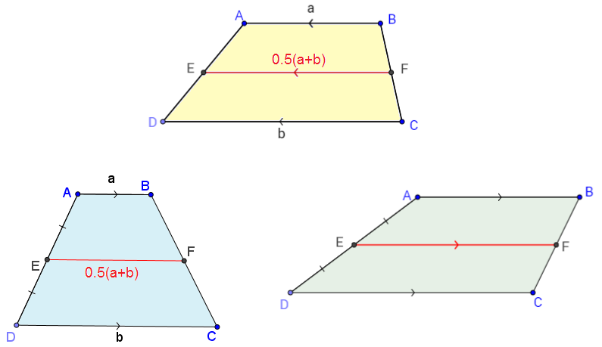
Is this a midsegment? Justify your answer.
Didactical purpose - Accumulated knowledge
CADGME 2018
Coimbra

Slide 10
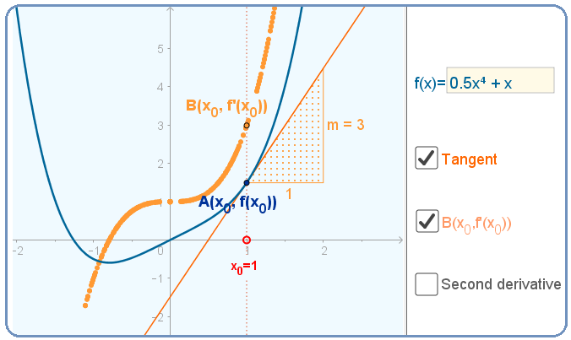
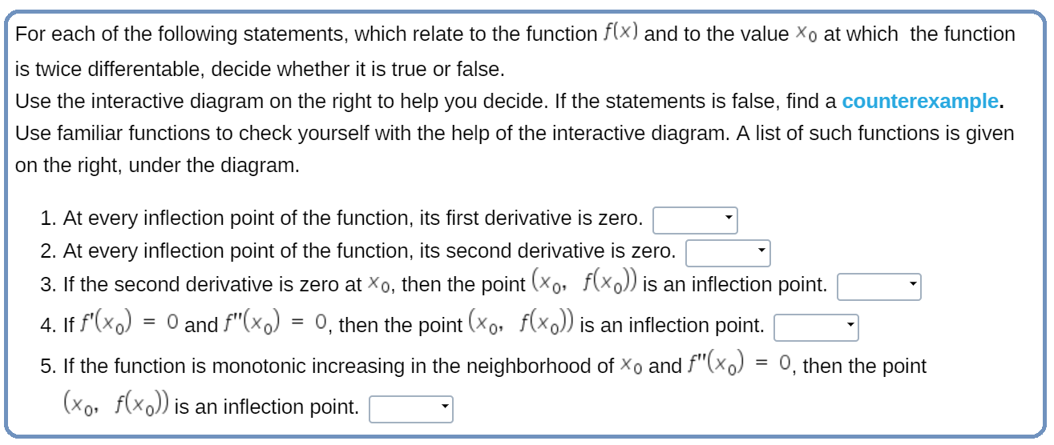
Applet 6: The connection between the graph of function
and the graphs of its derivatives
Didactical purpose - The reflective process regarding errors including inventing counter-examples
CADGME 2018
Coimbra

Slide 11
Conclusions
Digital tools open thousands of new ways to help our students, provoke their thinking, and develop their mathematical understanding.
Nevertheless, uncontrolled usage of digital tools might lead to bad habits and prevent our students from developing desirable habits of mathematical reasoning.
The digital tools we have shown, as well as the considerations we have mentioned, are merely examples. Each one of you could undoubtedly come up with some other considerations, now or in the future.
CADGME 2018
Coimbra

Slide 12
The applets that were presented today are developed by CET.
You are warmly invited to visit us at Challenge 5
Thank you for your attention
CADGME 2018
Coimbra

