Slide 1
Subject-specific components in dynamic geometry software
CADGME 2018
Djordje Herceg¹, Davorka Radakovic¹,
Dejana Herceg², Vera Herceg Mandić³
¹⁾ Department of Mathematics and Informatics,
Faculty of Science, University of Novi Sad
²⁾ Faculty of Engineering, University of Novi Sad
³⁾ Jovan Jovanović Zmaj Secondary School, Novi Sad

Slide 2
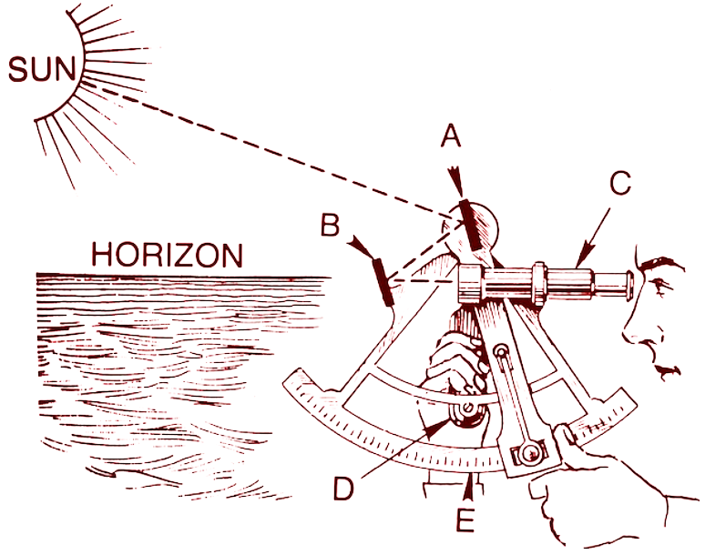
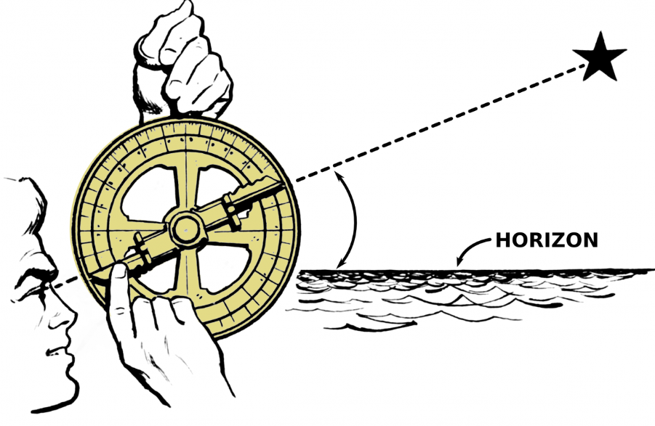
Motivation in Geography
The Age of Discovery
Advances in science and naval instruments led to more accurate mapping and systematic exploration.
Sextant and Astrolabe

Slide 3
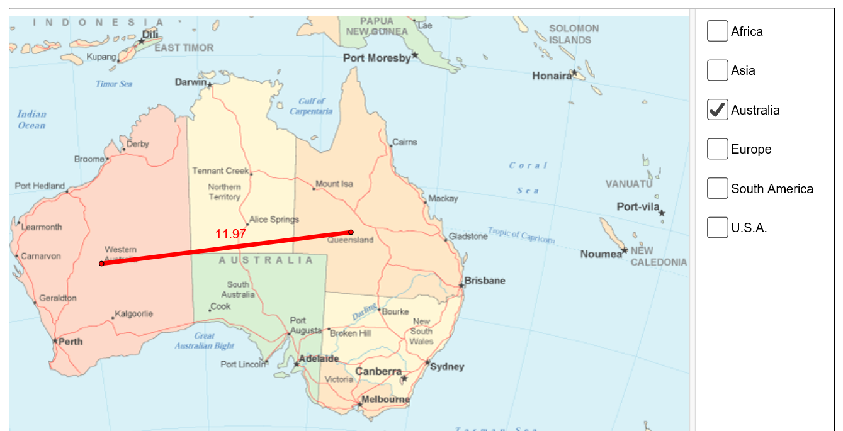
DGS in a Geography class
Tracking the voyages of the great explorers – Ferdinand Magellan and James Cook
Maps are bitmap images
Points, polylines and polygons are placed on maps
https://www.geogebra.org/m/kBB3KSeC

Slide 4
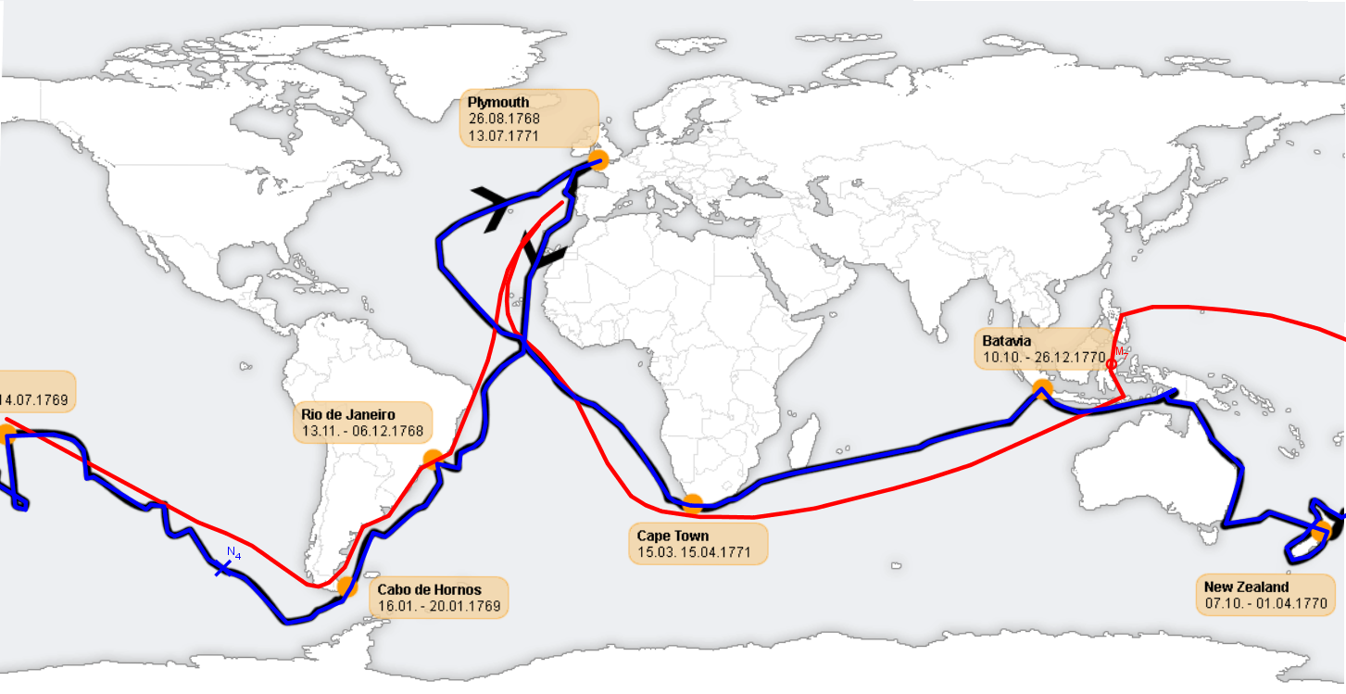
Voyages of Magellan and Cook

Slide 5
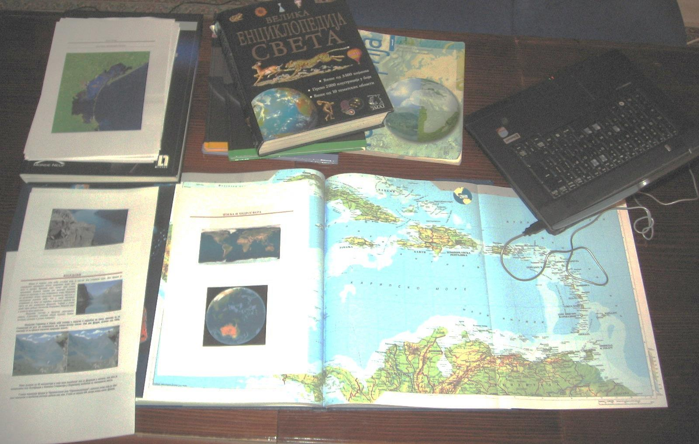
Open-ended problems in teaching

Slide 6

Students at work

Slide 7
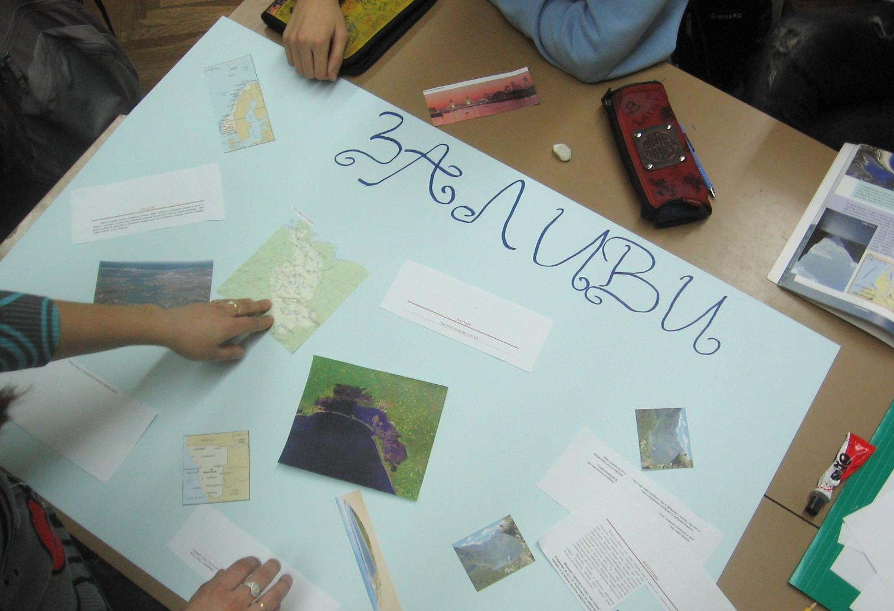
Students at work

Slide 8
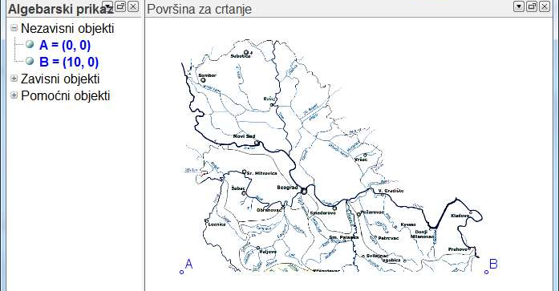
Measuring a river’s length

Slide 9
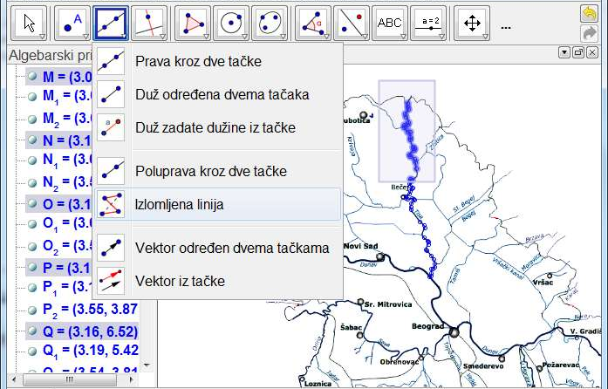
Tracing the river

Slide 10
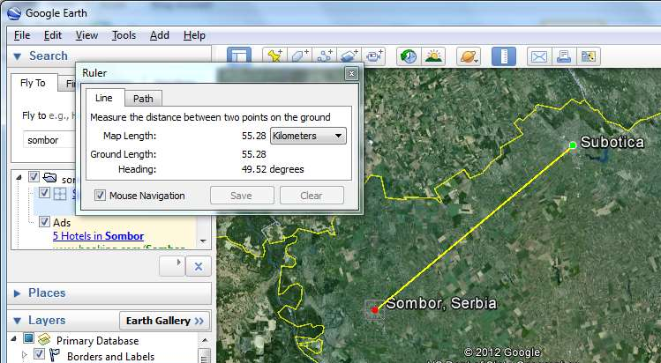
Finding the correct scale

Slide 11
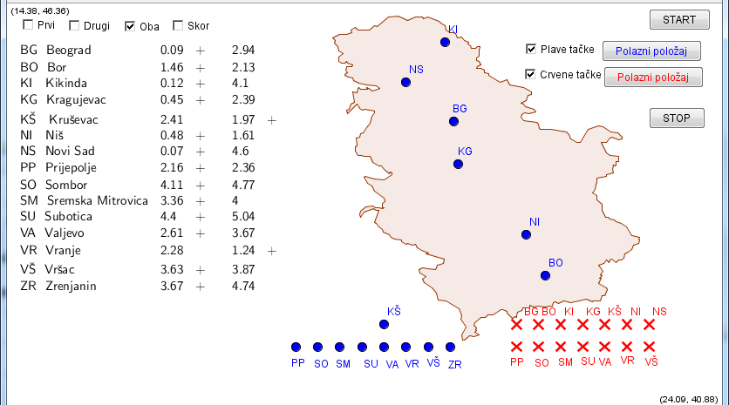
Game – Guess the city

Slide 12
Geographic data in GeoGebra
Geometric shapes represent geographic objects
Polygons for borders
Polylines for rivers and roads
Points for cities and other places
Sometimes drawn on top of pictures of maps
How do we know where to place them?

Slide 13
Issues
Teachers create their own maps
Accuracy and detail are difficult to achieve
Long lists of points typed in by hand or copied from files
Correspondence between geographic and geometric coordinates is questionable
Tedious and repetitive process
One map may consist of many objects in DGS
Semantics is lost

Slide 14
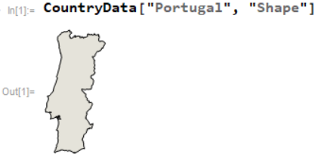
How Mathematica does it
In Mathematica, geographic data is obtained from a data server.
Due to large sizes, only the required subset is transferred.

Slide 15
Proposed solution
Use actual geographic data
The data for geographic drawings is:
  manually entered,
  read from a file, or
  obtained from an Internet service.
Introduce a function that emits the relevant data
A few changes are required in the DGS language
New object model is introduced
Calculation optimizations need to be implemented
SLGeometry

Slide 16
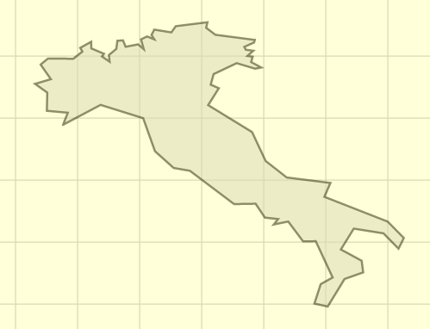
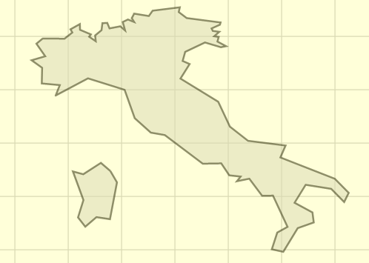
The Country function
Country(<name>, <part>) returns a list of points which represents a border
  italy = Country("Italy", 0)
  italy.$Visible = false
  pitaly = Polygon(italy)
  italy1 = Country("Italy", 1)
  italy1.$Visible = false
  pitaly1 = Polygon(italy1)

Slide 17
The City function
City(<name>, <index>) returns a point which represents the location of a city
  ns = City("NoviSad", 0)
  bg = City("Belgrade", 0)
  zh = City("Zurich", 0)
  li = City("Lisbon", 0)
  co = City("Coimbra", 0)
  path = Polyline({ns, bg, zh, li, co})
  sw = Country("Switzerland", 0)
  sw.$Visible = false
  psw = Polygon(sw)

Slide 18
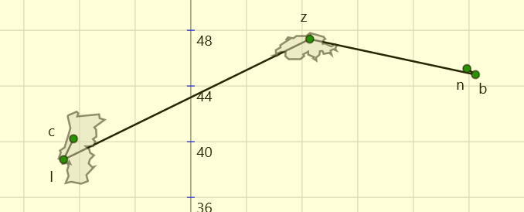
The result

Slide 19
The object model
Functions return objects which have properties
The usual way of calculating property values is to use separate functions
Identifier set is cluttered with many functions which target very specific objects
Example: Triangle has dozens of properties -> numerous functions are needed
The solution? Full object model!
Each object carries all its properties within itself

Slide 20
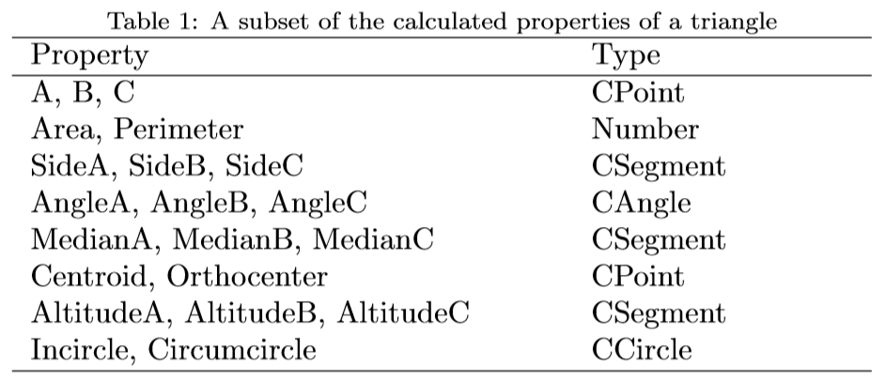
Example – the triangle

Slide 21
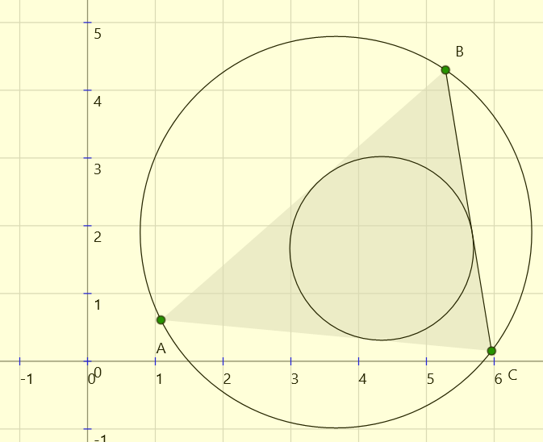
Dot notation
Dot notation is introduced to facilitate access to properties of objects
Property(object) becomes Object.Property
  t = Triangle(A, B, C)
  tsa = t.SideA
  tic = t.Incircle
  tcc = t.Circumcircle

Slide 22
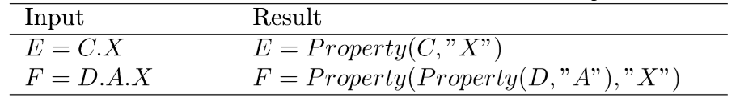
Property activation
Properties of objects can themselves be new objects with their sets of properties
References to properties can go arbitrarily deep
Only the referenced properties of objects are calculated.
A new property instantiation and activation mechanism was implemented to keep the calculation times reasonable

Slide 23
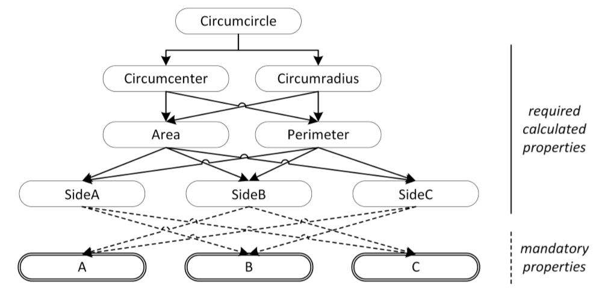
Property dependencies

Slide 24
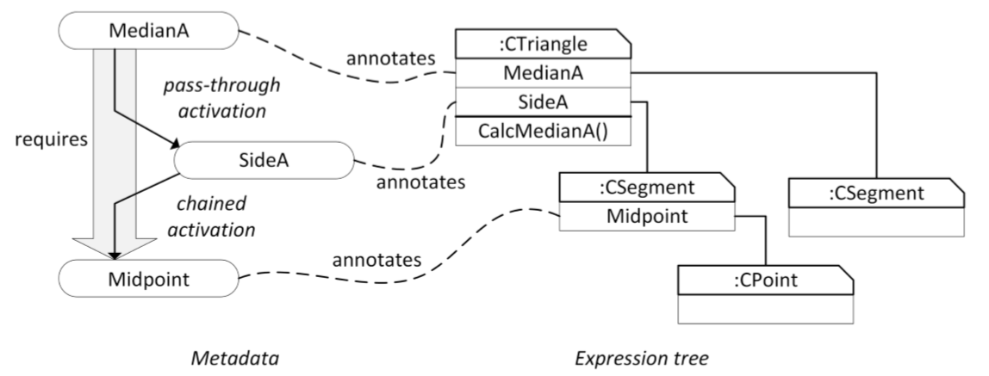
Chained property activation
Radaković, D., Herceg, Đ., Towards a completely extensible dynamic geometry software with metadata, Computer Languages, Systems & Structures 52 (2018) 1-20

Slide 25
Property expressions
Properties can be controlled by expressions
Great for interactivity
Dynamic properties can be indicators in visual tasks
For example, a point can change color, size or shape as it approaches the hidden city
p.Size = <expression1>
p.Shape = <expression2>

Slide 26
Current state of development
Theoretical foundations are in place
Computational engine is implemented
The object model and property activation infrastructure works
User interface needs more development
Component development guidelines and instructions need to be completed and published
We need developers!

Slide 27
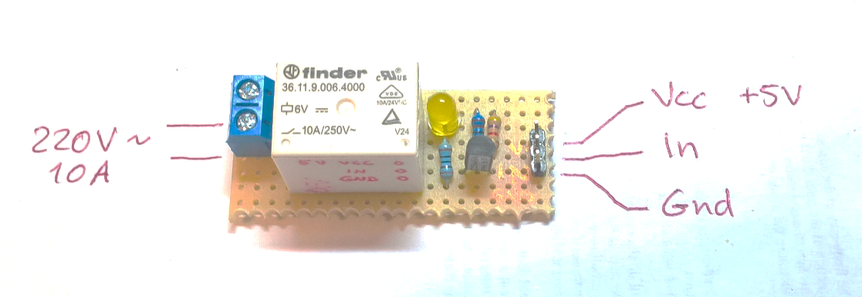
Arduino and DGS
Connect real hardware to computer simulations
Use microcontroller-based circuits as inputs
Control switches, screens, radios and actuators from a DGS simulation

Slide 28
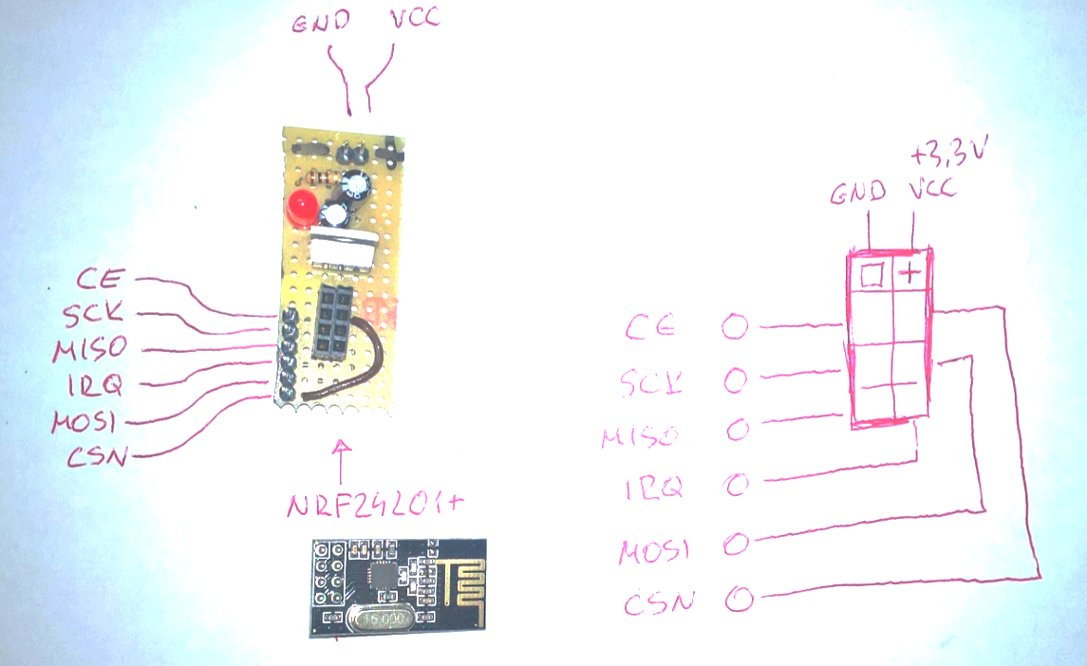
Planning, documenting and implementing

Slide 29
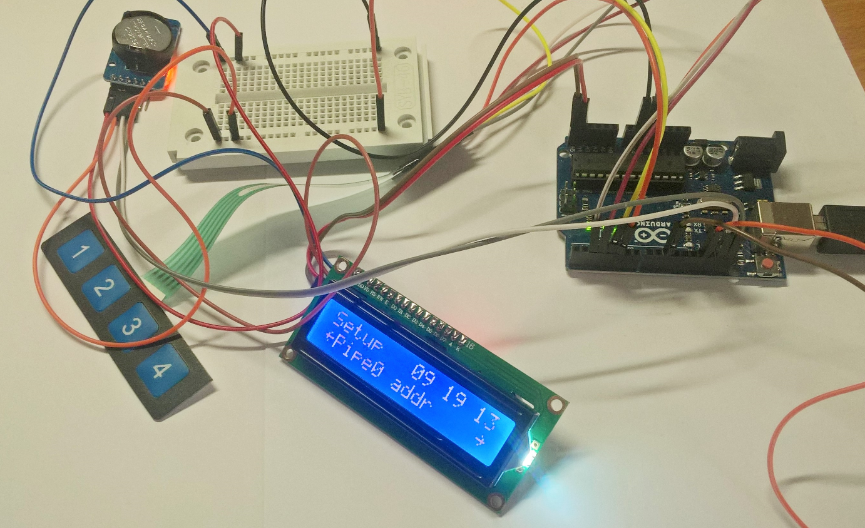
Building prototypes

Slide 30
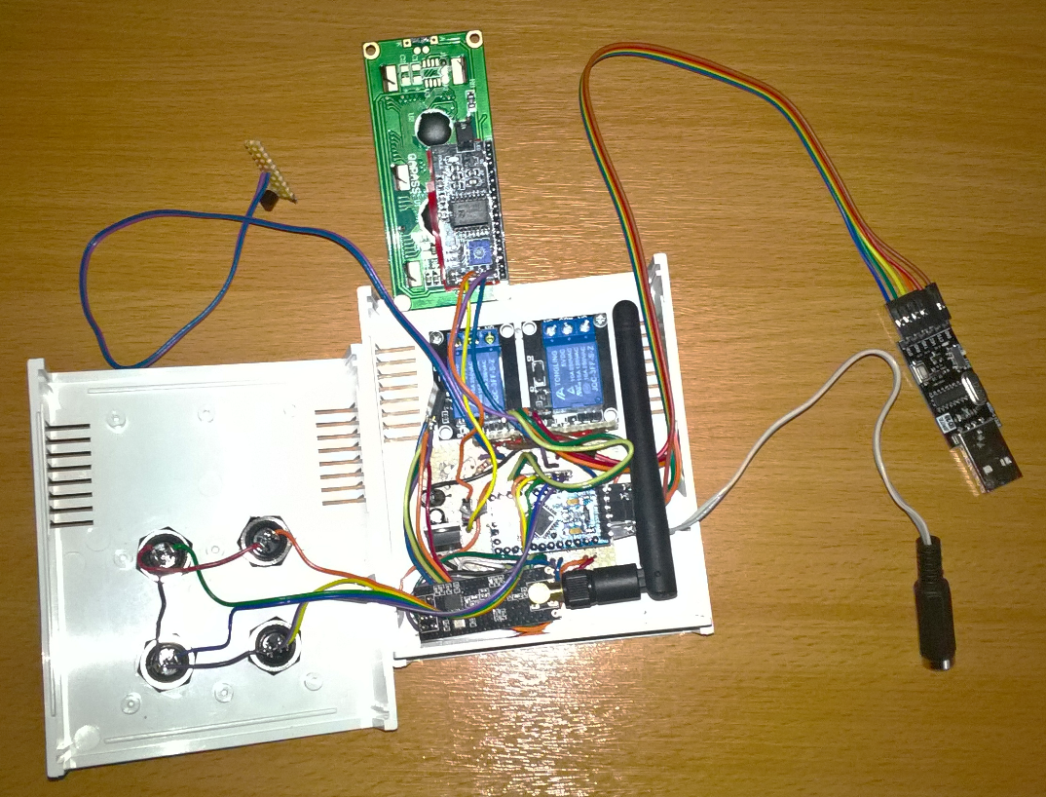
Connecting to the Computer

Slide 31
Conclusions
Introducing objects with properties into the DGS
A natural way of addressing properties
However, evaluation becomes complex
Data can be obtained from various sources, files, databases or internet services
As a consequence, we obtained dynamic properties
Another consequence is the ability to connect microcontroller devices, such as Arduino
BUT we still need developers

Slide 32
Thank you for your attention

