Slide 1

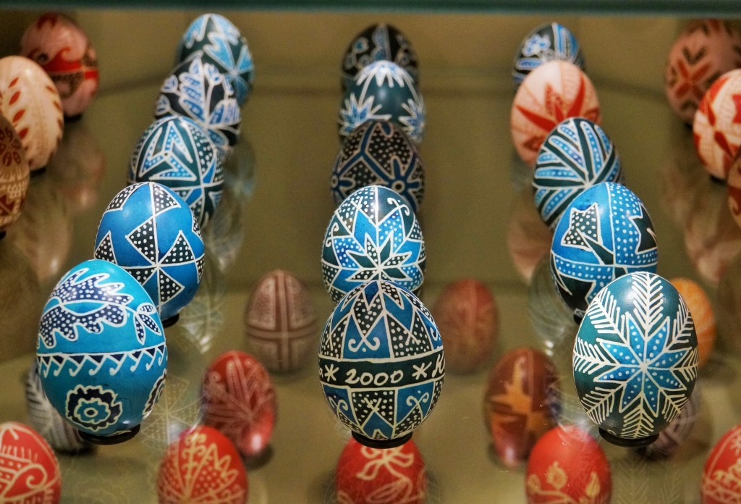
Traditional Patterns of Easter Eggs in the Carpathian Basin and Spherical Symmetries (Illustrating Spherical Symmetries in GeoGebra)
Eleonóra Stettner
Kaposvár University
Rózsa Nienhaus
Egg Art Museum Zengővárkony
CADGME - Conference on Digital Tools in Mathematics Education﻿
25-29 June 2018
University of Coimbra, Portugal

Slide 2
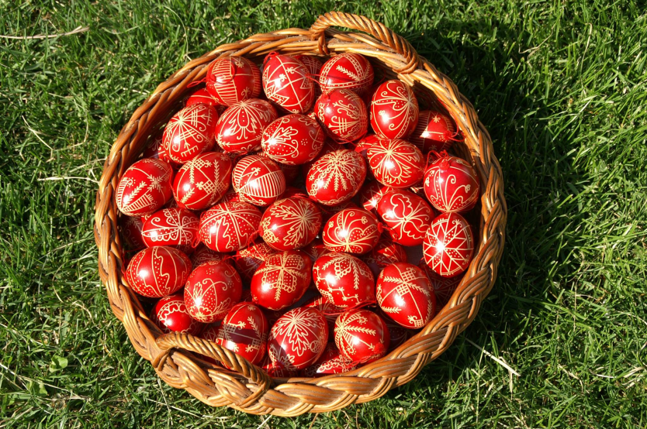
Contents
1. Introduction – Art on egg
2. Spherical symmetries → the original ancient egg motifs
which occur frequently
which occur rarely
which of them cannot be found
3. Visualisation of spherical symmetries in GeoGebra

Slide 3
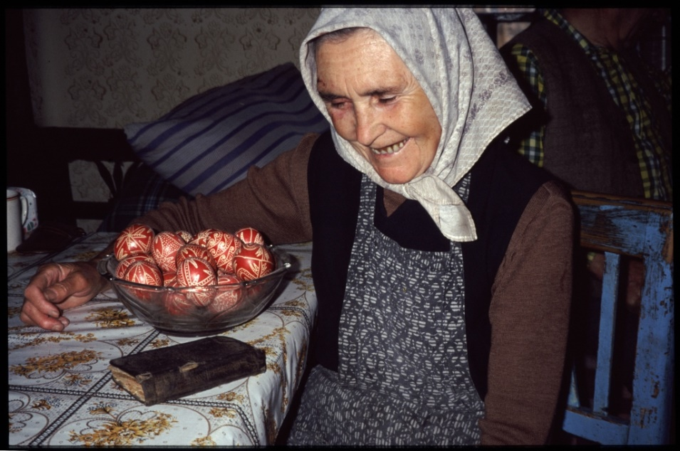
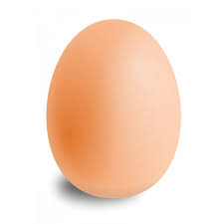
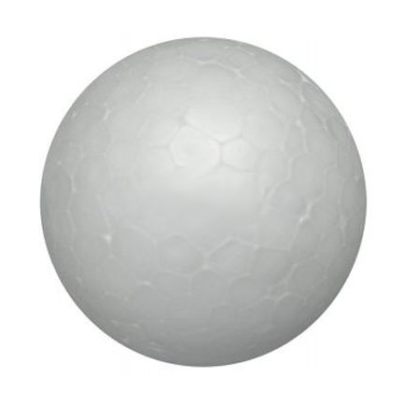
Old folk tradition →in connection with the Easter holiday
→ the custom of decorating eggs
Eggs and sphere → topologically equivalent

Slide 4
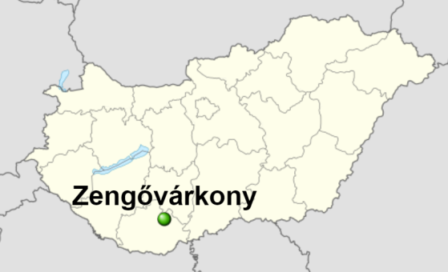
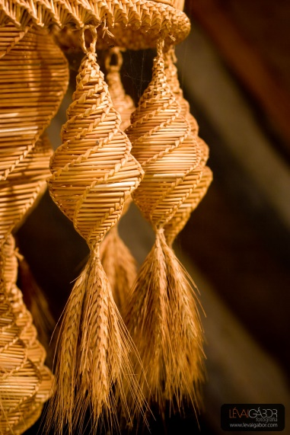
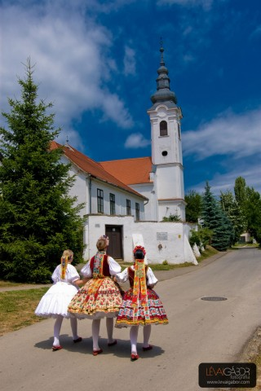
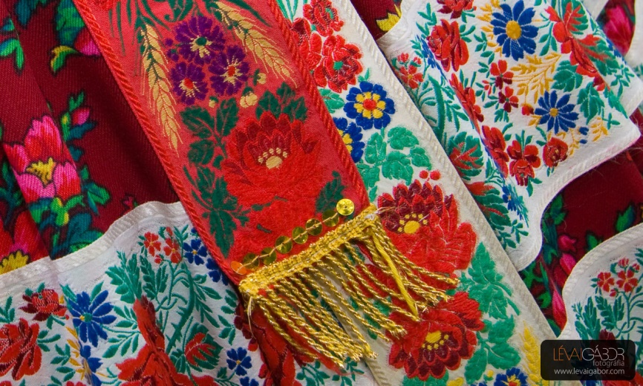
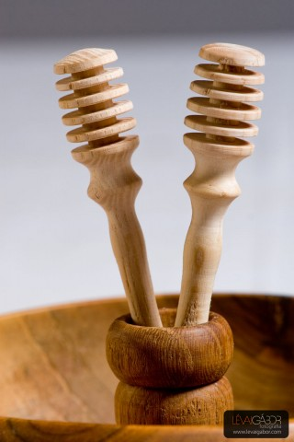
Zengővárkony is located in the south of Hungary, in the Mecsek mountains. It is a small village with rich folk art traditions.

Slide 5
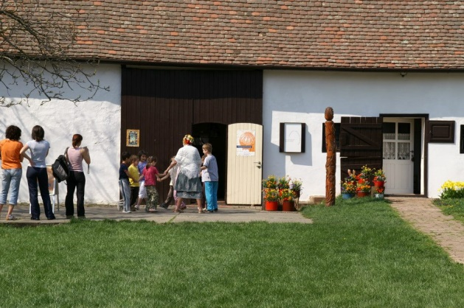
Since 16 April 2000 there has been a permanent exhibition here the Egg Art Museum „Míves Tojás Múzeum”, which displays decorated eggs.

Slide 6
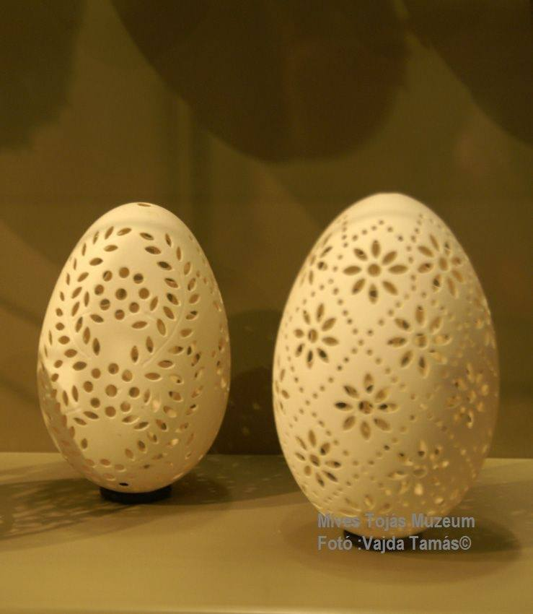
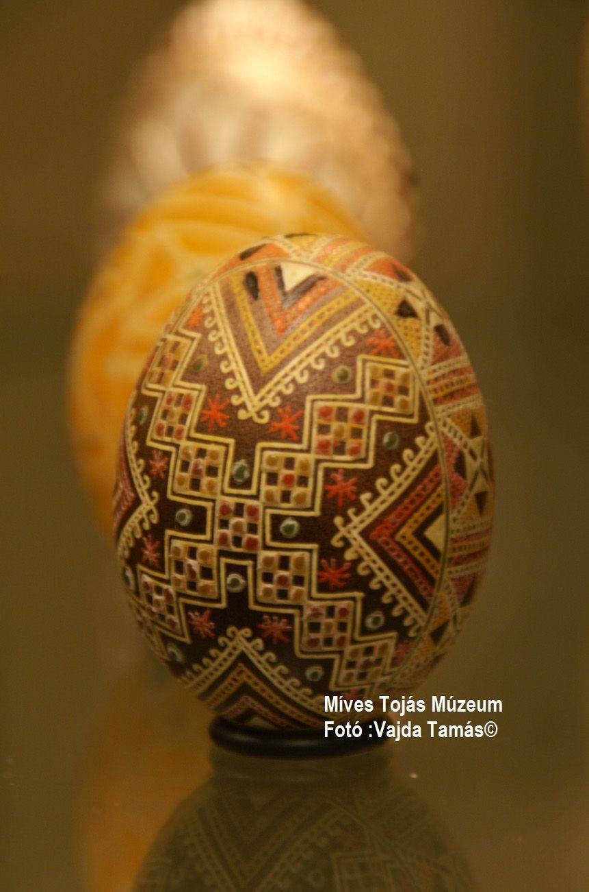
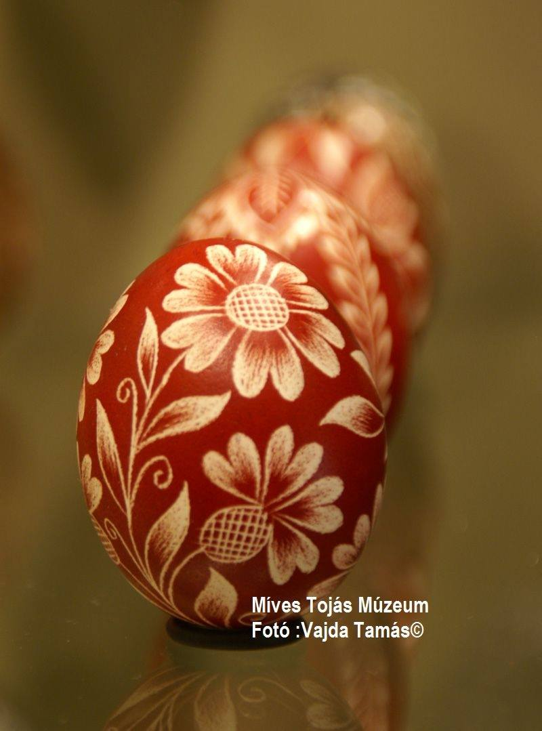
The decorated egg is fragile magic: a fragile egg is painted with symbols of the all-powerful universe and nature, the natural habit of Man.
The aims of the museum are to show the folk traditions of decorating eggs and to collect relevant items.
One can see here nearly 5,000, mostly painted, carved and waxed eggs, from 55 regions of 21 countries.

Slide 7
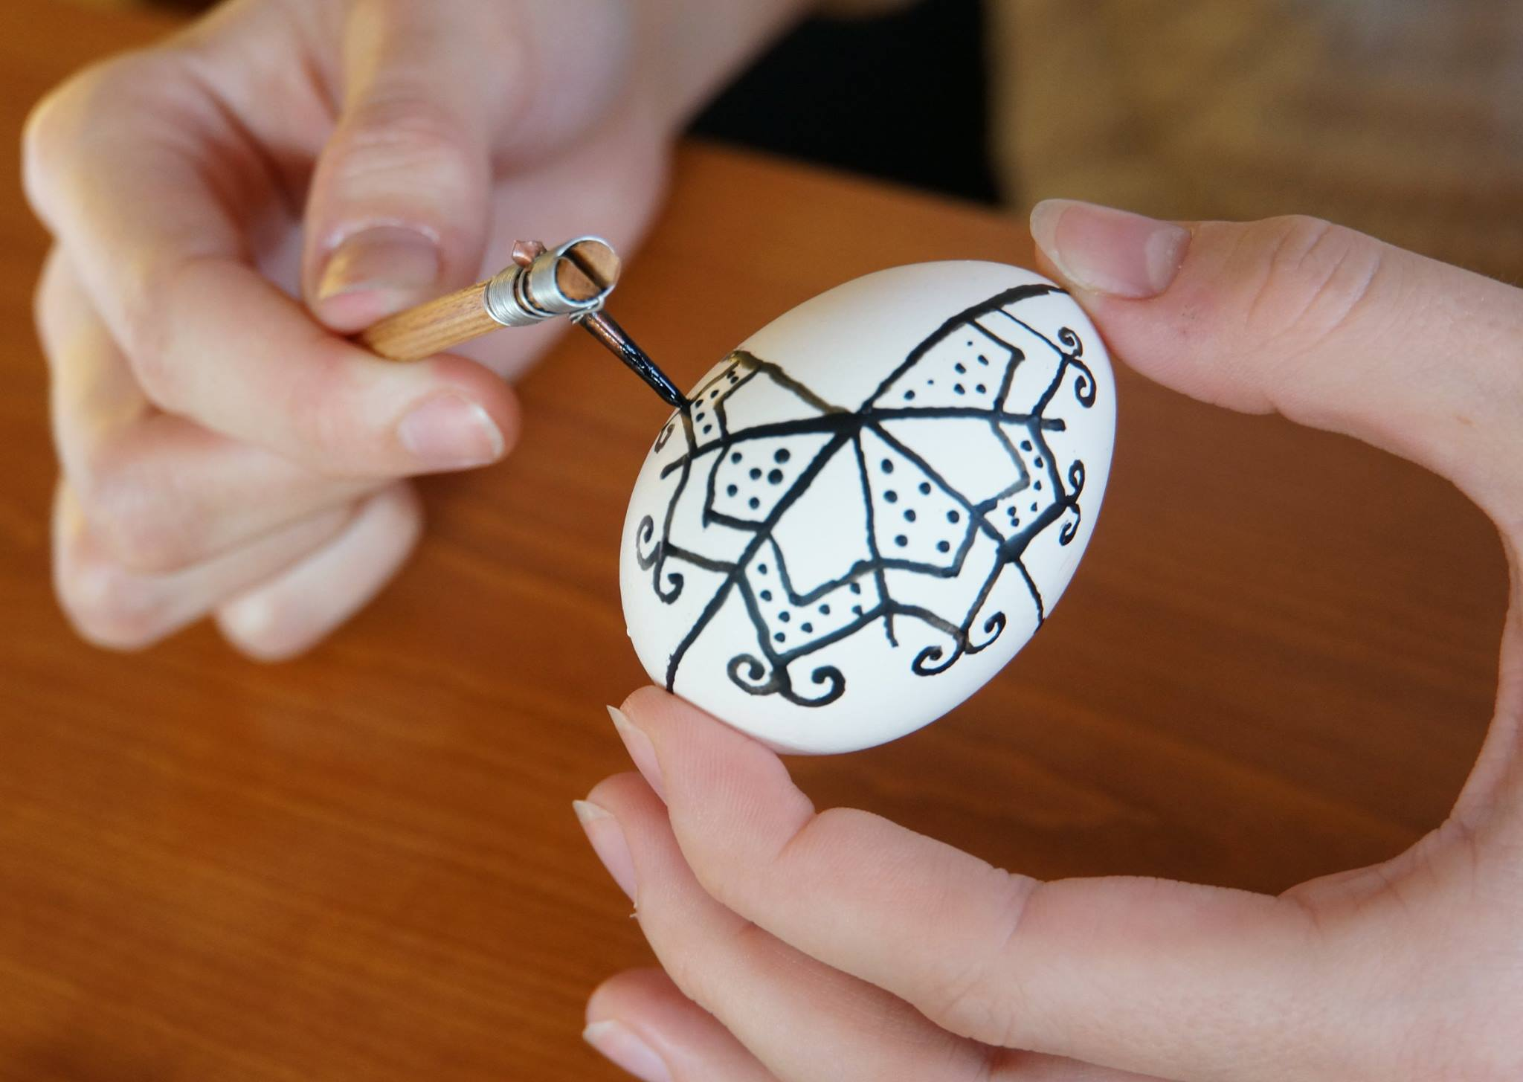
One of the most frequently used decoration methods is drawing with wax. With the help of a special device (íróka, gica) we draw patterns on the surface of the egg using melted wax.

Slide 8
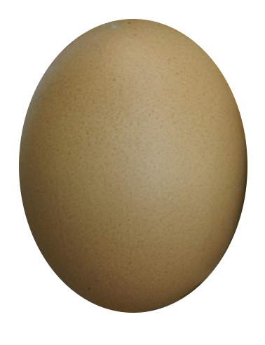
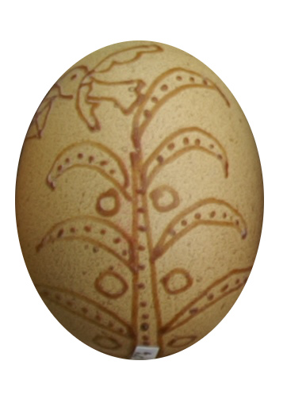
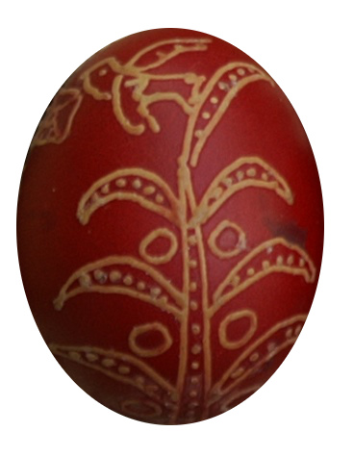
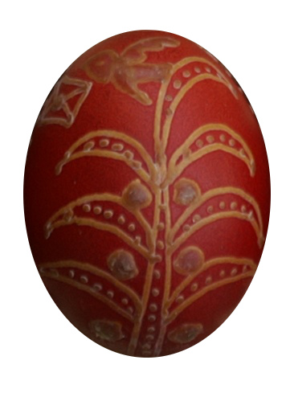
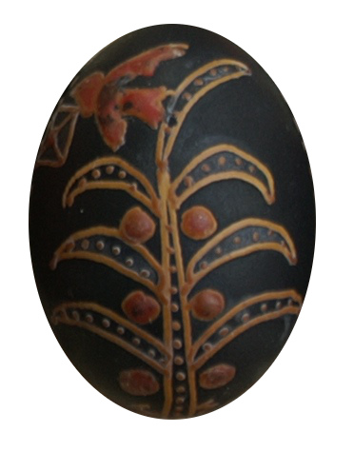
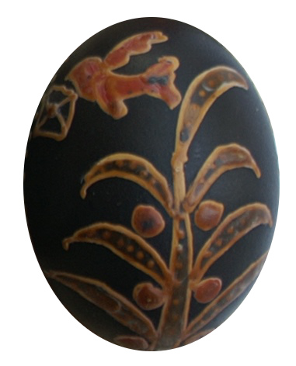
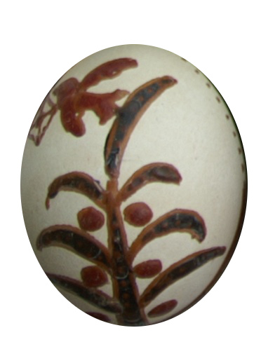
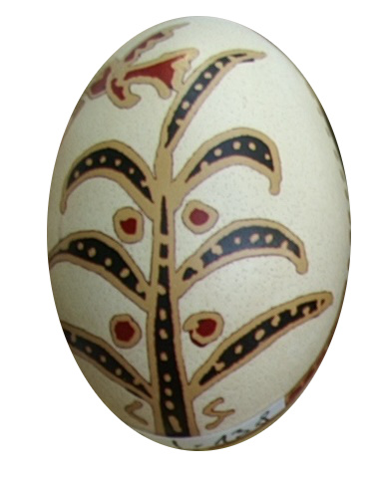
We can color the parts that are left out by putting the egg in paint. Then we dry the egg. We can have 2 options: we either leave the wax on the surface, or remove it. If we repeat this method, we can get more colorful compositions.
Notes:
The steps of the method can be seen here: pattern drawn with wax, painted in red, the part which remains red is covered with wax, then painted in black, the part which remains black is covered with wax, the black base is pickled with some acid, the wax is wiped off, the egg is ready
The richest symmetry have those painted eggs, which was made with this method (using wax) so I speak only about it.

Slide 9
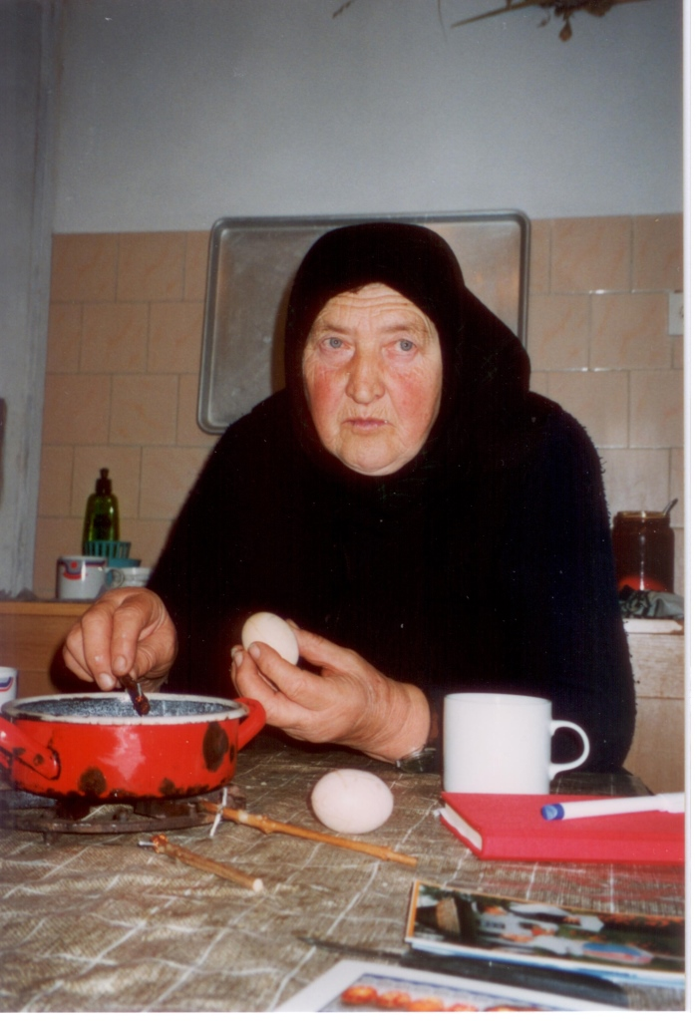
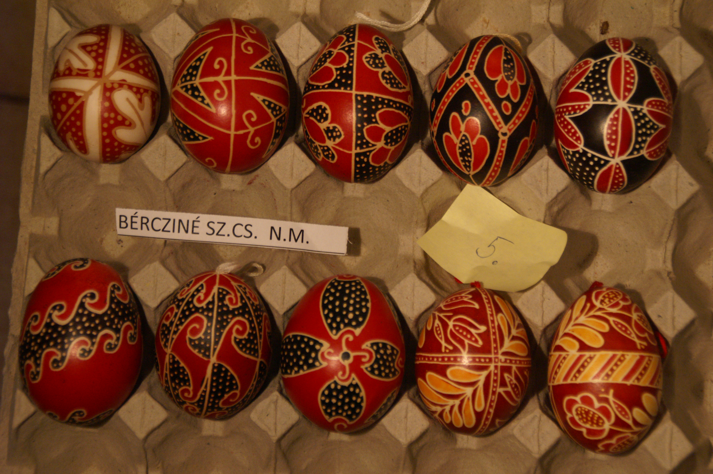
The lost passenger „utaveszett” pattern
Notes:
Eggs were painted on Good Friday or Holy Thursday. First, they took the egg in their hand, stroked it, and so decided what pattern to put on it.
The hardest, most complicated pattern was the lost passenger, it was drawn in total silence, focusing attention.

Slide 10
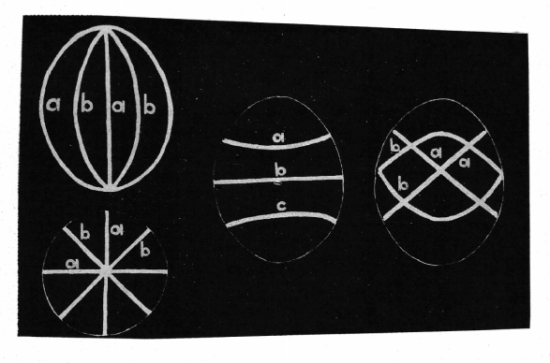
The spherical symmetry groups and the egg motifs
10 is on the egg
14
4 not
One of the possible explanations is the surface dividing
line system
Notes:
The spherical symmetry groups have an infinite number of elements, which can be divided into 14 groups.
I found egg motifs for 10 symmetry groups but for 4 I could not.
One of the possible explanations is the surface dividing line system, some of them can be seen here.

Slide 11
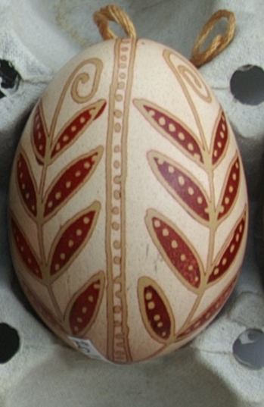
Rotation symmetries
NN group, the order of group N
here N = 4
2 centers of rotation
The order of rotational centers 4
4 element symmetry group
Notes:
I found the list of the symmetry groups and the pictures of the spherical symmetry in the book The Symmetries of Things written by Professor John H. Conway, Heidi Burgiel, Chaim Goodman-Strauss

Slide 12
22N group
The order of group 2N
Here 226, the group order 12

Slide 13
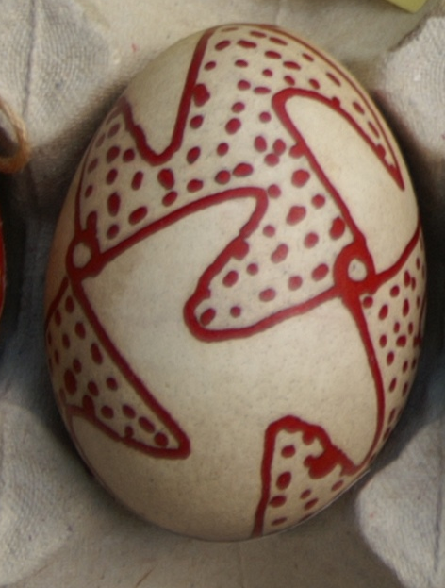
332 group
Rotational centers – 3, 3, 2
12 element symmetry group
Notes:
It is a very nice and interesting pattern. The egg is covered with closely equivalent shapes, like Escher paintings.

Slide 14
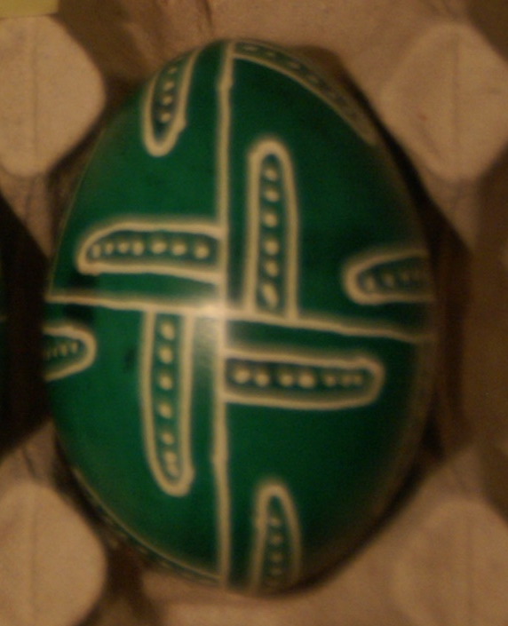
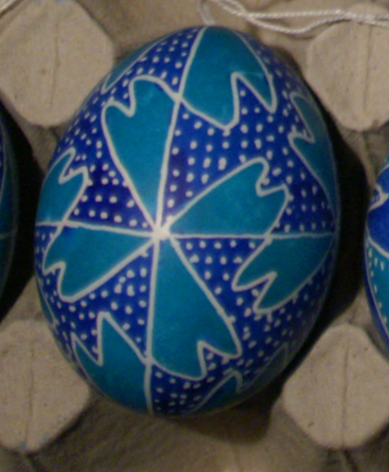
432 group
Rotational centers – 4, 3, 2
24 element symmetry group

Slide 15
?
532 group, 60 elements
Notes:
I did not find this symmetry among egg patterns.

Slide 16
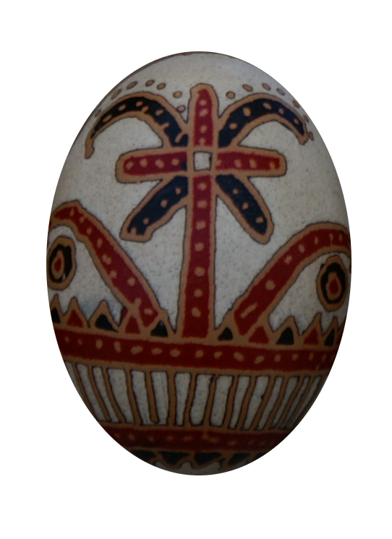
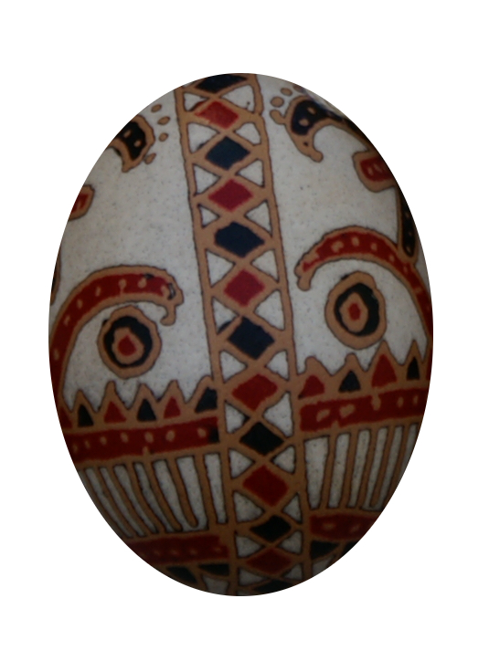
Reflection symmetries
*NN group, 2N elements
Here N = 2 axes
4 element symmetry group

Slide 17
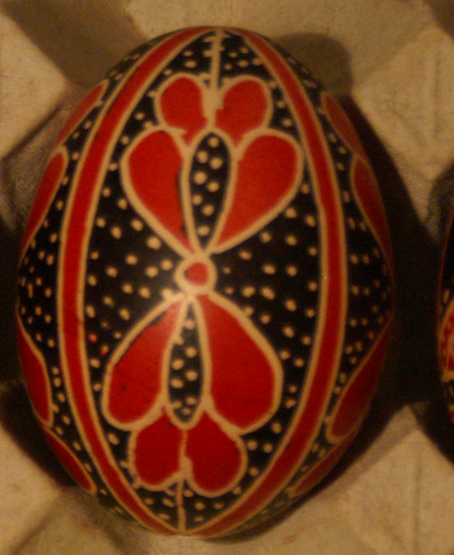
*22N group, 4N element symmetry group
*224, 16 element symmetry group

Slide 18
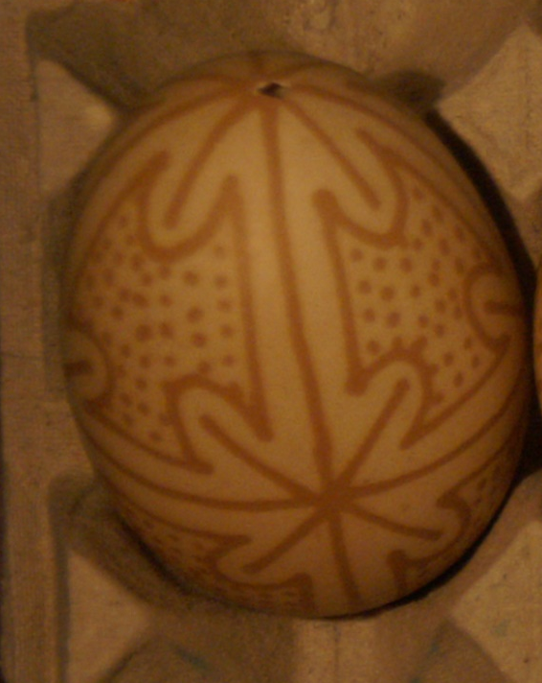
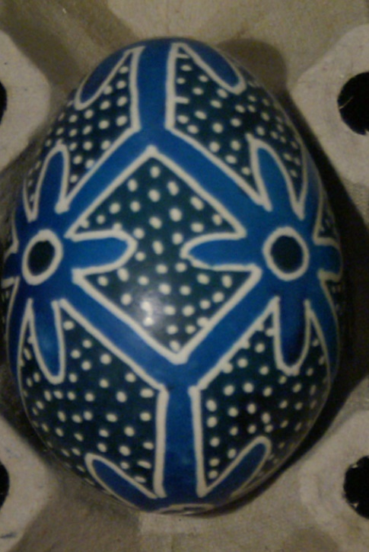
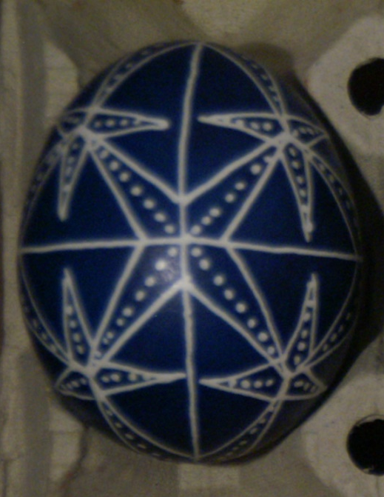
*432, 48 element group
Notes:
This symmetry group often occurs on eggs. We can see 3 very nice example here.

Slide 19
?
*532, 120 element group

Slide 20
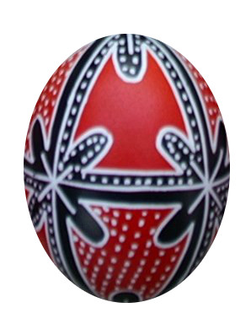
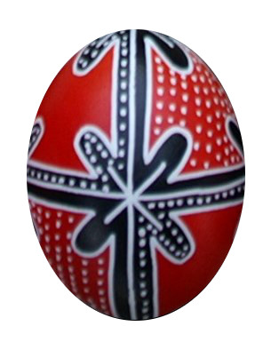
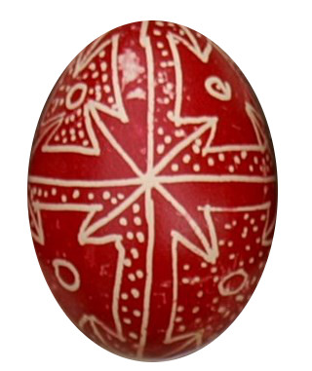
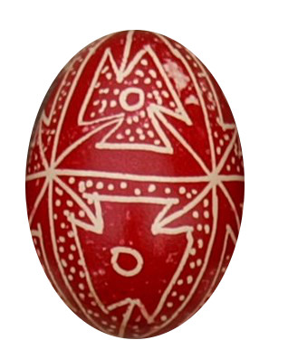
*332, 24 element group

Slide 21
Groups containing Rotational and reflection symmetries
?
3*2, 24 element symmetry group
?
N*, 2N element symmetry group

Slide 22
2*N, 4N element group
2*3, 12 element group

Slide 23
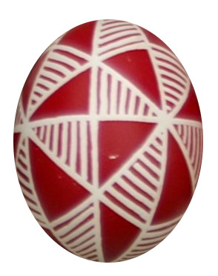
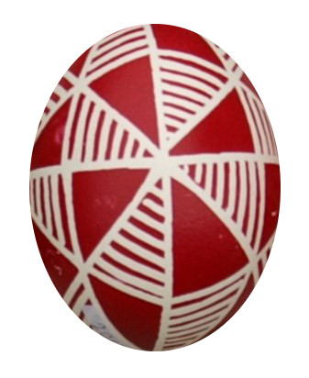
Groups containing Rotational and slide reflection symmetries
Nx, 2N element group
4x, 8 element group

Slide 24
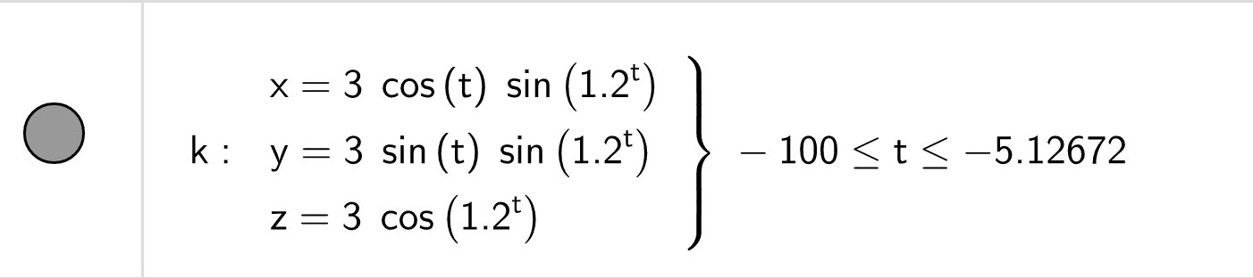
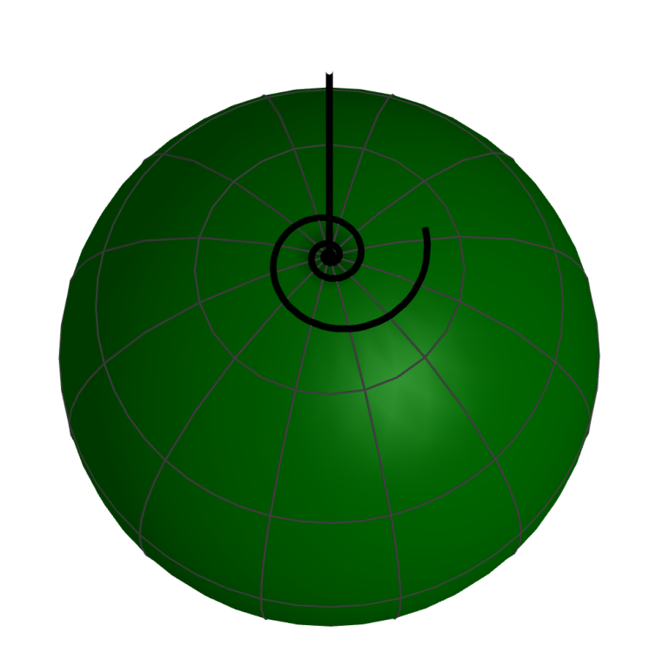
Spherical symmetries in GeoGebra
Notes:
As long as I saw only drawings of painted egg patterns, I was never sure about their symmetries. I did not know what on their backs sides could be. I've brought some eggs here and we can hold them and rotate them and so we can talk now about their symmetry.
I wanted to do this with spherical symmetries, so I made them in GeoGebra.
I searched patterns, which have no inner symmetry. I've tried several different functions. Finally, I chose the exponential one.
This became a nice spiral. The smaller the base is, the more winding the spiral is.

Slide 25
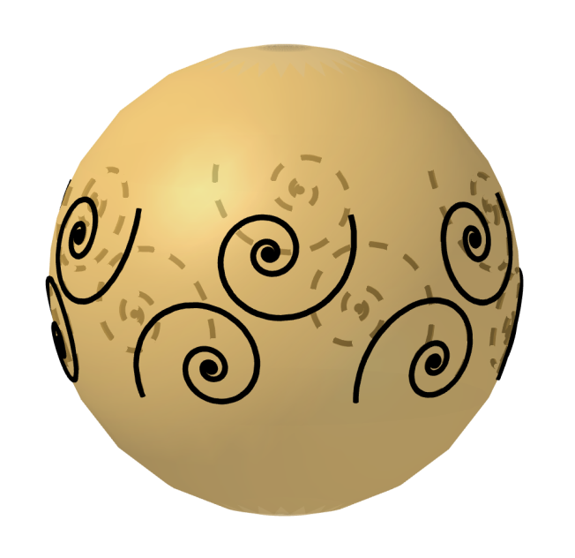
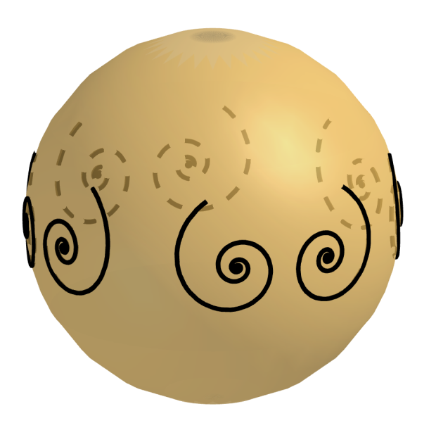
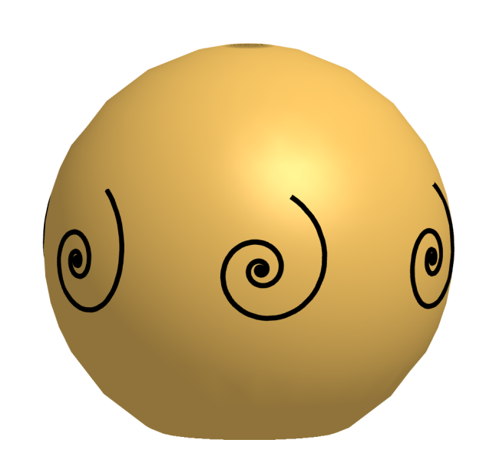
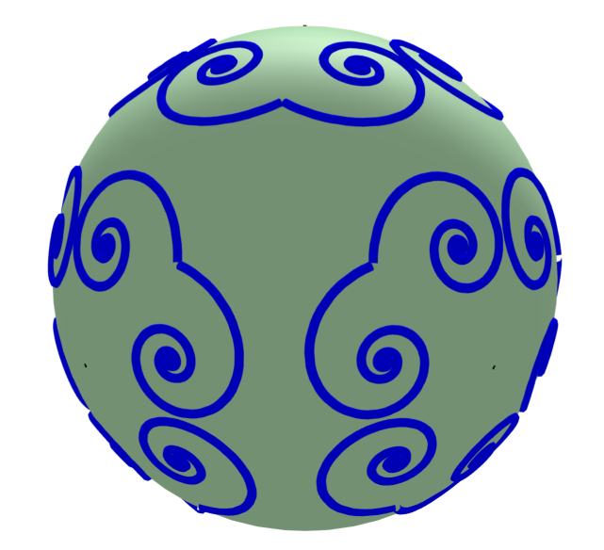
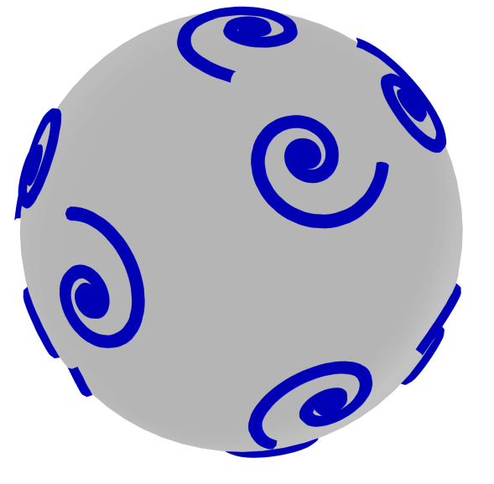
22N
*NN
NN
*332
332
Notes:
Then I twisted this spiral around an appropriate straight line and reflected it to the appropriate plane according to the spherical symmetries. Here are some examples. The problem is that if we draw too many spirals in the geogebra, the program is too slow or crashes. It is likely that a simpler line should be tried.

Slide 26
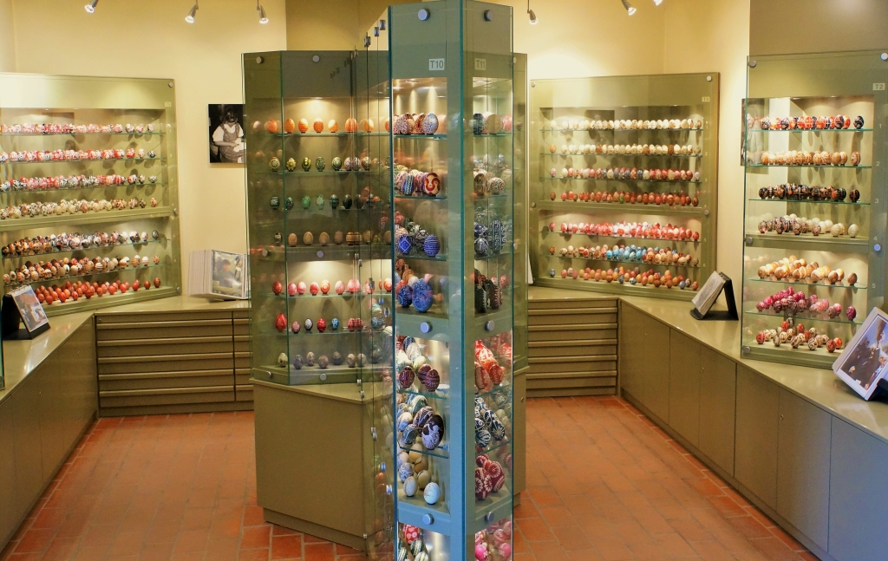
Thank you for your attention!

