Slide 2

SCHOOL OF EDUCATION

Slide 3
SCHOOL OF EDUCATION

Slide 4
SCHOOL OF EDUCATION
Robert Weinhandl
Teacher training for the Flipped Classroom Approach in secondary mathematics education in Austria

Slide 5
SCHOOL OF EDUCATION
Robert Weinhandl
Teacher training for the Flipped Classroom Approach in secondary mathematics education in Austria

Slide 6

SCHOOL OF EDUCATION
Robert Weinhandl
Teacher training for the Flipped Classroom Approach in secondary mathematics education in Austria

Slide 7
SCHOOL OF EDUCATION
Teacher training for the Flipped Classroom Approach in secondary mathematics education in Austria
Robert Weinhandl
Learning and teaching is a complex and difficult task.

Slide 8
SCHOOL OF EDUCATION
Teacher training for the Flipped Classroom Approach in secondary mathematics education in Austria
Robert Weinhandl
Learning and teaching is a complex and difficult task.
Rarely becomes easier when mathematics is at the centre of the learning process
and new digital technologies and modern didactics are to be applied.

Slide 9
SCHOOL OF EDUCATION
Teacher training for the Flipped Classroom Approach in secondary mathematics education in Austria
Robert Weinhandl
Learning and teaching is a complex and difficult task.
But…
Rarely becomes easier when mathematics is at the centre of the learning process
and new digital technologies and modern didactics are to be applied.

Slide 10
SCHOOL OF EDUCATION
Teacher training for the Flipped Classroom Approach in secondary mathematics education in Austria
Robert Weinhandl
But…
Learning and teaching is a complex and difficult task.
Rarely becomes easier when mathematics is at the centre of the learning process
and new digital technologies and modern didactics are to be applied.

Slide 11
SCHOOL OF EDUCATION
Teacher training for the Flipped Classroom Approach in secondary mathematics education in Austria
Robert Weinhandl
But…
Learning and teaching is a complex and difficult task.
Using these new technologies and offering modern didactics is both a necessity and a duty of a teacher in the 21st century.

Slide 12
SCHOOL OF EDUCATION
Teacher training for the Flipped Classroom Approach in secondary mathematics education in Austria
Robert Weinhandl
But…
Learning and teaching is a complex and difficult task.
Using these new technologies and offering modern didactics is both a necessity and a duty of a teacher in the 21st century.
Necessity because learning has evolved from pure repetition to the application of knowledge and the independent creation of skills, and because these very skills are needed by the students in later life.

Slide 13
SCHOOL OF EDUCATION
Teacher training for the Flipped Classroom Approach in secondary mathematics education in Austria
Robert Weinhandl
But…
Learning and teaching is a complex and difficult task.
Using these new technologies and offering modern didactics is both a necessity and a duty of a teacher in the 21st century.
Necessity because learning has evolved from pure repetition to the application of knowledge and the independent creation of skills, and because these very skills are needed by the students in later life.
Obligatory because the use of modern technologies and modern forms of learning are reflected in curricula in Austria and because the decree on digital basic education will come into force with the academic year 2018/19.

Slide 14
But…
SCHOOL OF EDUCATION
Teacher training for the Flipped Classroom Approach in secondary mathematics education in Austria
Robert Weinhandl
But…
Learning and teaching is a complex and difficult task.
Using these new technologies and offering modern didactics is both a necessity and a duty of a teacher in the 21st century.
Necessity because learning has evolved from pure repetition to the application of knowledge and the independent creation of skills, and because these very skills are needed by the students in later life.
Obligatory because the use of modern technologies and modern forms of learning are reflected in curricula in Austria and because the decree on digital basic education will come into force with the academic year 2018/19.
Obligatory
Necessity

Slide 15
SCHOOL OF EDUCATION
Teacher training for the Flipped Classroom Approach in secondary mathematics education in Austria
Robert Weinhandl
But…
Learning and teaching is a complex and difficult task.
Using these new technologies and offering modern didactics is both a necessity and a duty of a teacher in the 21st century.
But…
Necessity because learning has evolved from pure repetition to the application of knowledge and the independent creation of skills, and because these very skills are needed by the students in later life.
Obligatory because the use of modern technologies and modern forms of learning are reflected in curricula in Austria and because the decree on digital basic education will come into force with the academic year 2018/19.
Obligatory
Necessity

Slide 16
SCHOOL OF EDUCATION
Teacher training for the Flipped Classroom Approach in secondary mathematics education in Austria
Robert Weinhandl
But…
Learning and teaching is a complex and difficult task.
Using these new technologies and offering modern didactics is both a necessity and a duty of a teacher in the 21st century.
But…
Necessity
Obligatory

Slide 17
SCHOOL OF EDUCATION
Teacher training for the Flipped Classroom Approach in secondary mathematics education in Austria
Robert Weinhandl
But…
Learning and teaching is a complex and difficult task.
Using these new technologies and offering modern didactics is both a necessity and a duty of a teacher in the 21st century.
But…
Necessity
Obligatory
The new technologies and didactics will not make it into the Austrian classrooms all by themselves.

Slide 18
SCHOOL OF EDUCATION
Teacher training for the Flipped Classroom Approach in secondary mathematics education in Austria
Robert Weinhandl
But…
Learning and teaching is a complex and difficult task.
Using these new technologies and offering modern didactics is both a necessity and a duty of a teacher in the 21st century.
But…
Necessity
Obligatory
The new technologies and didactics will not make it into the Austrian classrooms all by themselves.
Among other things, this requires well-trained teachers who are convinced of the sense and use of digital technologies and modern forms of learning in mathematics teaching.

Slide 19
SCHOOL OF EDUCATION
Teacher training for the Flipped Classroom Approach in secondary mathematics education in Austria
Robert Weinhandl
But…
Learning and teaching is a complex and difficult task.
Using these new technologies and offering modern didactics is both a necessity and a duty of a teacher in the 21st century.
But…
Necessity
Obligatory
The new technologies and didactics will not make it into the Austrian classrooms all by themselves.
Among other things, this requires well-trained teachers who are convinced of the sense and use of digital technologies and modern forms of learning in mathematics teaching.
One possibility for this is the teacher training, which is the center of my PhD research.

Slide 20
How could the flipped-classroom method to lower secondary school mathematics teachers in Austria be introduced and their understanding of the main flipped-classroom-ideas and –goals developed?
SCHOOL OF EDUCATION
Teacher training for the Flipped Classroom Approach in secondary mathematics education in Austria
Robert Weinhandl
But…
Learning and teaching is a complex and difficult task.
Using these new technologies and offering modern didactics is both a necessity and a duty of a teacher in the 21st century.
But…
Necessity
Obligatory
The new technologies and didactics will not make it into the Austrian classrooms all by themselves.
Among other things, this requires well-trained teachers who are convinced of the sense and use of digital technologies and modern forms of learning in mathematics teaching.
One possibility for this is the teacher training, which is the center of my PhD research.
Research Question:

Slide 21
What kind of difficulties and problems (pedagogical, mathematical and technical) do lower secondary school mathematics teachers in Austria encounter while conducting flipped-classroom teaching?
SCHOOL OF EDUCATION
Teacher training for the Flipped Classroom Approach in secondary mathematics education in Austria
Robert Weinhandl
Research Question:
How could the flipped-classroom method to lower secondary school mathematics teachers in Austria be introduced and their understanding of the main flipped-classroom-ideas and –goals developed?
What kind of training and support (pedagogical, mathematical and technical) would lower secondary school mathematics teachers in Austria need for introducing flipped-classroom methods in their teaching and how should such training and support be offered?

Slide 22
Methods:
SCHOOL OF EDUCATION
Teacher training for the Flipped Classroom Approach in secondary mathematics education in Austria
Robert Weinhandl
Research Question:
How could the flipped-classroom method to lower secondary school mathematics teachers in Austria be introduced and their understanding of the main flipped-classroom-ideas and –goals developed?
What kind of training and support (pedagogical, mathematical and technical) would lower secondary school mathematics teachers in Austria need for introducing flipped-classroom methods in their teaching and how should such training and support be offered?
What kind of difficulties and problems (pedagogical, mathematical and technical) do lower secondary school mathematics teachers in Austria encounter while conducting flipped-classroom teaching?

Slide 23
SCHOOL OF EDUCATION
Teacher training for the Flipped Classroom Approach in secondary mathematics education in Austria
Robert Weinhandl
Methods:
multiple methods
How could the flipped-classroom method to lower secondary school mathematics teachers in Austria be introduced and their understanding of the main flipped-classroom-ideas and –goals developed?
What kind of training and support (pedagogical, mathematical and technical) would lower secondary school mathematics teachers in Austria need for introducing flipped-classroom methods in their teaching and how should such training and support be offered?
What kind of difficulties and problems (pedagogical, mathematical and technical) do lower secondary school mathematics teachers in Austria encounter while conducting flipped-classroom teaching?
Research Question:

Slide 24
SCHOOL OF EDUCATION
Teacher training for the Flipped Classroom Approach in secondary mathematics education in Austria
Robert Weinhandl
Methods:
multiple methods
Grounded Theory Approach
Design Based Research
Action Research
How could the flipped-classroom method to lower secondary school mathematics teachers in Austria be introduced and their understanding of the main flipped-classroom-ideas and –goals developed?
What kind of training and support (pedagogical, mathematical and technical) would lower secondary school mathematics teachers in Austria need for introducing flipped-classroom methods in their teaching and how should such training and support be offered?
What kind of difficulties and problems (pedagogical, mathematical and technical) do lower secondary school mathematics teachers in Austria encounter while conducting flipped-classroom teaching?
Research Question:

Slide 25
SCHOOL OF EDUCATION
Teacher training for the Flipped Classroom Approach in secondary mathematics education in Austria
Robert Weinhandl
Methods:
multiple methods
Grounded Theory Approach
Design Based Research
Action Research
How could the flipped-classroom method to lower secondary school mathematics teachers in Austria be introduced and their understanding of the main flipped-classroom-ideas and –goals developed?
What kind of training and support (pedagogical, mathematical and technical) would lower secondary school mathematics teachers in Austria need for introducing flipped-classroom methods in their teaching and how should such training and support be offered?
What kind of difficulties and problems (pedagogical, mathematical and technical) do lower secondary school mathematics teachers in Austria encounter while conducting flipped-classroom teaching?
Research Question:

Slide 26
SCHOOL OF EDUCATION
Teacher training for the Flipped Classroom Approach in secondary mathematics education in Austria
Robert Weinhandl
Methods:
multiple methods
Grounded Theory Approach
Design Based Research
Action Research
Data collection:
Interviews (experts and teachers)
Design research on an
online learning environment for FCA
Investigation of the learning products
of teachers in FCA in-service training
Protocols and records of own FCA teaching activities
(a) at school (b) in teacher training
How could the flipped-classroom method to lower secondary school mathematics teachers in Austria be introduced and their understanding of the main flipped-classroom-ideas and –goals developed?
What kind of training and support (pedagogical, mathematical and technical) would lower secondary school mathematics teachers in Austria need for introducing flipped-classroom methods in their teaching and how should such training and support be offered?
What kind of difficulties and problems (pedagogical, mathematical and technical) do lower secondary school mathematics teachers in Austria encounter while conducting flipped-classroom teaching?
Research Question:

Slide 27
SCHOOL OF EDUCATION
Teacher training for the Flipped Classroom Approach in secondary mathematics education in Austria
Robert Weinhandl
Methods:
multiple methods
Grounded Theory Approach
Design Based Research
Action Research
Data collection:
Interviews (experts and teachers)
Design research on an
online learning environment for FCA
Investigation of the learning products
of teachers in FCA in-service training
Protocols and records of own FCA teaching activities
(a) at school (b) in teacher training
How could the flipped-classroom method to lower secondary school mathematics teachers in Austria be introduced and their understanding of the main flipped-classroom-ideas and –goals developed?
What kind of training and support (pedagogical, mathematical and technical) would lower secondary school mathematics teachers in Austria need for introducing flipped-classroom methods in their teaching and how should such training and support be offered?
What kind of difficulties and problems (pedagogical, mathematical and technical) do lower secondary school mathematics teachers in Austria encounter while conducting flipped-classroom teaching?
Research Question:

Slide 28
SCHOOL OF EDUCATION
Teacher training for the Flipped Classroom Approach in secondary mathematics education in Austria
Robert Weinhandl
Methods:
multiple methods
Grounded Theory Approach
Design Based Research
Action Research
Data collection:
Interviews (experts and teachers)
Design research on an
online learning environment for FCA
Investigation of the learning products
of teachers in FCA in-service training
Protocols and records of own FCA teaching activities
(a) at school (b) in teacher training
How could the flipped-classroom method to lower secondary school mathematics teachers in Austria be introduced and their understanding of the main flipped-classroom-ideas and –goals developed?
What kind of training and support (pedagogical, mathematical and technical) would lower secondary school mathematics teachers in Austria need for introducing flipped-classroom methods in their teaching and how should such training and support be offered?
What kind of difficulties and problems (pedagogical, mathematical and technical) do lower secondary school mathematics teachers in Austria encounter while conducting flipped-classroom teaching?
Research Question:

Slide 29
SCHOOL OF EDUCATION
Teacher training for the Flipped Classroom Approach in secondary mathematics education in Austria
Robert Weinhandl
Methods:
multiple methods
Grounded Theory Approach
Design Based Research
Action Research
Data collection:
Interviews (experts and teachers)
Design research on an
online learning environment for FCA
Investigation of the learning products
of teachers in FCA in-service training
Protocols and records of own FCA teaching activities
(a) at school (b) in teacher training
How could the flipped-classroom method to lower secondary school mathematics teachers in Austria be introduced and their understanding of the main flipped-classroom-ideas and –goals developed?
What kind of training and support (pedagogical, mathematical and technical) would lower secondary school mathematics teachers in Austria need for introducing flipped-classroom methods in their teaching and how should such training and support be offered?
What kind of difficulties and problems (pedagogical, mathematical and technical) do lower secondary school mathematics teachers in Austria encounter while conducting flipped-classroom teaching?
Research Question:

Slide 30
SCHOOL OF EDUCATION
Teacher training for the Flipped Classroom Approach in secondary mathematics education in Austria
Robert Weinhandl
Methods:
multiple methods
Grounded Theory Approach
Design Based Research
Action Research
Data collection:
Interviews (experts and teachers)
Design research on an
online learning environment for FCA
Investigation of the learning products
of teachers in FCA in-service training
Protocols and records of own FCA teaching activities
(a) at school (b) in teacher training
How could the flipped-classroom method to lower secondary school mathematics teachers in Austria be introduced and their understanding of the main flipped-classroom-ideas and –goals developed?
What kind of training and support (pedagogical, mathematical and technical) would lower secondary school mathematics teachers in Austria need for introducing flipped-classroom methods in their teaching and how should such training and support be offered?
What kind of difficulties and problems (pedagogical, mathematical and technical) do lower secondary school mathematics teachers in Austria encounter while conducting flipped-classroom teaching?
Research Question:

Slide 31
SCHOOL OF EDUCATION
Teacher training for the Flipped Classroom Approach in secondary mathematics education in Austria
Robert Weinhandl
First findings…
Based on 8 expert interviews
How could the flipped-classroom method to lower secondary school mathematics teachers in Austria be introduced and their understanding of the main flipped-classroom-ideas and –goals developed?
What kind of training and support (pedagogical, mathematical and technical) would lower secondary school mathematics teachers in Austria need for introducing flipped-classroom methods in their teaching and how should such training and support be offered?
What kind of difficulties and problems (pedagogical, mathematical and technical) do lower secondary school mathematics teachers in Austria encounter while conducting flipped-classroom teaching?
Research Question:

Slide 32
SCHOOL OF EDUCATION
Teacher training for the Flipped Classroom Approach in secondary mathematics education in Austria
Robert Weinhandl
First findings…
Based on 8 expert interviews
Experts are persons who offer teacher training for the use of technology in mathematics lessons or FCA
How could the flipped-classroom method to lower secondary school mathematics teachers in Austria be introduced and their understanding of the main flipped-classroom-ideas and –goals developed?
What kind of training and support (pedagogical, mathematical and technical) would lower secondary school mathematics teachers in Austria need for introducing flipped-classroom methods in their teaching and how should such training and support be offered?
What kind of difficulties and problems (pedagogical, mathematical and technical) do lower secondary school mathematics teachers in Austria encounter while conducting flipped-classroom teaching?
Research Question:

Slide 33
SCHOOL OF EDUCATION
Teacher training for the Flipped Classroom Approach in secondary mathematics education in Austria
Robert Weinhandl
First findings…
Based on 8 expert interviews
Experts are persons who offer teacher training for the use of technology in mathematics lessons or FCA
Six men and two women
How could the flipped-classroom method to lower secondary school mathematics teachers in Austria be introduced and their understanding of the main flipped-classroom-ideas and –goals developed?
What kind of training and support (pedagogical, mathematical and technical) would lower secondary school mathematics teachers in Austria need for introducing flipped-classroom methods in their teaching and how should such training and support be offered?
What kind of difficulties and problems (pedagogical, mathematical and technical) do lower secondary school mathematics teachers in Austria encounter while conducting flipped-classroom teaching?
Research Question:

Slide 34
SCHOOL OF EDUCATION
Teacher training for the Flipped Classroom Approach in secondary mathematics education in Austria
Robert Weinhandl
First findings…
Based on 8 expert interviews
Experts are persons who offer teacher training for the use of technology in mathematics lessons or FCA
Six men and two women
Interview duration between 21 minutes and
58 minutes
How could the flipped-classroom method to lower secondary school mathematics teachers in Austria be introduced and their understanding of the main flipped-classroom-ideas and –goals developed?
What kind of training and support (pedagogical, mathematical and technical) would lower secondary school mathematics teachers in Austria need for introducing flipped-classroom methods in their teaching and how should such training and support be offered?
What kind of difficulties and problems (pedagogical, mathematical and technical) do lower secondary school mathematics teachers in Austria encounter while conducting flipped-classroom teaching?
Research Question:

Slide 35
SCHOOL OF EDUCATION
Teacher training for the Flipped Classroom Approach in secondary mathematics education in Austria
Robert Weinhandl
First findings…
Based on 8 expert interviews
Experts are persons who offer teacher training for the use of technology in mathematics lessons or FCA
Six men and two women
Interview duration between 21 minutes and
58 minutes
Ø 34 minutes
How could the flipped-classroom method to lower secondary school mathematics teachers in Austria be introduced and their understanding of the main flipped-classroom-ideas and –goals developed?
What kind of training and support (pedagogical, mathematical and technical) would lower secondary school mathematics teachers in Austria need for introducing flipped-classroom methods in their teaching and how should such training and support be offered?
What kind of difficulties and problems (pedagogical, mathematical and technical) do lower secondary school mathematics teachers in Austria encounter while conducting flipped-classroom teaching?
Research Question:

Slide 36
SCHOOL OF EDUCATION
Teacher training for the Flipped Classroom Approach in secondary mathematics education in Austria
Robert Weinhandl
First findings…
open coding led to 86 codes
How could the flipped-classroom method to lower secondary school mathematics teachers in Austria be introduced and their understanding of the main flipped-classroom-ideas and –goals developed?
What kind of training and support (pedagogical, mathematical and technical) would lower secondary school mathematics teachers in Austria need for introducing flipped-classroom methods in their teaching and how should such training and support be offered?
What kind of difficulties and problems (pedagogical, mathematical and technical) do lower secondary school mathematics teachers in Austria encounter while conducting flipped-classroom teaching?
Research Question:

Slide 37
SCHOOL OF EDUCATION
Teacher training for the Flipped Classroom Approach in secondary mathematics education in Austria
Robert Weinhandl
First findings…
open coding led to 86 codes
reduction of codes through synthesis based on definitions and code removal resulted in 14 codes
How could the flipped-classroom method to lower secondary school mathematics teachers in Austria be introduced and their understanding of the main flipped-classroom-ideas and –goals developed?
What kind of training and support (pedagogical, mathematical and technical) would lower secondary school mathematics teachers in Austria need for introducing flipped-classroom methods in their teaching and how should such training and support be offered?
What kind of difficulties and problems (pedagogical, mathematical and technical) do lower secondary school mathematics teachers in Austria encounter while conducting flipped-classroom teaching?
Research Question:

Slide 38
SCHOOL OF EDUCATION
Teacher training for the Flipped Classroom Approach in secondary mathematics education in Austria
Robert Weinhandl
First findings…
open coding led to 86 codes
reduction of codes through synthesis based on definitions and code removal resulted in 14 codes
these codes were presented in a Concept Map and connections of the codes were examined
How could the flipped-classroom method to lower secondary school mathematics teachers in Austria be introduced and their understanding of the main flipped-classroom-ideas and –goals developed?
What kind of training and support (pedagogical, mathematical and technical) would lower secondary school mathematics teachers in Austria need for introducing flipped-classroom methods in their teaching and how should such training and support be offered?
What kind of difficulties and problems (pedagogical, mathematical and technical) do lower secondary school mathematics teachers in Austria encounter while conducting flipped-classroom teaching?
Research Question:

Slide 39
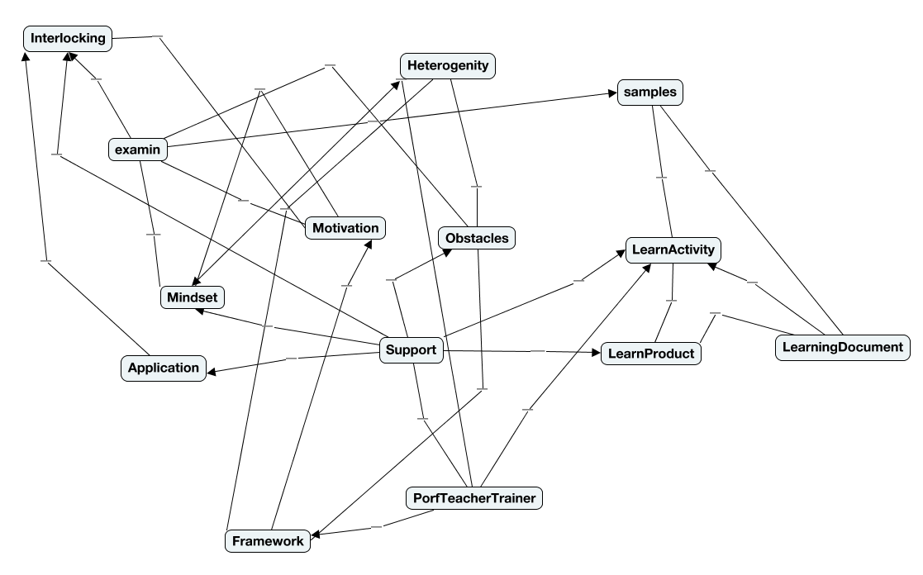
SCHOOL OF EDUCATION
Teacher training for the Flipped Classroom Approach in secondary mathematics education in Austria
Robert Weinhandl
First findings…
How could the flipped-classroom method to lower secondary school mathematics teachers in Austria be introduced and their understanding of the main flipped-classroom-ideas and –goals developed?
What kind of training and support (pedagogical, mathematical and technical) would lower secondary school mathematics teachers in Austria need for introducing flipped-classroom methods in their teaching and how should such training and support be offered?
What kind of difficulties and problems (pedagogical, mathematical and technical) do lower secondary school mathematics teachers in Austria encounter while conducting flipped-classroom teaching?
Research Question:

Slide 40
SCHOOL OF EDUCATION
Teacher training for the Flipped Classroom Approach in secondary mathematics education in Austria
Robert Weinhandl
First findings…
further reduction
How could the flipped-classroom method to lower secondary school mathematics teachers in Austria be introduced and their understanding of the main flipped-classroom-ideas and –goals developed?
What kind of training and support (pedagogical, mathematical and technical) would lower secondary school mathematics teachers in Austria need for introducing flipped-classroom methods in their teaching and how should such training and support be offered?
What kind of difficulties and problems (pedagogical, mathematical and technical) do lower secondary school mathematics teachers in Austria encounter while conducting flipped-classroom teaching?
Research Question:

Slide 41
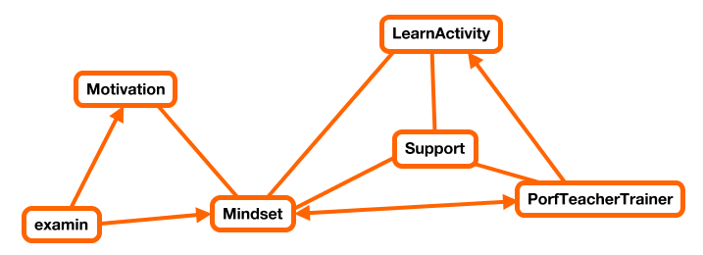
SCHOOL OF EDUCATION
Teacher training for the Flipped Classroom Approach in secondary mathematics education in Austria
Robert Weinhandl
First findings…
How could the flipped-classroom method to lower secondary school mathematics teachers in Austria be introduced and their understanding of the main flipped-classroom-ideas and –goals developed?
What kind of training and support (pedagogical, mathematical and technical) would lower secondary school mathematics teachers in Austria need for introducing flipped-classroom methods in their teaching and how should such training and support be offered?
What kind of difficulties and problems (pedagogical, mathematical and technical) do lower secondary school mathematics teachers in Austria encounter while conducting flipped-classroom teaching?
Research Question:

Slide 42
SCHOOL OF EDUCATION
Teacher training for the Flipped Classroom Approach in secondary mathematics education in Austria
Robert Weinhandl
First findings…
How could the flipped-classroom method to lower secondary school mathematics teachers in Austria be introduced and their understanding of the main flipped-classroom-ideas and –goals developed?
What kind of training and support (pedagogical, mathematical and technical) would lower secondary school mathematics teachers in Austria need for introducing flipped-classroom methods in their teaching and how should such training and support be offered?
What kind of difficulties and problems (pedagogical, mathematical and technical) do lower secondary school mathematics teachers in Austria encounter while conducting flipped-classroom teaching?
Research Question:

Slide 43
SCHOOL OF EDUCATION
Teacher training for the Flipped Classroom Approach in secondary mathematics education in Austria
Robert Weinhandl
First findings…
How could the flipped-classroom method to lower secondary school mathematics teachers in Austria be introduced and their understanding of the main flipped-classroom-ideas and –goals developed?
What kind of training and support (pedagogical, mathematical and technical) would lower secondary school mathematics teachers in Austria need for introducing flipped-classroom methods in their teaching and how should such training and support be offered?
What kind of difficulties and problems (pedagogical, mathematical and technical) do lower secondary school mathematics teachers in Austria encounter while conducting flipped-classroom teaching?
Research Question:

Slide 44
SCHOOL OF EDUCATION
Teacher training for the Flipped Classroom Approach in secondary mathematics education in Austria
Robert Weinhandl
First findings…
How could the flipped-classroom method to lower secondary school mathematics teachers in Austria be introduced and their understanding of the main flipped-classroom-ideas and –goals developed?
What kind of training and support (pedagogical, mathematical and technical) would lower secondary school mathematics teachers in Austria need for introducing flipped-classroom methods in their teaching and how should such training and support be offered?
What kind of difficulties and problems (pedagogical, mathematical and technical) do lower secondary school mathematics teachers in Austria encounter while conducting flipped-classroom teaching?
Research Question:

Slide 45
SCHOOL OF EDUCATION
Teacher training for the Flipped Classroom Approach in secondary mathematics education in Austria
Robert Weinhandl
First findings…

Slide 46
SCHOOL OF EDUCATION
Teacher training for the Flipped Classroom Approach in secondary mathematics education in Austria
Robert Weinhandl
First findings…
Research Question:

Slide 47
SCHOOL OF EDUCATION
Teacher training for the Flipped Classroom Approach in secondary mathematics education in Austria
Robert Weinhandl
First findings…
future
research

Slide 48
SCHOOL OF EDUCATION
Teacher training for the Flipped Classroom Approach in secondary mathematics education in Austria
Robert Weinhandl
First findings…
future
research

Slide 49


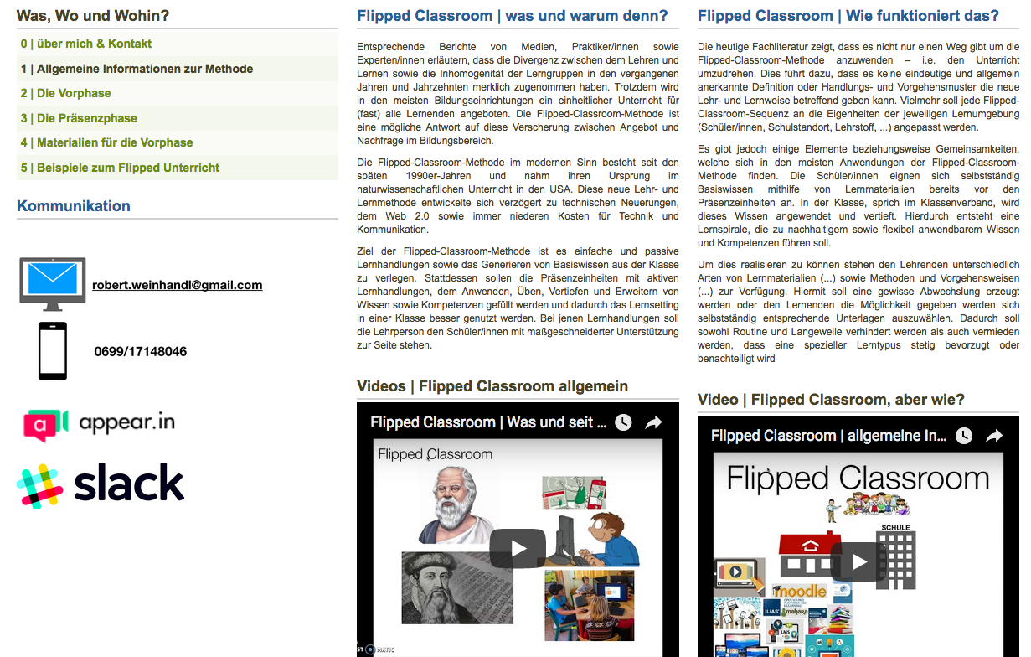
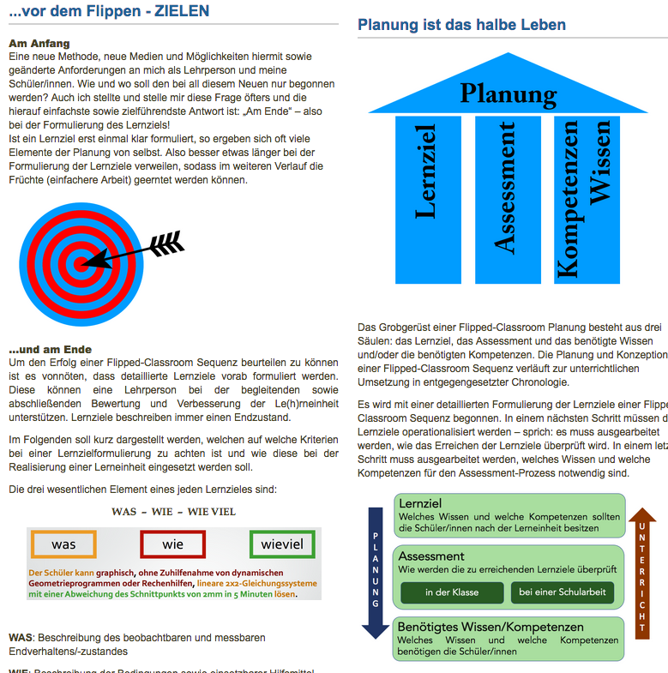
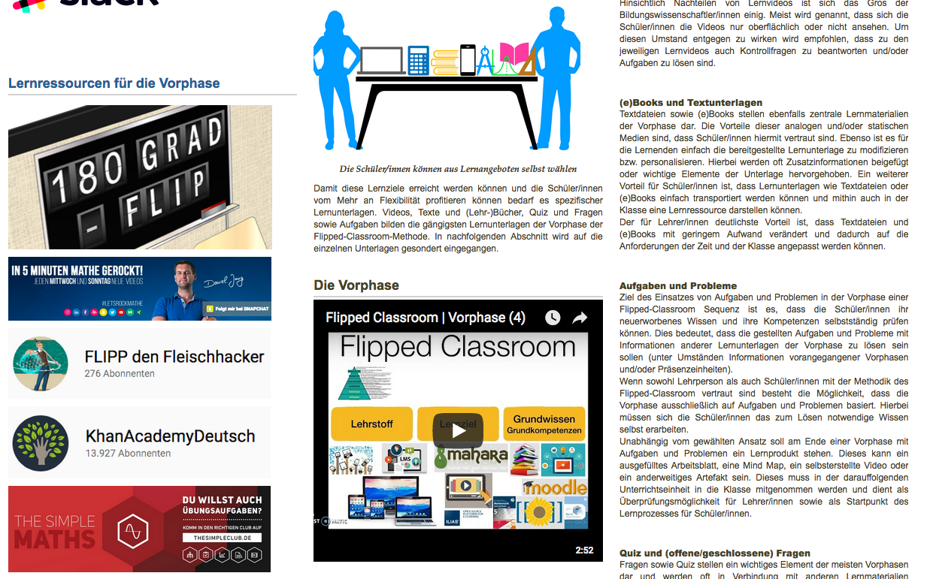
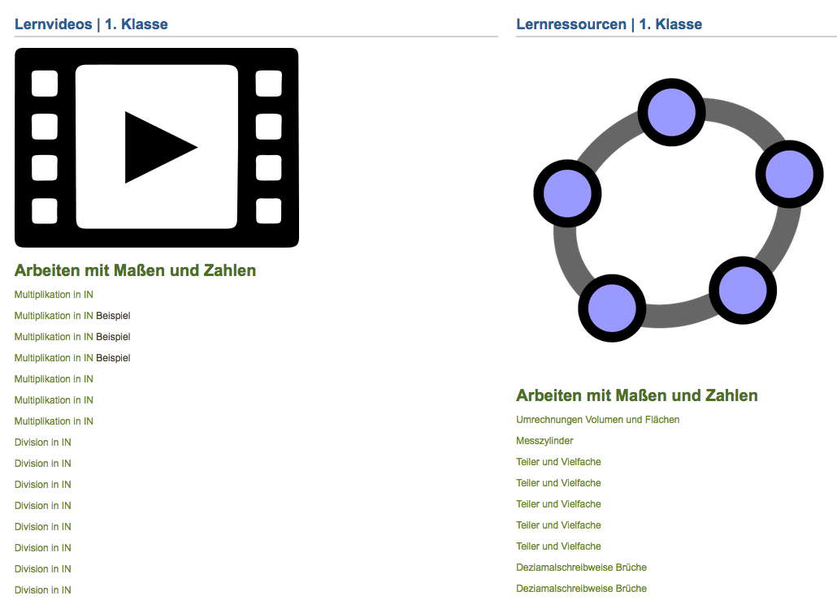
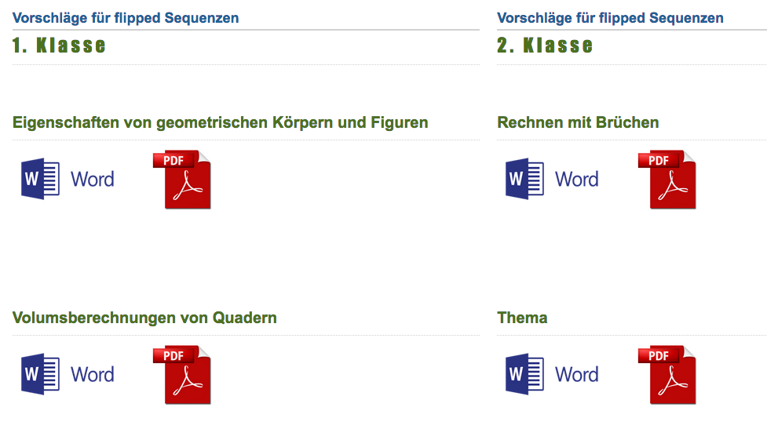
First findings…
future
research
SCHOOL OF EDUCATION
Teacher training for the Flipped Classroom Approach in secondary mathematics education in Austria
Robert Weinhandl

Slide 50
First findings…
future
research
SCHOOL OF EDUCATION
Teacher training for the Flipped Classroom Approach in secondary mathematics education in Austria
Robert Weinhandl

Slide 51
First findings…
future
research
SCHOOL OF EDUCATION
Teacher training for the Flipped Classroom Approach in secondary mathematics education in Austria
Robert Weinhandl

Slide 52
First findings…
future
research
SCHOOL OF EDUCATION
Teacher training for the Flipped Classroom Approach in secondary mathematics education in Austria
Robert Weinhandl

Slide 53
First findings…
future
research
SCHOOL OF EDUCATION
Teacher training for the Flipped Classroom Approach in secondary mathematics education in Austria
Robert Weinhandl

Slide 54
First findings…
future
research
Thank you for your attention.
SCHOOL OF EDUCATION
Teacher training for the Flipped Classroom Approach in secondary mathematics education in Austria
Robert Weinhandl

Slide 55
First findings…
future
research
Teacher training for the Flipped Classroom Approach in secondary mathematics education in Austria
Robert Weinhandl
SCHOOL OF EDUCATION
Thank you for your attention.

