Slide 1
Computer Algebra- and Dynamic Geometry Systems in Mathematics Education (CADGME) Conferences
Csaba Sárvári, University of Pécs
We have established -together with Zsolt Lavicza- four main goals for our CADGME conference:
to separate and develop valuable research initiatives during exhaustive discussions with colleagues;
to think collectively about further research directions for enabling us to use CAS-DGS more effectively both in mathematics and mathematics teaching;
to strengthen cooperation in the CAS-DGS research and teaching community;
we wanted and want to help the younger colleagues' scientific career.

Slide 2
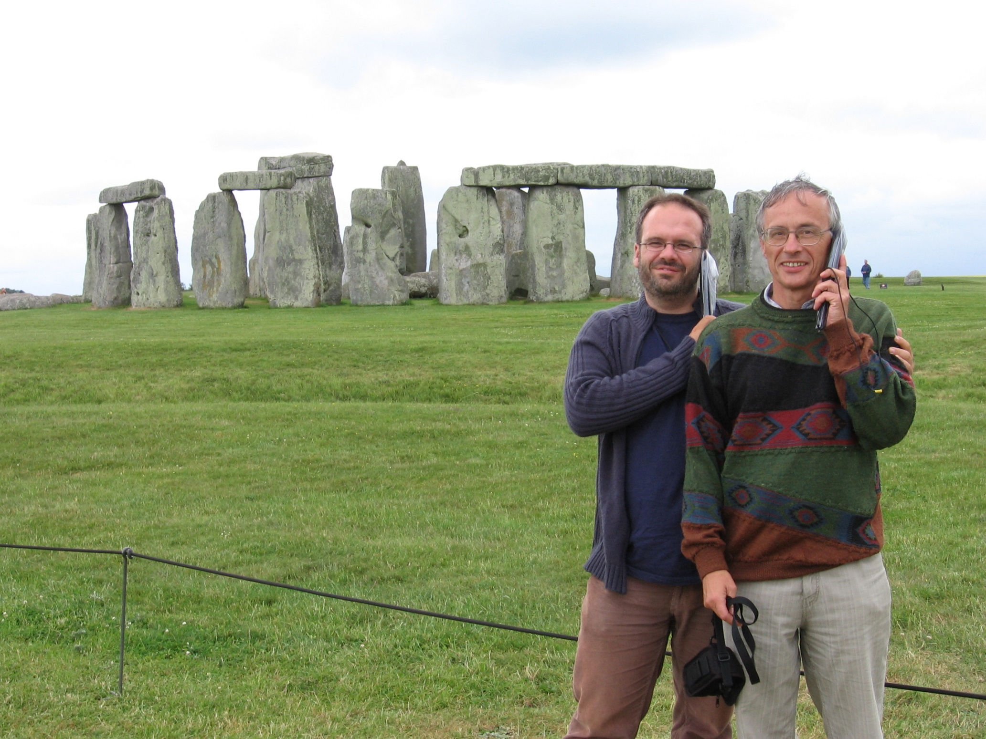

Slide 3
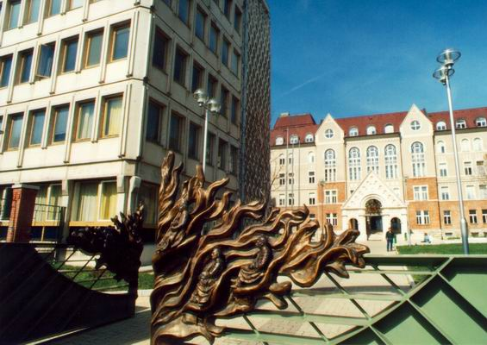
First Central- and Eastern European Conference on
Computer Algebra- and Dynamic Geometry Systems
in Mathematics Education (CADGME)
University of Pécs, Pollack Mihály Faculty of Engineering, Hungary
21-23 June, 2007
Keynote speakers:
Kenneth Ruthven, University of Cambridge, UK
Herschel’s heritage and today’s technology integration: a postulated parallel
Colette Laborde, Université Joseph Fourier, France
The design of tasks taking full advantage of dynamic geometry: what kinds of knowledge does it require from teachers?
Bruno Buchberger, RISC - University of Linz, Austria
Lazy Thinking: A reasoning strategy for inventing algorithms
Edith Schneider, University of Klagenfurt, Austria
CAS as didactical challenge
Luc Trouche, Université Montpellier, France
Resources for teaching mathematics in ICT environments: which, who and how?
Vlasta Kokol-Voljc, University of Maribor, Slovenia
Assessment in CAS and DGS environment
https://cadgme2007.mik.pte.hu/

Slide 4
CADGME 2007.
Characteristic feature : using CAS or DGS stand alone
Some characteristic talks and workshops
Wolfgang Windsteiger
Towards computer-supported proving in maths education
Emiliya Velikova and Valentina Voinohovska
Computer-aided scientific research of students for creating original mathematical problems
Mehmet Bulut, Yilmaz Aksoy, and Beref Mirasyedioglu
The effects of CAS in the development of problem solving abilities
Peter Lebmeir and Jürgen Richter-Gebert
Recognizing the type of a locus with scriptable dynamic geometry software
Yip-Cheung Chan
Different approaches of interplay between experimentation and theoretical consideration in dynamic geometry exploration: An example from exploring Simon line
Zoltan Kovacs
Blind Versus Wise Use of CAS
Ulrich Kortenkamp
Beyond DGS - Simulations and Scripting with Cinderella
Markus Hohenwarter
GeoGebra in Secondary School Teaching
Colette Laborde
Connecting geometrical, numerical and algebraic aspects of 3D geometry using Cabri3D

Slide 5
Zoltan Kovacs Blind Versus Wise Use of CAS
„During my courses for mathematics major students I often use technology linked to the arising problems. In such cases I noted that some students were used to learn just some procedures, which made them able to solve (partially) some problems and when they got the result, they accepted it passively and did not relate it to the initial problem.”
My operational philosophy can be articulated as follows:
• You must doubt. Check your result.
• Before pushing the Enter, have an idea concerning the result.
Always compare the output with your conception.
• Explain the result: compare with your knowledge, do a simple case by hand.
• Change the parameters (if it is possible), CAS needs your help: you work together with CAS.
• Sometimes the life is easier without CAS. Do not use it when it is not necessary.
• Do not neglect paper and pencil skills.

Slide 6
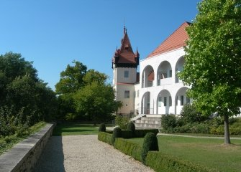
Second Central- and Eastern European Conference on
Computer Algebra- and Dynamic Geometry Systems in Mathematics Education (CADGME-2009)
CADGME-2, 11-13, July, GeoGebra 14-15, July, 2009,
RISC, Linz (Castle of Hagenberg), Austria
Keynote speakers:
Paul Andrews (University of Cambridge, UK)
Understanding the cultural dimension in research in mathematics teaching
and learning
Ralph-Johan Back, Abo Akademi University Turku, Finland
Structured Derivations: A Method for Teaching Proofs in High School Mathematics
Bruno Buchberger (RISC, University of Linz, Austria)
Mathematical Invention: How Much Can be Automated?
André Heck (University of Amsterdam, Netherlands)
Modelling in Cross-Disciplinary Authentic Student Research Projects
Jozef Hvorecký (City University Bellevue, Bratislava, Slovakia)
Using a Managerial Analogy for Making Mathematics More Attractive
http://www.risc.jku.at/conferences/cadgme2009/?content=general

Slide 7
CADGME - 2009.
Characteristic features, topics:
integration of CAS and DGS
appears the topic Teorem Proving
thinking about past, present and future
Some characteristic talks
Jesus Escribano, Francisco Botana, Miguel Abanades
Integrating DG and CAS abilities under a common framework
Steve Arnold
Dynamic integration of CAS and DGS: what does this mean?
Walther Neuper
Common grounds for modeling mathematics in educational software
Markus Hohenwarter
GeoGebra - Past, present, and future of this Dynamic Mathematics Software
Pedrag Janicic
Automated geometry theorem proving: readability vs. efficiency

Slide 8
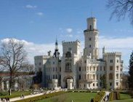
Third Central- and Eastern European Conference on
Computer Algebra- and Dynamic Geometry Systems
in Mathematics Education
29 June -1 July, 2010 Hluboká nad Vltavou, Czech Republic
Keynote speakers:
Paul Drijvers, Netherlands
The teacher and the tool
Ulrich Kortenkamp , Germany
Interoperable Interactive Geometry for Europe
Matija Lokar, Slovenia
Using learning blocks to prepare e-content for teaching mathematics
Pavel Pech, Czech Republic
Classical vs. Computer Approach in Proving Theorems
Francisco Botana, Spain
On using automated deduction techniques in dynamic geometry environments
Wei-Chi Yang, USA
Why should we integrate Computer Algebra System with Interactive Geometry?
http://home.pf.jcu.cz/~cadgme2010/

Slide 9
CADGME – 2010.
Characteristic features, topics:
special learning modes with different special tools,
special modes of proof, automated theorem proving,
creation new tools
Some characteristic talks
Philippe R. Richard, Leduc Nicolas, Tessier-Baillargeon Michele and Gagnon Michel
Contribution of a computer algebra system (CAS) in the solving of problems in geometry with the help of an emerging tutorial system
Andreas Fest, Maren Hiob-Viertler and Andrea Hoffkamp.
An interactive learning activity for the formation of the concept of function based on representational transfer
Gabriel Katz and Vladimir Nodelman
Computer-aided Explorations of Two-Parameter Modular Spaces: Giving Geometric Life to Routine Algebra.
Paul Drijvers
Instrumental orchestrations of mathematical situations in technological environments: deepening the concept through concrete examples
Matija Lokar, Primož Lukšič
Flexible mathematics content preparation

Slide 10
CADGME 2010 keynote:
Classical vs. Computer Approach in Proving Theorems
Pavel Pech, Faculty of Education, University of South Bohemia, Czech Republic
Proofs of mathematics theorems form the most difficult part of mathematics. For this reason
proofs are often omitted at most of schools. But without proofs there is no mathematics.
Despite this proving or at least verification of statements should be done in teaching
mathematics of all school categories. It seems that new technologies CAS and DGS could
help remedy this state. In the last 4 decades new methods of proving, deriving and discovering
theorems by computers were invented. At the same time various dynamic geometry software
was developed.
In the presentation I will show basic methods of proving, deriving and discovering of some
well known statements by computer. By this we will use both DGS to describe and verify a
problem, and CAS to make a rigorous proof. On many examples the theory of automated
theorem proving is demonstrated. This new approach of proving theorems is compared with
traditional methods. Strengths and weaknesses of both – classical and computer – methods are
shown.

Slide 11
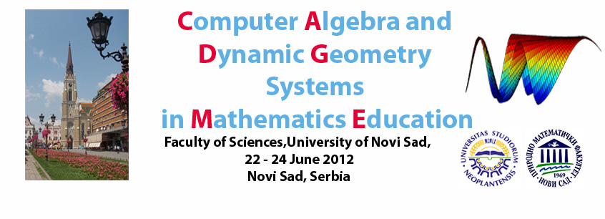
Keynote speakers:
Alan Rogerson (International Consultant in Maths Education, Poland)
Fundamentals, the Future and the Power of the Force
Adrian Oldknow (Emeritus Professor, University of Chichester, UK)
Software and activities to motivate and support learners in mathematics, science and technology
Jean-baptiste Lagrange (University of Reims, France)
Functions, Dynamic Geometry and CAS: offering possibilities for learners and teachers
Hans-Georg Weigand (University of Würzburg, Germany)
Theses about the use of computer algebra systems in the next decade
Olga Hadžić (University of Novi Sad, Serbia)
The Role of Computers in Changing Students Attitudes Towards Mathematics
http://www.dmi.uns.ac.rs/cadgme2012/index.html

Slide 12
CADGME 2012.
Characteristic features, topics:
discussing the potential of Theorem-Prover based Systems (TPS) for educational practice. (eduTPS)
different aspects of using GeoGebra and other DGS
Some characteristic talks
Jan Rocnik and Walther Neuper
Interactive Course Material by TP-based Programming. A Case Study
Lajos Szilassi
The possibilities of and limits to the application of the GeoGebra dynamic geometry programme in elementary and secondary education
Francesca Ferrara and Ornella Robutti
The use of DGS to face optimization problems at secondary school
Ulrich Kortenkamp, Christian Dohrmann and Paul Libbrecht
Open Discovery Space: Sustaining the Intergeo Project for DGS content and teachers' CPD in Europe

Slide 13
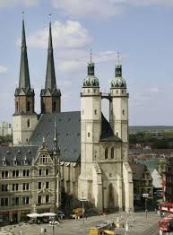
Fifth Central- and Eastern European Conference
on Computer Algebra- and Dynamic Geometry Systems
in Mathematics Education
26-29 September, 2014 Halle (Saale), Germany
Keynote speakers:
Ralph-Johan Back, Abo Akademi University Turku, Finland
Structured derivations in practice: experiences from the E-math project
Marcelo de Carvalho Borba, Graduate Program in Mathematics Education, UNESP/Brasil
Math Problem, Facebook and Emergent Classrooms
Predrag Janičić, University of Belgrade, Serbia
Challenges for the Next Generation Mathematics Education Software
Tomás Recio, Universidad de Cantabria, Santander, Spain
Dynamic Geometry and Mathematics: few trains on a two-way track
Jürgen Richter-Gebert, University of Technology, Munich, Germany
Mathematics on electronic media in a changing world
http://cadgme2014.cermat.org/

Slide 14
CADGME - 2014.
Characteristic features, topics:
How resources are transforming the practice?
Challenges for the Next Generation Mathematics Education Software
Some characteristic talks
Theodosia Prodromou, Zsolt Lavicza, Balazs Koren
Increasing students’ involvement in technology-supported mathematics lesson sequences
Paul Libbrecht
Adaptations to a Learning Resource
Světlana Tomiczková and Miroslav Lávička
Using dynamic geometry and computer algebra systems in problem based courses for future engineers
Lilla Korenova
Mobile learning in elementary and secondary school mathematics in Slovakia
Florian Schacht
Student Documentations in Mathematics Classrooms Using Digital Tools: Theoretical Considerations and Empirical Findings

Slide 15
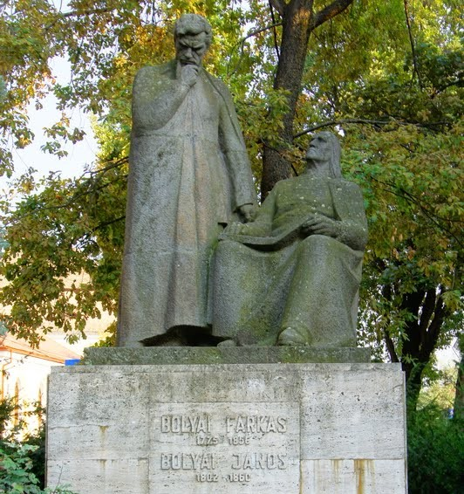
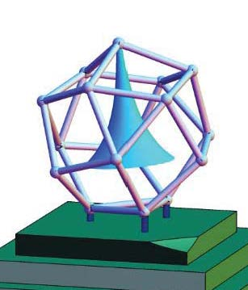
Sixth Central- and Eastern European Conference on Computer Algebra- and Dynamic Geometry Systems
in Mathematics Education
7-10 September, 2016 Targu Mures, Romania
https://cadgme.ms.sapientia.ro/index.html
Keynote speakers:
Christian Bokhove , (University of Southampton, UK)
Using technology for maths teaching and learning: instructional design, digital books and automated feedback
Noah Dana-Picard , (Jerusalem College of Technology, Israel)
The usage of technology to revive classical topics in mathematics
Zoltán Kátai, (Sapientia University, Targu Mures, Romania)
Learning algorithms in technologically and artistically enhanced interactive environments
Zsolt Lavicza, (STEM Education Centre, Johennes Kepler University, Linz, Austria)
GEOMATECH: Integrating Technology into Primary and Secondary School Teaching to Enhance Mathematics Education in Hungary
Morten Misfeldt, (Aalborg University, Copenhagen, Denmark)
Teaching mathematics with reasoning tools: learning, teaching and curriculum planning

Slide 16
CADGME - 2016.
Characteristic features, topics:
The impact of digital tools on students' learning of geometry;
Modeling and Experimental Approach in Math Classrooms
Some characteristic talks
Kristóf Fenyvesi, Zsolt Lavicza, Diego Lieban, Imre Nyögéri, Ho-gul Park & Taeyoung Choi
STEAM Workshops for Collaborative Problem Solving Based on Connecting Hands-on 4dframe Activities with the Implementation of Geogebra
Valentyna Pikalova
Teaching and Learning Math Behind Computer Science with the Help of GeoGebra and Python
Zoltán Kovács and Csilla Sólyom-Gecse
GeoGebra Tools with Proof Capabilities
Miguel A. Abanades, Francisco Botana, Zoltan Kovacs, Tomas Recio and Csilla Solyom-Gecse Automatic Discovery in GeoGebra: First Steps
Gregor Jerše and Matija Lokar
Learning and teaching programming and numerical methods with a system for automatic assessment

Slide 17
The thematic expansion of CADGME conferences
1. The aim of the conference is to establish a forum for academics in Central- and Eastern Europe
to be able to share their work with regard to CAS and DGS.
2. Theorem-Prover based Systems for Education (eduTPS)” played an important role at CADGME ’12, the conference on Computer Algebra and Dynamic Geometry Systems in Mathematics Education held at Novi Sad in June 2012.
3. One of the working groups of CADGME 2018 will be TAME: Technology, Arts and Mathematics Education
One of the keynotes: STEAM-ing Up Learning with GeoGebra: from Explorations in Arts and Design to Robot-making Activities
Notes:
STEAM is an educational approach to learning that uses Science, Technology, Engineering, the Arts and Mathematics as access points for guiding student inquiry, dialogue, and critical thinking. The end results are students who take thoughtful risks, engage in experiential learning, persist in problem-solving, embrace collaboration, and work through the creative process. These are the innovators, educators, leaders, and learners of the 21st century!

Slide 18
Publications of reviewed papers presented at CADGME
We published papers about talks at the CADGME conferences in the following peer-reviewed journals:
Teaching Mathematics and Computer Science (TMCS)
The International Journal for Technology in Mathematics Education (IJTME)
The Electronic Journal of Mathematics & Technology (eJMT) and
Acta Didactica Napocensia (ADN)
We published more than 140 papers the majority of them in Special Issues.

Slide 19
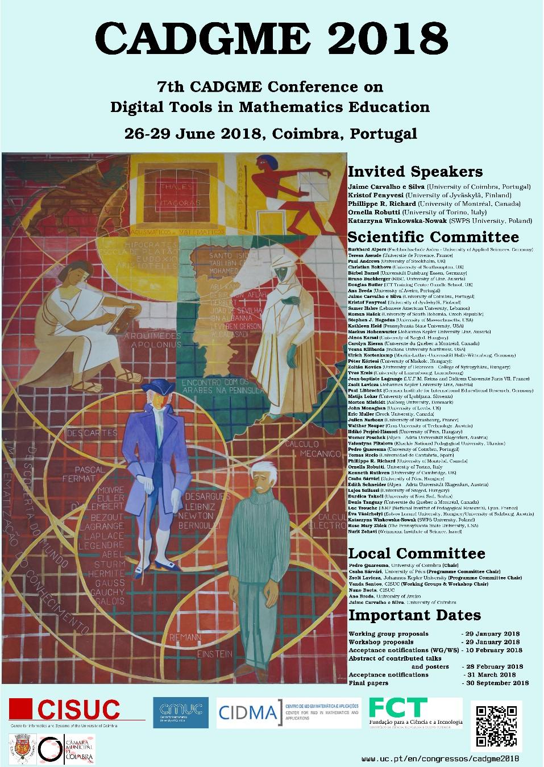
Our forthcoming conference: Seventh CADGME - Conference on ﻿Computer Algebra and Dynamic Geometry Systems in Mathematics Education﻿ 26-29 June 2018 University of Coimbra, Portugal
Jaime Carvalho e Silva, University of Coimbra, Portugal
The challenges schools face with the development of Computer Algebra
Kristof Fenyvesi, University of Jyväskylä, Finland
STEAM-ing Up Learning with GeoGebra: from Explorations in Arts and Design to Robot-making Activities
Phillipe R. Richard, University of Montréal, Canada
The Utility of the Automatic Reasoning Tools for Performing Mathematical Work
Ornella Robutti, University of Torino, Italy
Mathematics teachers working in collaboration with the use of technology
﻿Katarzyna Winkowska-Novak, SWPS University, Poland
﻿GeoGebra role in building mental models and improving computational thinking skills
https://www.uc.pt/en/congressos/cadgme2018
We would be appreciate if you could advertise our conference to your colleagues who might be interested in coming.
We look forward to meeting you in Coimbra!

