Slide 1
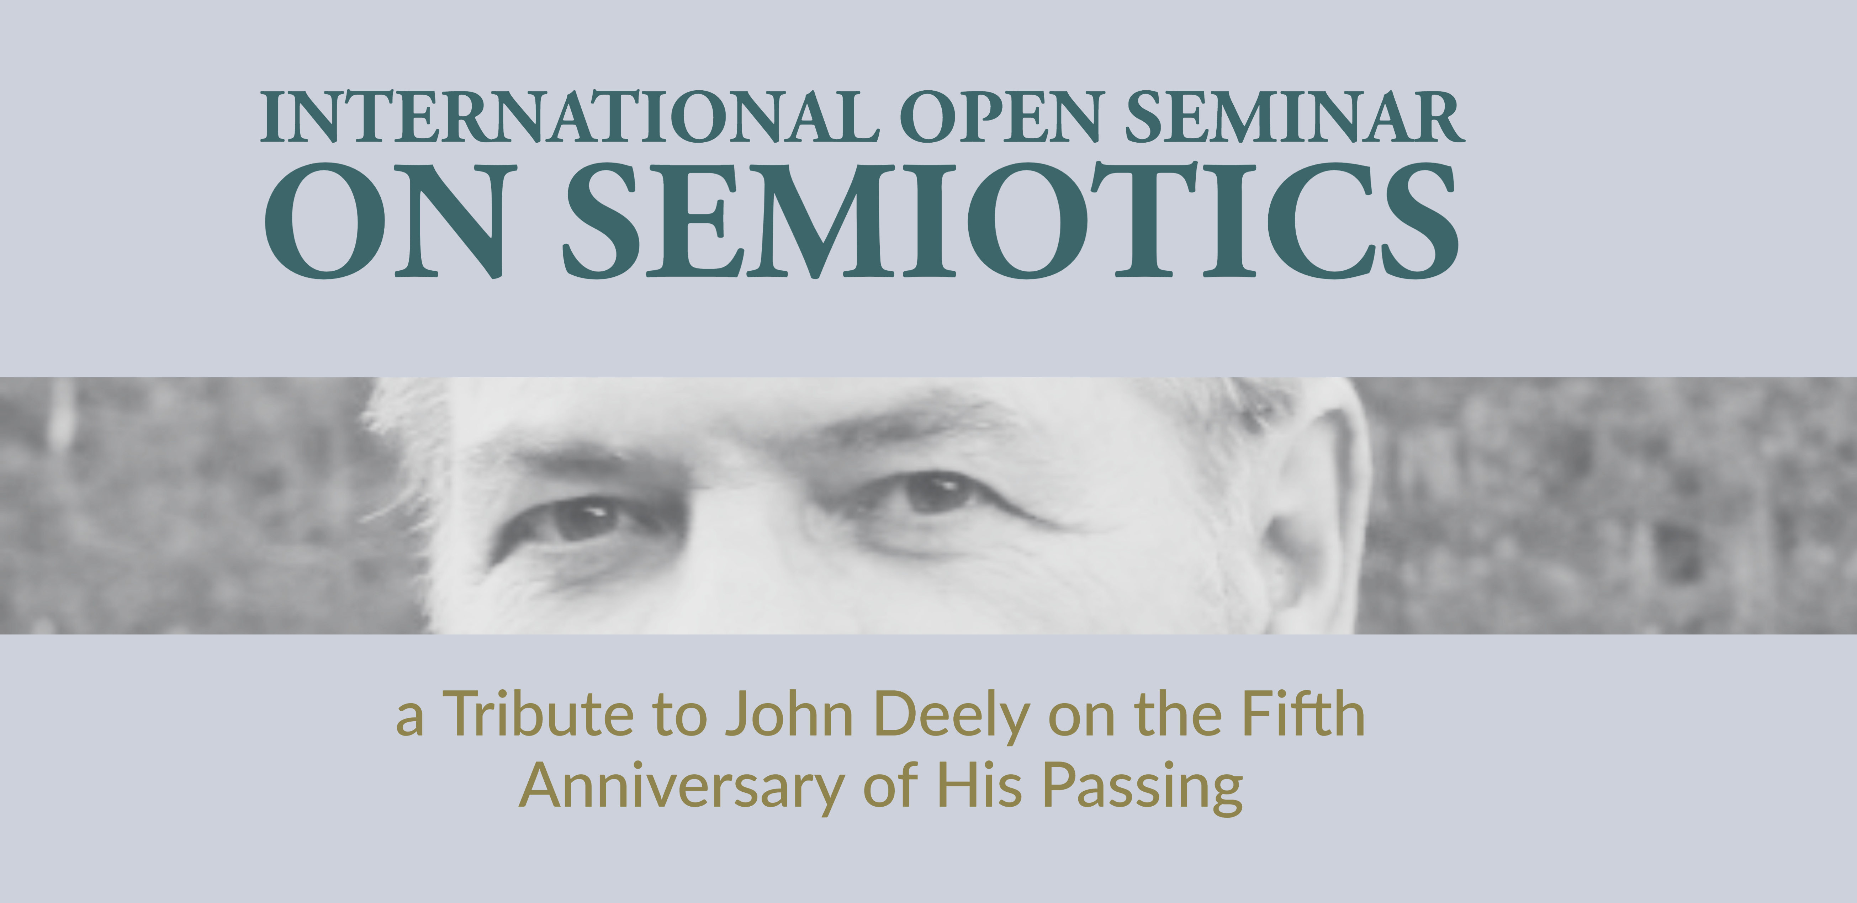
The contested relation to reality of "the creative treatment of actuality”: a triadic semiotic critique
FERNANDO ANDACHT
Universidad de la República
MONTEVIDEO, URUGUAY

Slide 2
the KERNEL of semiosis viewed from a documentary film perspective
It all begins with an unnerving, disconcerting question: “In what sense is the parent of a dead child still a parent?” (Deely 1990, p. 37)
In order to profit from Deely’s enlightening answer to his peculiar query, I will draw from Peirce’s semiotic pragmaticism and contrast it with W. James’ own take on pragmatism.
I will also briefly revisit the notion of ‘frame’ drawn from G. Bateson (1955/1972), E. Goffman (1974) and a related concept from J. Bleger (1960). The aim is to compare it with the triadic relation.

Slide 3
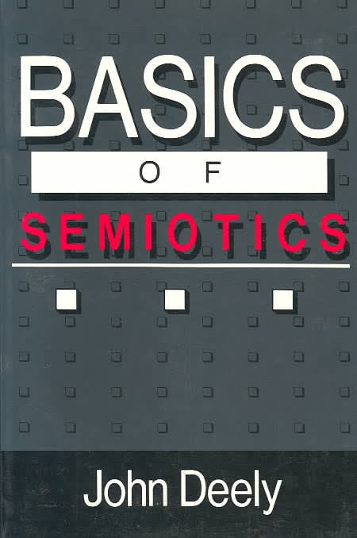
Deely’s take on relation in a triadic spirit: how to grasp what is invisible
“A relation in the sense constitutive of the sign in the being proper to it as sign cannot be seen or touched. It can be understood, but, without that understanding, it cannot be grasped directly at all. Animals make use of signs without knowing that there are signs, Maritain noted that is to say (1957: 53), "without perceiving the relation of signification". (1990, 37)

Slide 4
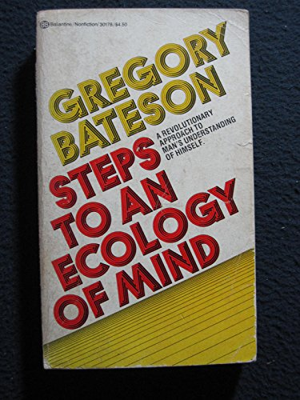
Bateson on ‘metacommunication’ as the basis of ‘frames’ in animals
“When “mood-signs” are replaced by man-made signs we witness “the drama precipitated when organisms, having eaten of the fruit of the Tree of Knowledge.” (1955/1972, p. 184)
“(T)here must have been an extraordinary step in the evolution of communication when organisms discovered, or were born with, the innate knowledge … that a message or meaningful act could be emitted as a message to influence another organism … especially those messages which define the context; the message ’This is play’ … is a message defining context in a way, or defining a frame … It implies a certain system of discourse, a certain onion-skin structure.”
(Bateson 1956, p. 163, quoted in Engler & Gardiner, 2012, p.7 – emphasis
in the original)

Slide 5
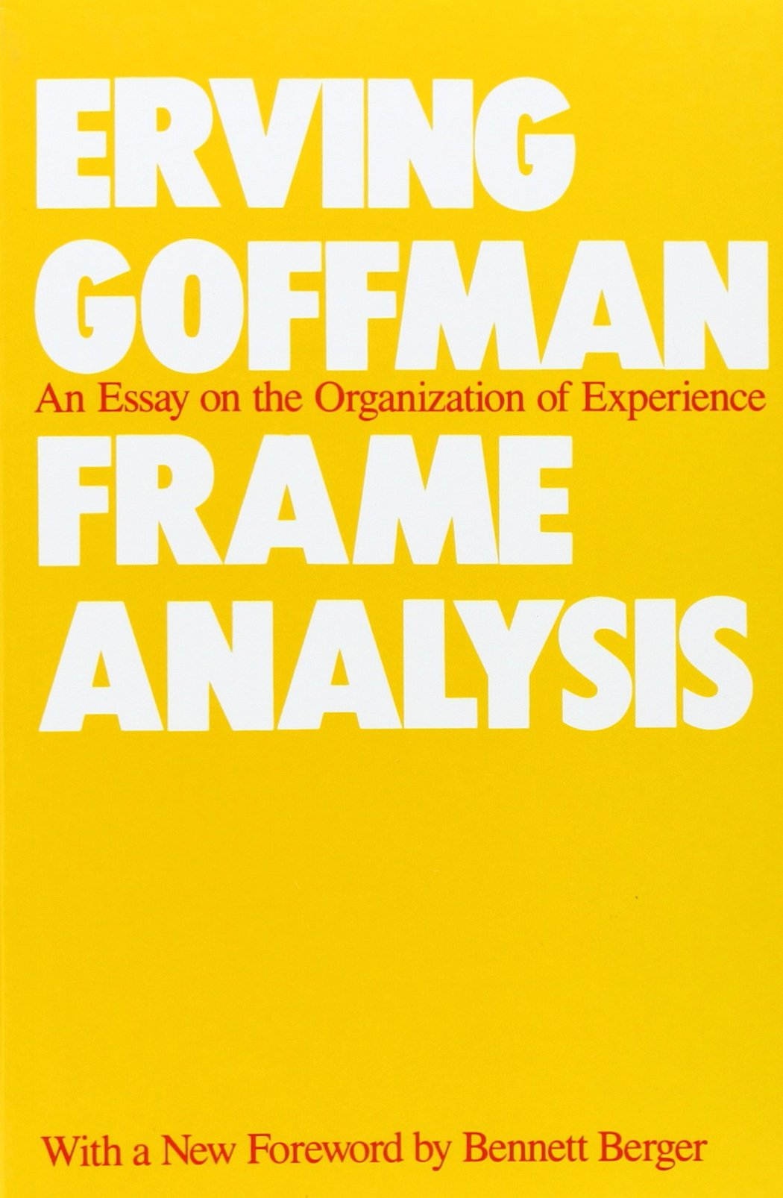
What is in a frame that the same thing in another would mean something else?
- (M)uch use will be made of Bateson's use of the term ‘frame.’ I assume that definitions of a situation are built up in accordance with principles of organization which govern events - at least social ones - and our subjective involvement in them; frame is the word I use to refer to such of these basic elements as I am able to identify. That is my definition of frame. (Goffman, 1974/1986, p. 10-11)

Slide 6
Goffman’s phenomenological take on experience partly based on William James
“ I try to follow a tradition established by W. James in his famous chapter “The Perception of Reality”, first published in 1869. Instead of asking what reality is, he gave matters a subversive phenomenological twist, italicizing the following question: Under what circumstances do we think things are real?”
(Goffman, 1974/1986, p. 2)

Slide 7
the ‘frame’ in a psychoanalytic light: j. bleger (1960) on the ‘encuadre’
- “The frame is then an institution within which phenomena take place that we call behaviors. The frame is maintained and tends to be maintained (actively by the psychoanalyst) as invariable and, while it exists as such, it seems inexistent or unnoticed, as much as the institutions or the relations of which we become aware precisely when they are missing, when they are blocked or stop to exist”. (p. 104)
- “The frame, if it is invariable, turns out to be decisive for the phenomena of the process of behavior. (…) the frame is a metabehavior, and the phenomena that we acknowledge as behaviors depend on it. It is the implicit, but the explicit depends on it.” (105, emphasis in the orig.)

Slide 8
An almost peircean take on Nature & culture
“Considering the extent to which Bateson’s whole thinking turned upon relations between entities (or agents) rather than on the entities themselves, one may wonder why he did not take up the semiotic thinking from Peirce. As soon as we accept the reality of sign processes, of relative being, we also immediately see the deep significance of Bateson’s lifelong attempt to determine the pattern that connects... nature and culture. Semiosis is constitutive to both of these realms, evolution and thinking are made up of the same stuff, and the name for this stuff is relative being.”
(Jesper Hoffmeyer, 2008, p. 42)

Slide 9
Deely’s answer: all you need is a relation dyadic & triadic relations
- “Right away it is easy to see that ‘being a parent’ or ‘becoming a parent’, in the minimal sense, results from an action that is over and above the being of each of the individuals taken as independent biological organisms in their own right.” (p. 37)
- “(T)he characteristic of being a parent rests not on the dynamic interaction of sexual activity alone but on that taken together with, coordinated with, a certain outcome that exists precisely as a trajectory independent of either parent in his or her individual being.” (p. 38)

Slide 10
the SIGN relation never perishes
- “This relation, objective and physical or merely physical, is distinct from and superordinate to the individual being of both parent and child. It is not merely that intelligible aspect proper to the individual being of both whereby, henceforward, in order to be fully understood, each must be thought in connection with the other. Unlike this permanent aspect of intelligibility, the physical relation and the objectivity that may or may not accompany it are transitive: they are a type of relation that comes into being for a while and then ceases or, in the case of the objective relation, that may pass in and out of being many times, in each case remaining as a relation unchanged in its essential content”. (Deely, 1990, p. 40, emph.added)

Slide 11
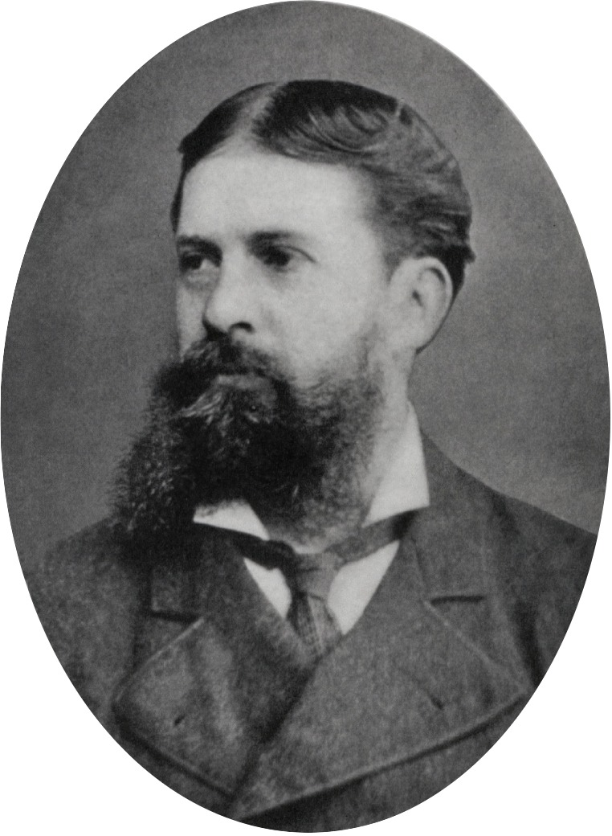
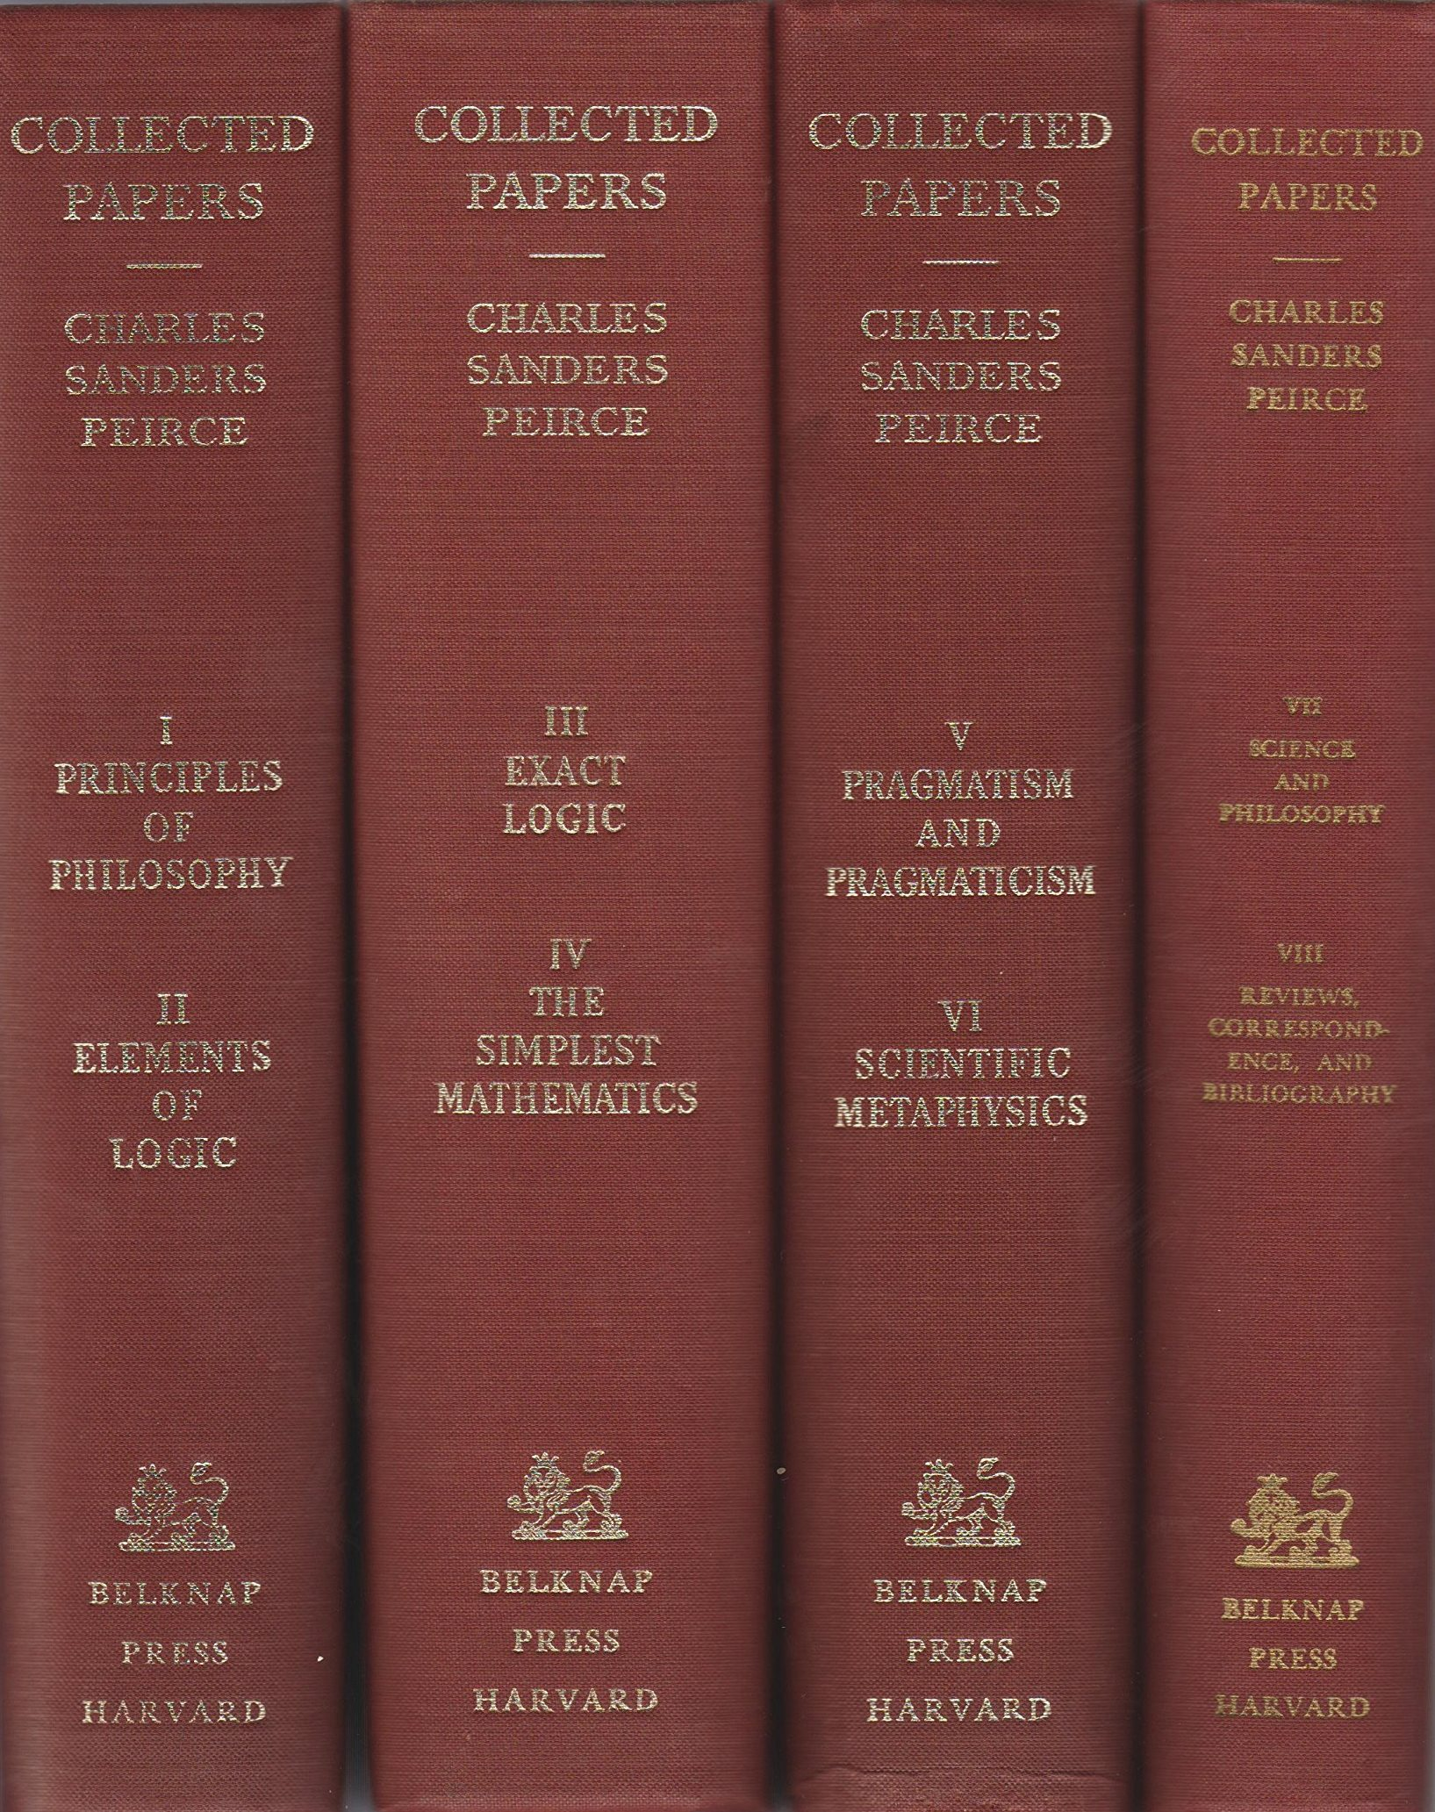
bateson’s pattern that connects &
Peirce’s teleology
- “What pattern connects the crab to the lobster and the orchid to the primrose and all the four of them to me? And me to you? And all the six of us to the amoeba in one direction and to the back-ward schizophrenic in another?” (Bateson, 1979, p. 8)
- “Mind has its universal mode of action, namely, by final causation. The microscopist looks to see whether the motions of a little creature show any purpose. If so, there is mind there.” (CP 1.269)

Slide 12
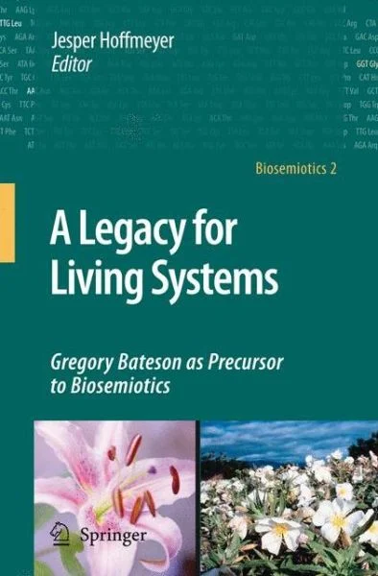
Teleology throughout the universe
The Batesonian understanding of the-pattern- that-connects as primary in the sense that the connected parts or structures are never independent of the pattern that connects them (in time and space) but are, on the contrary, only fully understandable when seen in relation to that pattern, runs through all these chapters as a red thread.
(J. Hoffmeyer, 2008, p. 9)

Slide 13
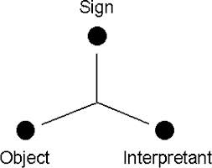
Deely’s answer: thirdness as
“the pattern that connects” (Bateson)
“The foundation of the relation of parenthood in any given case is a determinate outcome of a determinate action, but the relation itself is neither the contingent action nor its determinate outcome. The relation is the pattern, the thirdness, linking the two and superordinate to each.” (p. 41)

Slide 14
Bateson on relation
“Relationship is not internal to the single person. It is nonsense to talk about ‘dependency’ or ‘aggressiveness’ or ‘pride,’ and so on. All such words have their roots in what happens between persons, not in some something-or-other inside a person. (Bateson, 1979, p. 133)
No doubt there is a learning in the more particular sense. There are changes in A and changes in B which correspond to the dependency­ succorance of the relationship. But the relationship comes first; it precedes. (ibid, emphasis in the orig.)

Slide 15
Peirce’s rainbow realism & synechism
“(W)henever we think, we have present to the consciousness some feeling, image, conception, or other representation, which serves as a sign. But it follows from our own existence (which is proved by the occurrence of ignorance and error) that everything which is present to us is a phenomenal manifestation of ourselves. This does not prevent its being a phenomenon of something without us, just as a rainbow is at once a manifestation both of the sun and of the rain.” (CP 5.383)

Slide 16
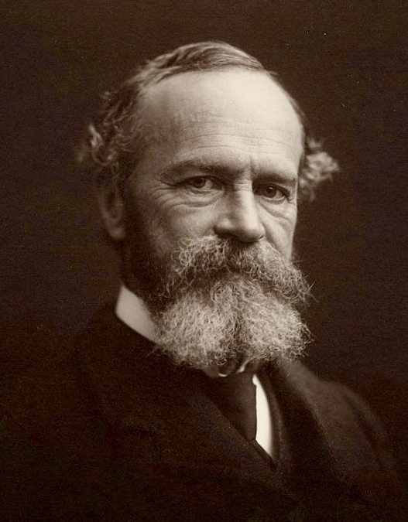
When James’ pragmatism comes close to peirce’s rainbow realism
It is identically our pragmatistic conception. In our cognitive as well as in our active life we are creative. We ADD, both to the subject and to the predicate part of reality. The world stands really malleable, waiting to receive its final touches at our hands. Like the kingdom of heaven, it suffers human violence willingly. Man ENGENDERS truths upon it.
(James, 1907, p. 256, capitals in the original)

Slide 17
W. James’ (1907) take on representation is akin to documentary theory’s dualism
We may glimpse it [reality], but we never grasp it; what we grasp is always some substitute for it, which some previous human thinking has peptonized and cooked for our consumption. If so vulgar an expression were allowed us we might say that wherever we find it, it has been already faked. (1907, p. 248, emphasis in the original)
Peptonize: the transformation of proteins by the action of pepsin (a ferment), in the process of digestion.

Slide 18
SYNECHISM, an alternative to dualism
- “Synechism, even in its less stalwart forms, can never abide dualism (...) But dualism in its broadest legitimate meaning as the philosophy which performs its analyses with an axe, leaving as the ultimate elements, unrelated chunks of being, this is most hostile to synechism. (...) the synechist will not admit that physical and psychical phenomena are entirely distinct, -- whether as belonging to different categories of substance, or as entirely separate sides of one shield, -- but will insist that all phenomena are of one character (...) all alike present that mixture of freedom and constraint, which allows them to be, nay, makes them to be teleological, or purposive.”
(CP 7.570)

Slide 19
Peircean steps to correct a dualistic account of representation
- “(T)he essence of actual existence is reaction.”
(MS 942: 28)
- “(W)hatever exists is individual, since existence (not reality) and individuality are essentially the same thing.” (C.P 3.613)

Slide 20
Peircean steps to correct …
“Almost everybody will now agree that the ultimate good lies in the evolutionary process in some way. If so, it is not in individual reactions in their segregation, but in something general or continuous. Synechism is founded on the notion that the coalescence, the becoming continuous, the becoming governed by laws, the becoming instinct with general ideas, are but phases of one and the same process of the growth of reasonableness.” (CP 5.4)

Slide 21
john Grierson’s 1933 influential definition of the documentary genre
“Documentary, or the creative treatment of actuality, is a new art with no such background in the story and the stage as the studio product so glibly possesses.”
(John Grierson 1933, p. 7, emphasis added)

Slide 22
James’ creative addition to reality
- “We plunge forward into the field of fresh experience with the beliefs our ancestors and we have made already; these determine what we notice; what we notice determines what we do; what we do again determines what we experience; so from one thing to another, altho the stubborn fact remains that there IS a sensible flux, what is true of it seems from first to last to be largely a matter of our own creation.” (James, 1907, p. 256)

Slide 23
Idealism & semiotic as different perspectives
“The conflict, thus, is between an idealist perspective in which the mind knows only what it constructs and the semiotic perspective in which what the mind constructs and what is partially prejacent to those constructions interweave objectively to constitute indistinctly what is directly experienced and known.” (Deely, 1990, p. 122 )

Slide 24
The lure of the notion of character in the theory & the poetics of documentary
A powerful and unanimous reflexive discourse: the prevalence of the notion of ‘CHARACTER’ in the theory of the documentary genre
Definition: The term ‘character’ is used to refer to any and every person who accepts to be filmed in a dcomentary
Goal: To argue against this claim from the perspective of triadic semiotic, I will use Peirce’s triadic model and Deely’s (1990) take on semiosis. I claim that it is the ‘person’ that the documentary genre represents.

Slide 25
An influential documentary theorist: jean-louis comolli
“[T]he cinema really produces the reality, which by a legerdemain it seems to show. But it’s a red herring (un leurre), the bait of fiction […] in the documentary, the belief of the viewer is somehow warranted by the idea that reality exists.” (Comolli in an interview, 1995)

Slide 26

Documentary’s dualistic approach to reality I
“The documentary, on the contrary, is shaped by the questioning of that objectivity, of that possibility of dealing with the real. The great documentary isn’t only based on this presupposition, but it also thematizes that very impossibility of dealing with whatever it is that may be called real. In front of this ‘real’, every documentary, deep down, is precarious, is incomplete, is imperfect, and it’s precisely from that imperfection that its perfection is born. The documentary is always a subjective view.”
(E.Coutinho , at an interview, 2003)

Slide 27
Documentary’s dualistic approach to reality II
“It is not possible for the film maker or for the photographer to nourish the illusion that he or she is filming the real. We are always filming an encounter: the encounter between the world of the film-maker and his crew, mediated by the camera, and the world which is in front of that camera. That is why most of my films begin with a crew that arrives at the place for filming: a shanty town, a garbage lot, a building.”
(E. Coutinho at an interview, 2003)

Slide 28
The fallacy of the Peptonized Real I
We’re always filming encounters. […] It’s the verbal act which is extraordinary. A verbal act which was provoked, catalysed, by the moment of filming, without there being a conscious deliberation neither from me nor from the person. To film is […] to provoke, to catalyse that moment. It’s in the interaction that takes place in the filming process that a great character [personagem] is born.
(E.C., interview, 2003)

Slide 29
The fallacy of the Peptonized Real II
“And there is a whole process in which you try to put yourself in the place of the other. Even though that is impossible. What matters are the reasons of the other, not yours. What’s interesting is the fiction of the others not my own, mine come after those of the others. The others talk about life, only fiction in way. They are confessions that have a very high fictional component. But I’m interested in their fiction and, to understand from which place the person is talking.”
(E. Coutinho, interview 2003)

Slide 30
THE MIDAS TOUCH of the DOCUMENTARY FILM
“A [TV] interview tries hard to seem objective and supposedly to show the ‘real’. The documentary, on the contrary, is shaped by the questioning of that objectivity, of that possibility of dealing with the real. The great documentary isn’t only based on this presupposition, but it also thematizes that very impossibility of dealing with whatever it is that may be called real. In front of this ‘real’, every documentary, deep down, is precarious, is incomplete, is imperfect, and it’s precisely from that imperfection that its perfection is born. The documentary is always a subjective view. The documentary is the very act of documenting.”
(E. Coutinho, interview 2003)

Slide 31
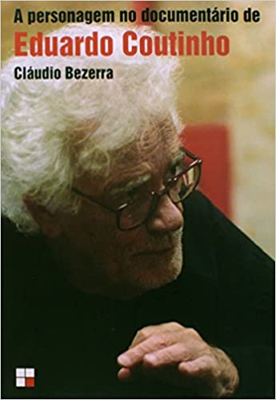
a recurrent concept in documentary theory
“The concept of performance [is due to the ] narrative exigencies for the construction of characters [who] occupy the core of the concerns of Coutinho” (Bezerra, 2014, p. 10)
“The performance of the character of Coutinho’s films is a kind of theater, a particular gesture in the way s/he places him/herself on stage, of entering the play proposed by the director and to display a presence in the film, based on a life experience”. (ibid, p. 15)

Slide 32
a Typical theoretical account of the creation of the documentary character
- Xavier (2009) claims that “the documentary creation of Coutinho is a dramatic form which is born out of that sort of personal confrontation between the individual and the director [due to] the presence of the cinematic gaze by means of which every image becomes theatrical” (p. 213).
- Xavier (2010) describes “a process of theatricalization generated by the camera-effect (by the) the outright play of masks.” (p.16)
- “There are many ways in which the subject or ‘character’ comes into the scene, composes her image.” ( p. 16).

Slide 33
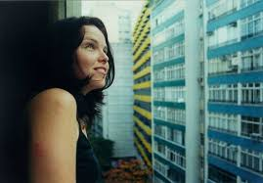
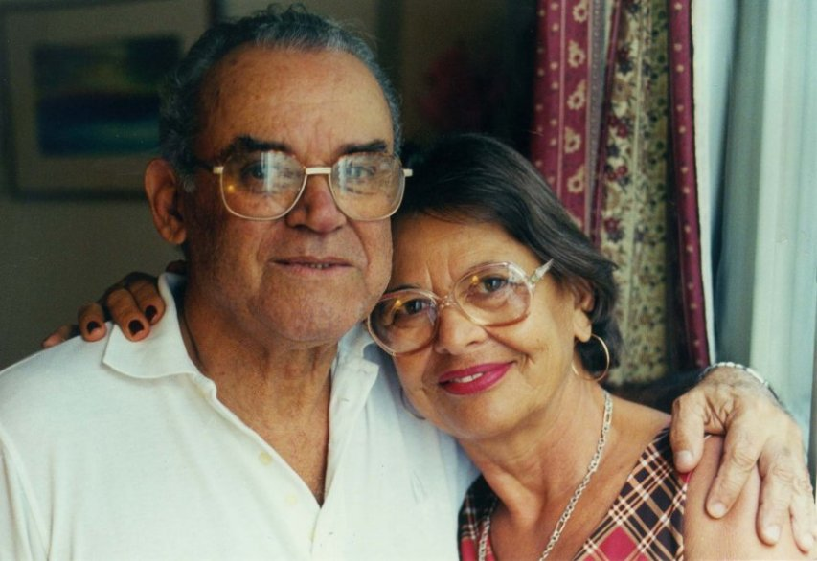
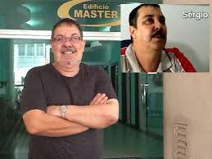
DUALISM - synechism
- A dualist approach underlies these theoretical studies and also the reflections of the documentary makers. They all posit the inevitable presence of the ‘character’, because of what they believe to be an absolute division between the filmed world and what exists outside of it.
- I propose a synechistic critique of dualism, of the doctrine “which performs its analyses with an axe, leaving as the ultimate elements, unrelated chunks of being” (CP 7.570)

Slide 34
goffman’s “order of interaction” on the screen as it is in life
Human identity is relational: it comes about as the upshot of the encounter with the Other and with oneself through the internal dialogue. On every occasion, to a certain extent, who I am depends on who my addresee is and on the purpose of the interaction.
“A correctly staged and performed scene leads the audience to impute a self to a performed character, but this imputation— this self —is a product of a scene that comes off, and is not a cause of it.” (Goffman, 1959, p. 252)

Slide 35
Two expressions of the pygmalion myth
“To film, for me, is to provoke, to catalyse, that moment. It is in the interaction which takes place in the filming process that a great character is born.” (Coutinho, interviewed by Figuerõa et al. 2003, p. 217)
Coutinho’s documentary O fim e o princípio “does not allow us to infer almost anything about the real life of the small villages of the northern sertão.” (Mesquita e Lins, 2014, p.55).

Slide 36
Epistemological dualism
- The hegemonic documentary theory claims that besides the creation of an aesthetic experience, the documentary film produces the real . I argue that itis an example of epistemological dualism. According to this approach, the continuity between the real and its filmed representation is not conceivable, they “cannot accept synechism, “the doctrine that all that exists is continuous” (CP 1.172)
- This theoretical discourse ilustrates “the unmasking turn of mind” of Mannheim’s (1925) sociology of knowledge (Hacking, 1999, p. 53). In this case, its aim is not to refute theoretically the belief in the realism of the documentary representation of the real, “but the destruction of the practical effectiveness of these ideas”. (p. 54)

Slide 37
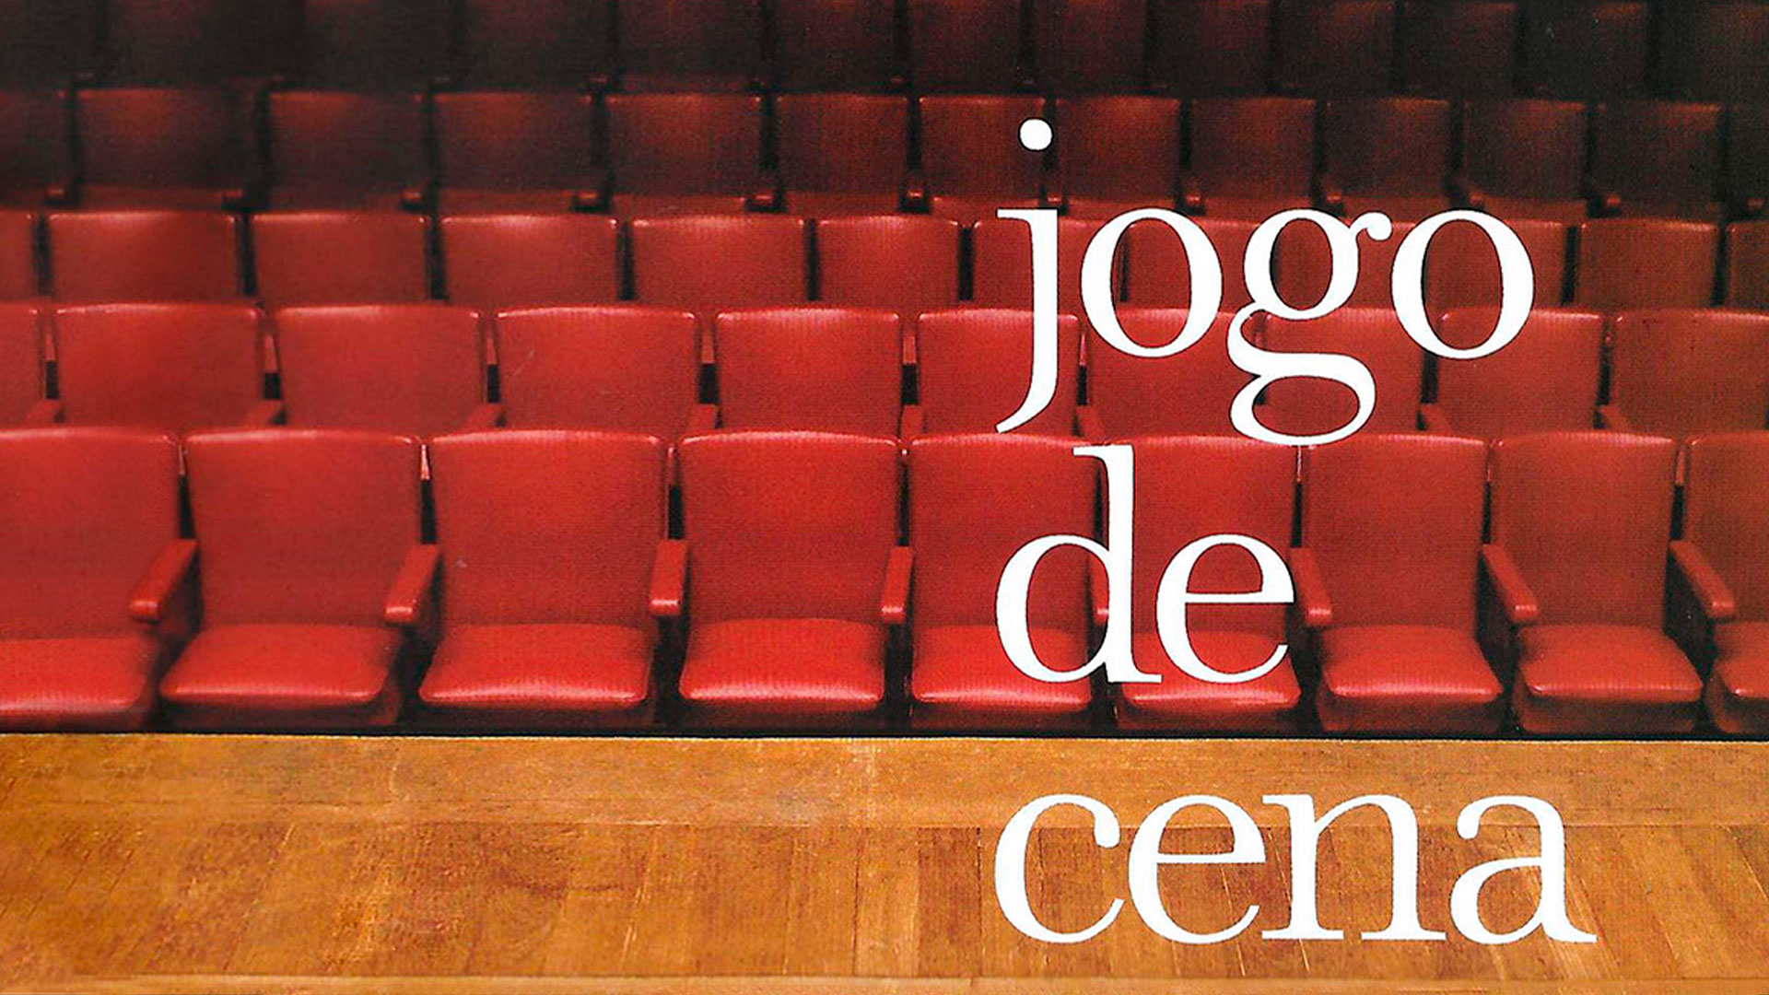
Sarita, the woman who didn`t want not to be cheerful: the ending of jogo de cena (Coutinho, 2007)
I now present film evidence of the synechistic account of the kind of semiotic process that those who accept to participate in a documentary such as Jogo de Cena (E. Coutinho, 2007) undergo.
One woman asks to return to the stage, so as to present a better version of her self. What transpires on that second occasion when she comes on the stage may be used as evidence of the continuity between this person in and out of the filmed realm.
https://www.youtube.com/watch?v=-oPz_fZX9XY

Slide 38
Why choose this sequence of the documentary?
- We can analyze the end of the film, which portrays the return of Sarita, by means of the epistemic contrast between the Dynamical Object (Od) and the Immediate Object (Oi).
- The Od is “a Form that should have been really embodied in a Subject independently of the communication”, which therefore “is quite independent of the sign” (EP2: 477, 1906).
- The Oi identifies what the sign represents, and it can do so correctly or mistakenly.

Slide 39
The epiphany of the Real
In our lives, we all behave like Sarita, the tearful woman on the stage. The director who talks to her, the film viewers, we are always traveling on a path that leads us fallibly to the truth.
And therein consists the powerful epiphany that we are offered in Jogo de Cena. Its aesthetic gift is the (self) discovery of the real nature of the grief of Sarita, of our own grief.

Slide 40
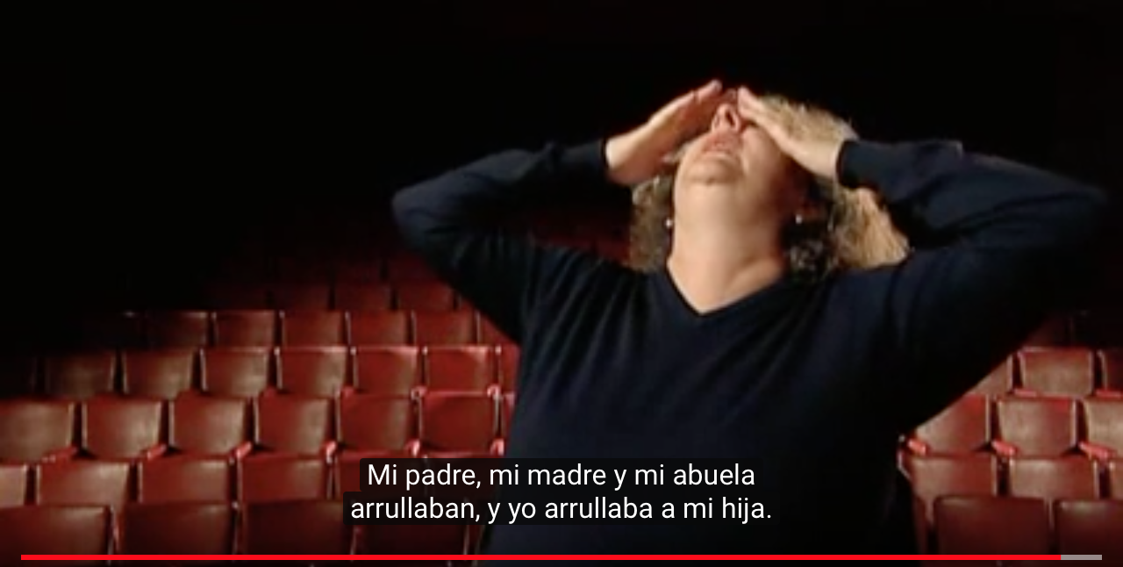
Sarita or the humid insistence of the real

Slide 41
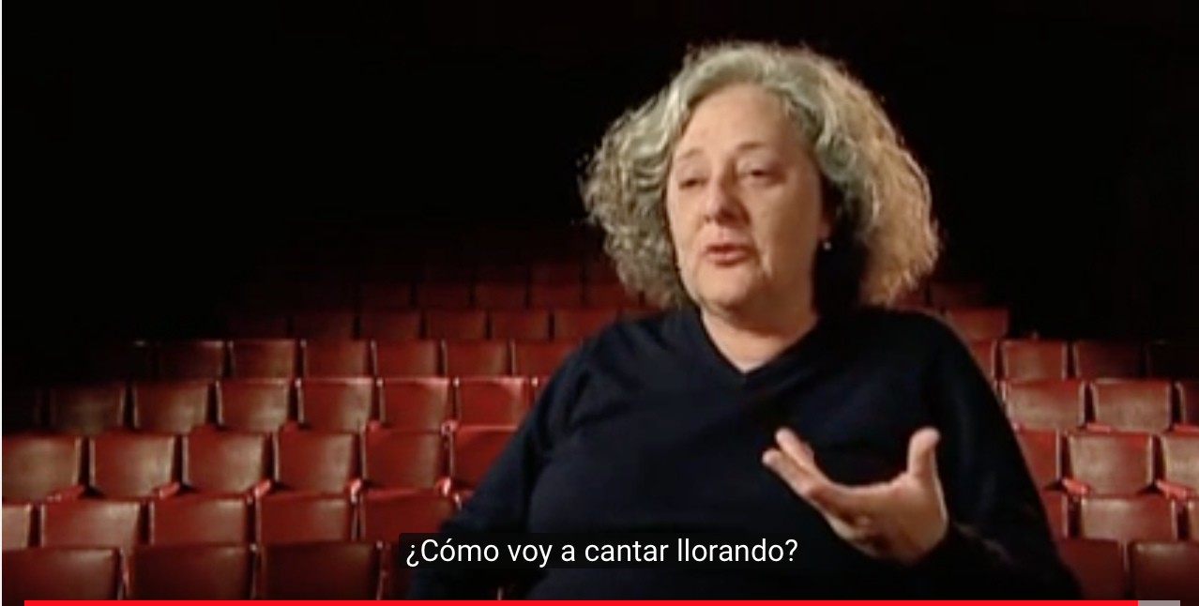
When the Immediate Object must be cast aside, because the Dynamical Object holds sway

Slide 42
The dichotomy of Od / Oi accounts for the fallible revelation of the Real ‘in documentary film and in life
- Ransdell (2007) describes the self-correcting process whereby an apparently correct or adequte Oi must be discarded, because we realize that it is not causally linked with the Od. If I paraphrase Ransdell, I would say about this scene: “All of us (and Sarita) believed that p, and p is not true”
- There is always “a deictic or indicative function” (Ransdell, 2007), which is the causal link of our signs with Od .

Slide 43
To quote deely one MORE time
- Deely concludes his 1990 book with words that guided my inquiry into the workings of the triadic relation of semiosis:
- “As semiotics comes of age, it must increasingly free itself from the drag of pre-existing philosophical paradigms. Beginning with the sign – that is, from the function of signs taken in their own right within our experience (semiosis) – it is the task of semiotics to create a new paradigm – its own – and to review, criticize, and improve wherever possible all previous accounts of experience, knowledge and belief in the terms of that paradigm.” (1990, p. 124, emphasis in the orig.)
)

Slide 44
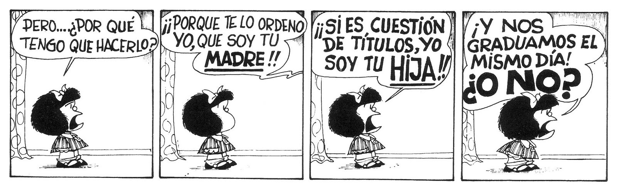
Semiosis: all you need is a (triadic) relation

Slide 45
References
Bateson, G. (1972). Steps to an ecology of the mind. Chicago: The University of Chicago Press.
Bateson, G. (1979). Mind and nature : a necessary unity. New York: Dutton
Bezerra, C. (2014). A personagem no documentário de Eduardo Coutinho. Campinas: Papirus Editora.
Bleger, J. (1960/1967). Psicoanálisis del encuadre psicoanalítico. In: Simbiosis y ambigüedad: estudio psicoanalítico. Buenos Aires: Paidós.
Deely, J. (1990). Basics of Semiotics. Bloomington: Indiana Univ. Press.
Engler, S. & Gardiner, M. (2012). Re-Mapping Bateson's Frame. Journal of Ritual Studies. 26 (2), 7-20.
Figuerõa, A. et al. (2003). O documentário como encontro. Interview with the film maker E. Coutinho. Galáxia. Revista transdisciplinar de Comunicação, Semiótica, Cultura 6, 213-232.

Slide 46
references
Goffman, E. (1974/1986). Frame Analysis. An essay on the organization of experience. Boston: Northeastern Univ. Press
Goffman, E. (1959). The presentation of self in everyday life. New York: Doubleday.
Hacking, I. (1999). The social construction of what? Harvard University Press Cambridge: Massachusetts & London, England,1999.
Hoffmeyer, J. (ed.) (2008). A Legacy for Living Systems: Gregory Bateson as Precursor to Biosemiotics. New York: Springer
Mesquita, C. & Lins, C (2014). “O fim e O princípio. Entre o mundo e a cena”. Novos Estudos CEBRAP, 49-63 http://novosestudos.uol.com.br/ v1/files/uploads/contents/ content_1565/file_1565.pdf
Peirce, C.S. (1931-1958). The Collected Papers of C. S. Peirce. C. Hartshorne, P. Weiss & A. Burks (Eds.). Cambridge: Harvard University Press

Slide 47
References
Ransdell, J. (2007). On the use and abuse of the immediate/dynamical object distinction. Arisbe The Peirce Gateway: http://www.cspeirce.com/menu/library/aboutcsp/ransdell/useabuse.htm
Xavier, I. (2010). O exemplar e o contingente no teatro das evidências. Literatura e Sociedade 14, 14-23.
Xavier, I. (2009).“Character Construction in Brazilian Documentary Films: Modern Cinema, Classical Narrative and Micro-Realism”. In: NAGIB, Lúcia & MELLO, Cecília (Eds.) Realism and the Audiovisual Media. New York: Palgrave Macmillan, 210-223 .

